Slide 1

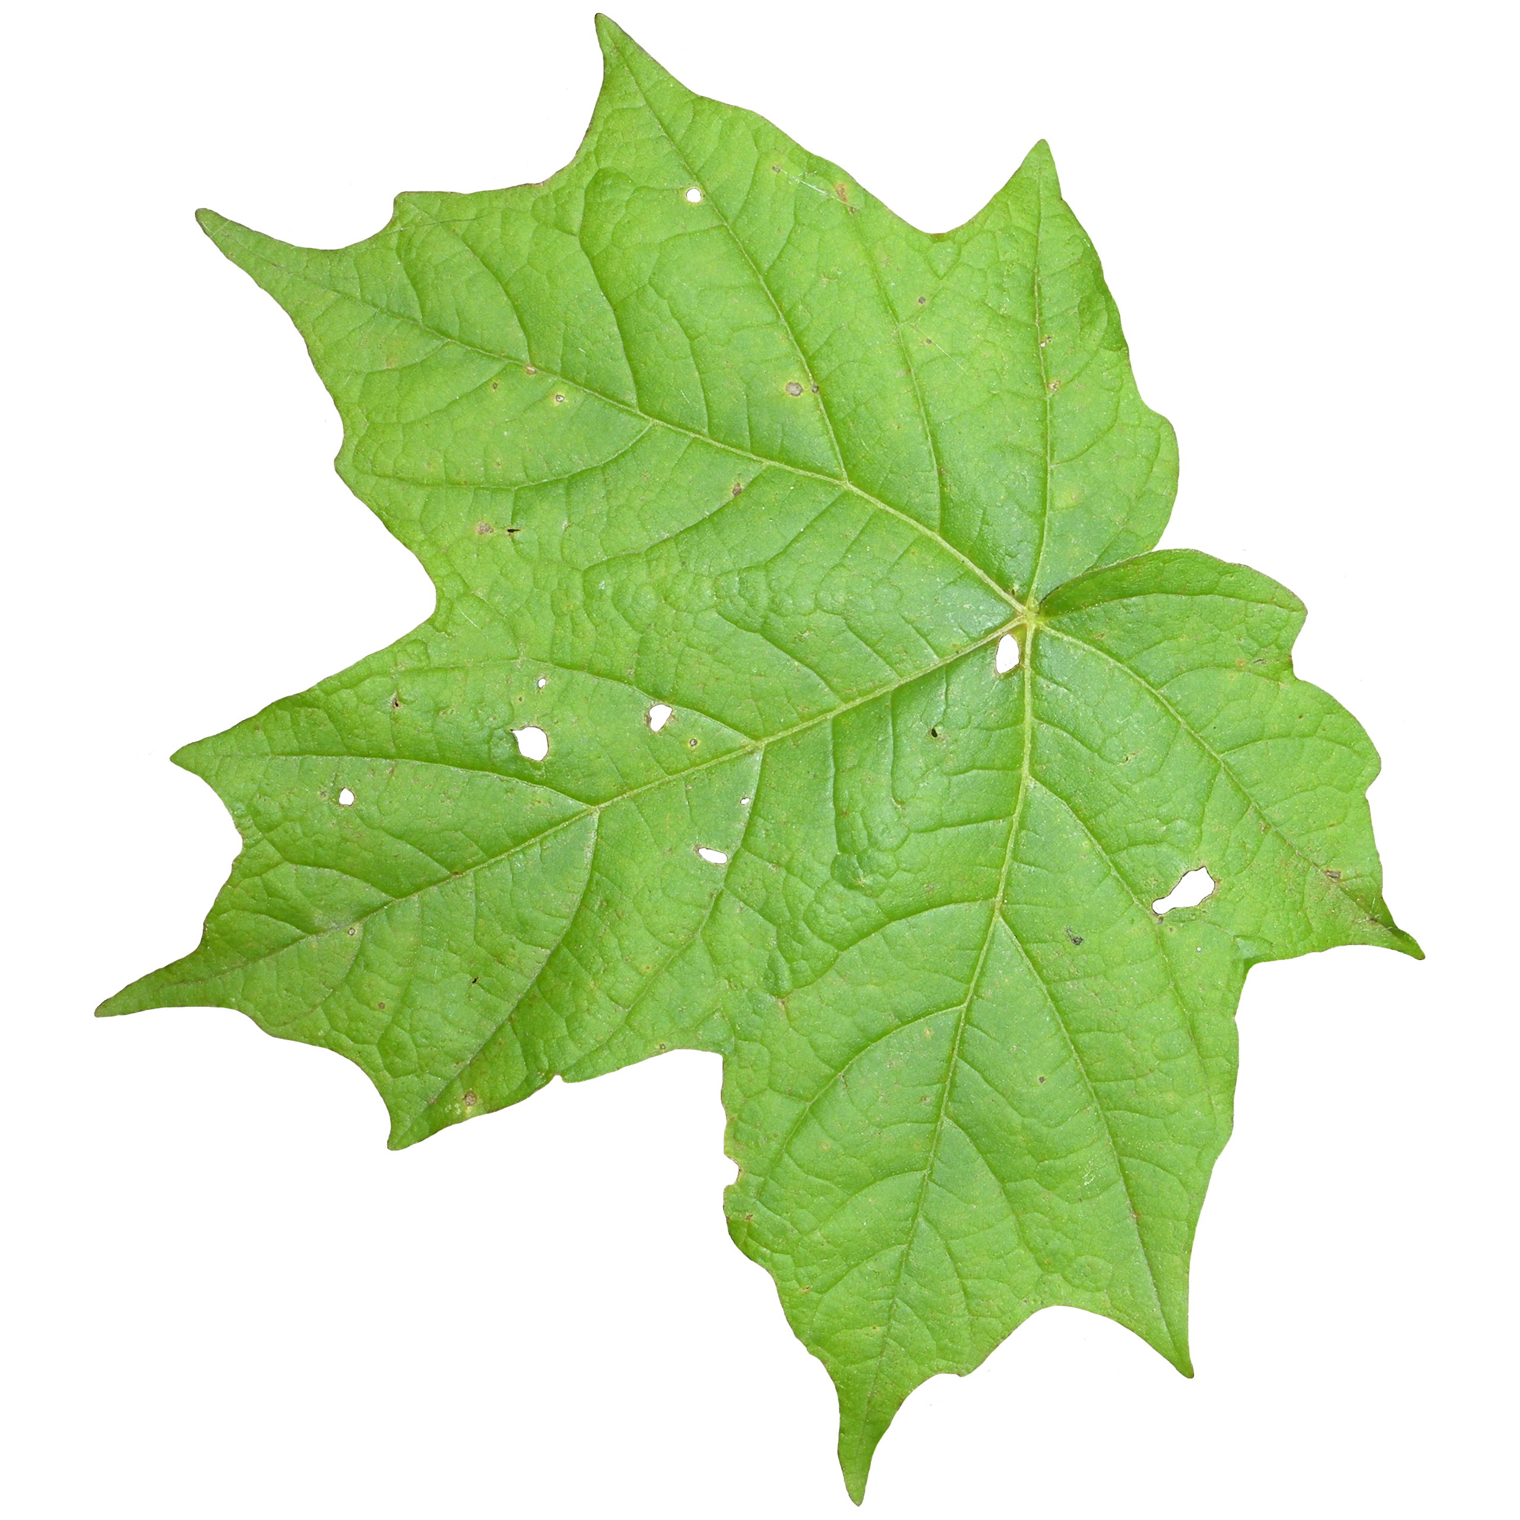
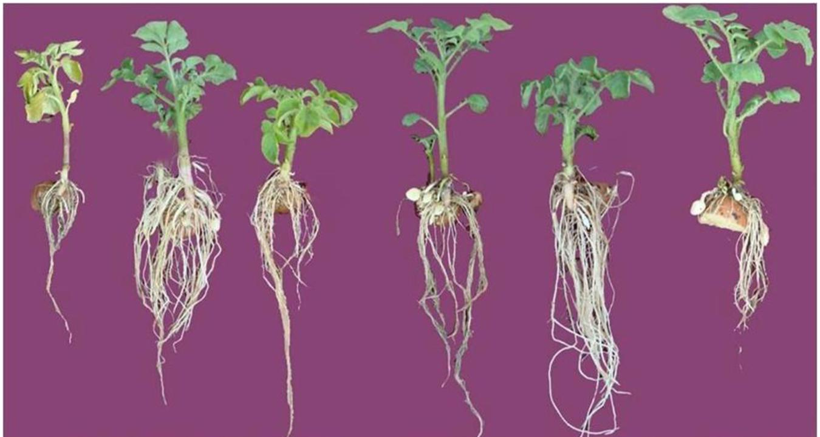
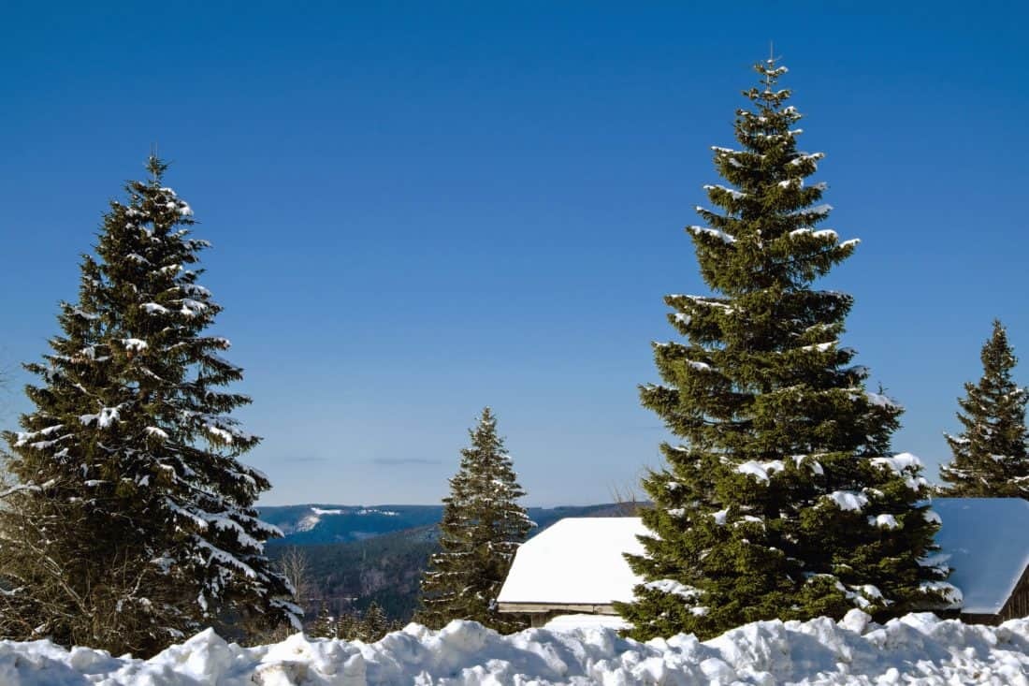
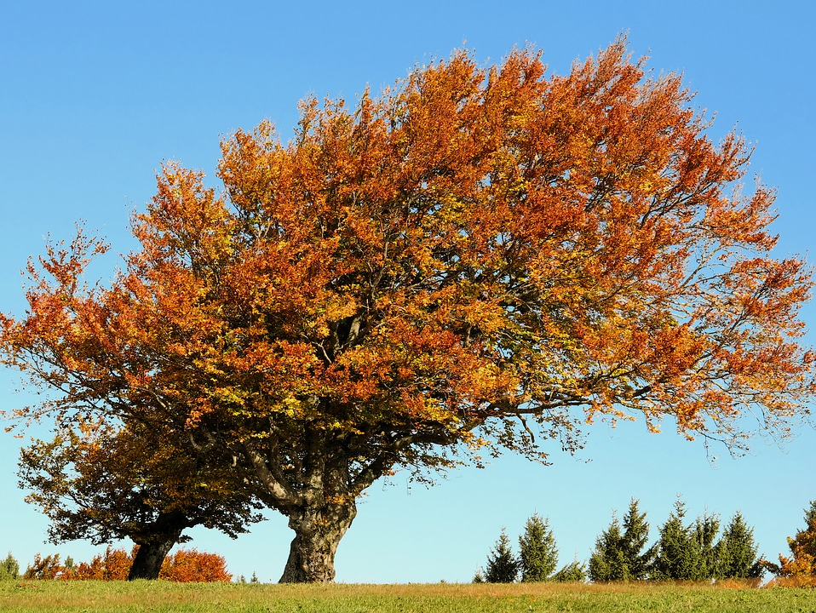


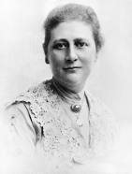

Year One | Science | Summer Term 1 | Plants
Prior Learning
1 |  | We can talk about similarities and differences in objects, places and materials.
2 |  | We can talk about features of our environment.
3 |  | We can make observations of plants and animals and talk about changes.
Key Learning
1 |  | In our local area there are lots of different plants with different names.
2 |  | We can identify plants by looking at their characteristics.
3 |  | Plants have common parts but these parts can be different depending on the type of plant.
4 |  | Some trees keep their leaves all year round (evergreen) while others drop their leaves in autumn and regrow them in spring (deciduous)
Key vocabulary
Parts of plants and trees | Leaf, flower, blossom, petal, fruit, berry, root, seed, trunk, branch, stem, bark, stalk, bud
evergreen | Trees that keep their leaves all year
deciduous | Trees that lose their leaves each year
Names of trees in the local area
Names of garden and wild flowering plants in the local area
Key Science Skills
Observe over time | Pattern seeking
Research
Key Scientist
 | Beatrix Potter (1866 – 1943) As well as a celebrated author, Potter was also a keen scientist, studying plants, mushrooms and fungi.

