Slide 1



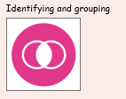

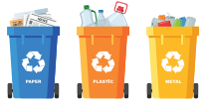
Year One | Science | Spring Term 2 | Caring for the planet
Prior Learning
1 |  | Children in reception learn to reuse and recycle.
2 |  | Children learn to respect their environment and keep it clean and tidy.
Key Learning
1 |  | Everyone should look after the Planet. Some actions help the planet while others harm the planet.
2 |  | Looking after the planet helps care for humans, other animals and plants.
Key vocabulary
Earth | The planet we live on.
Plant | A living thing growing in soil.
Animal | A living creature
Helpful | An action that is useful
Harmful | An action that causes hurt or damage
Recycle | To use rubbish again
Reuse | To use again or more than once
Key Science Skills
Observe over time
Research

