Slide 1
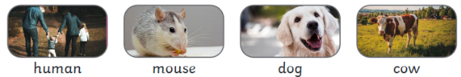
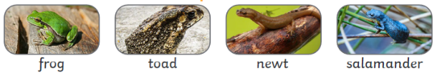
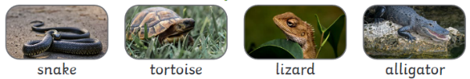
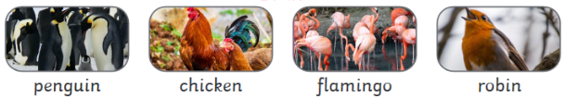
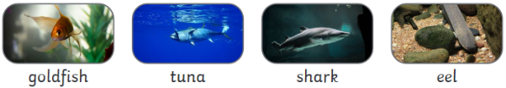



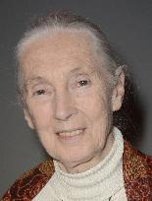



Year One – Science – Spring 1 – Animals
Key vocabulary
mammals | Animals which breathe air, have hair or fur and drink milk from their mother as babies.
amphibians | Creatures that live on land and water and have webbed feet.
reptiles | Cold-blooded, scaly creatures which breathe air.
birds | Animals with feathers, a beak, two legs and two wings. Some birds fly and some swim.
fish | Animals which live and breathe underwater using gills. They have scales and fins to help them swim.
carnivore | Animals which only eat meat.
herbivore | Animals which only eat plants.
omnivore | Animals which eat a mix of plants and meat.
mammals
amphibians
reptiles
birds
fish
Carnivore | Omnivore | Herbivore
Dame Jane Goodall (1934 - )
Jane Goodall is best-known for her detailed and long-term research into chimpanzees in Tanzania. She corrected lots of incorrect ideas about chimpanzees, for example that they are not herbivores but omnivores, and she learned extensively about their behaviour in the wild.

