Slide 1

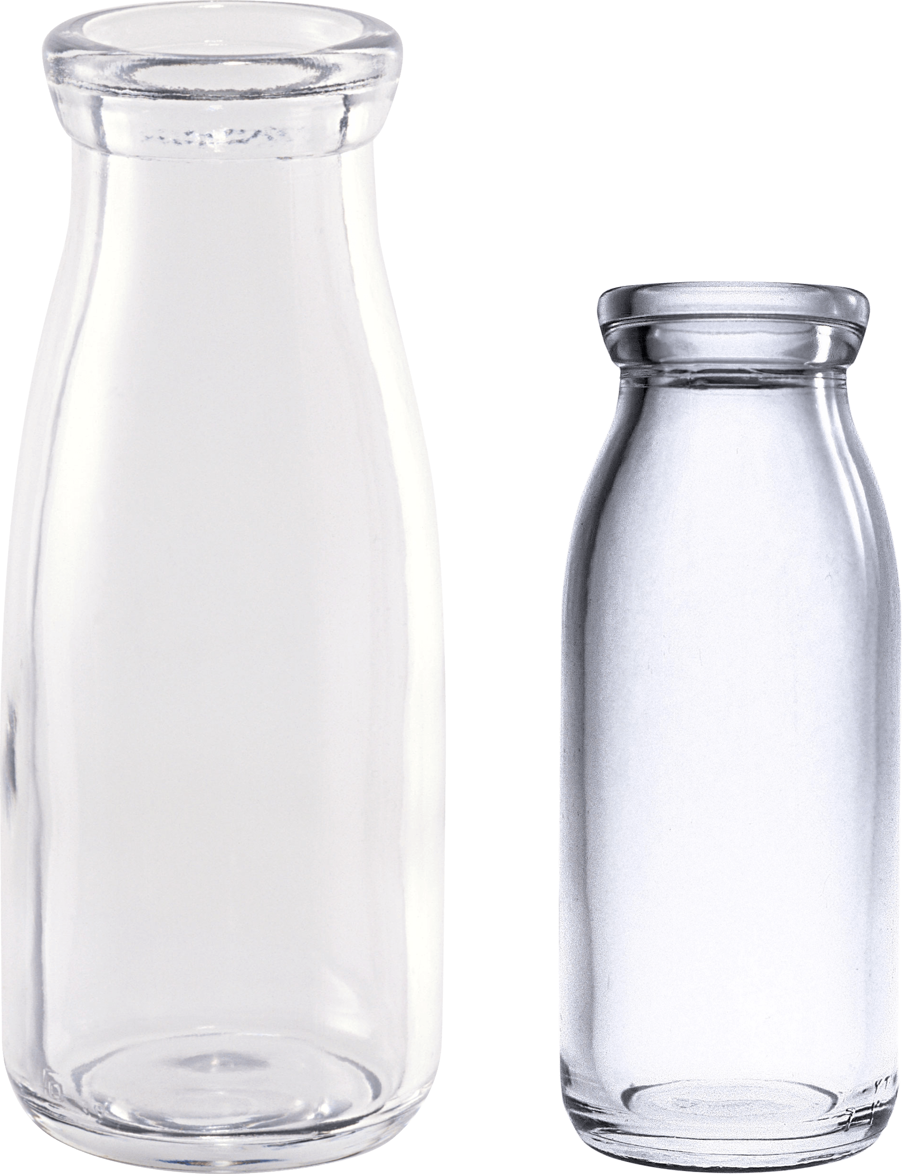
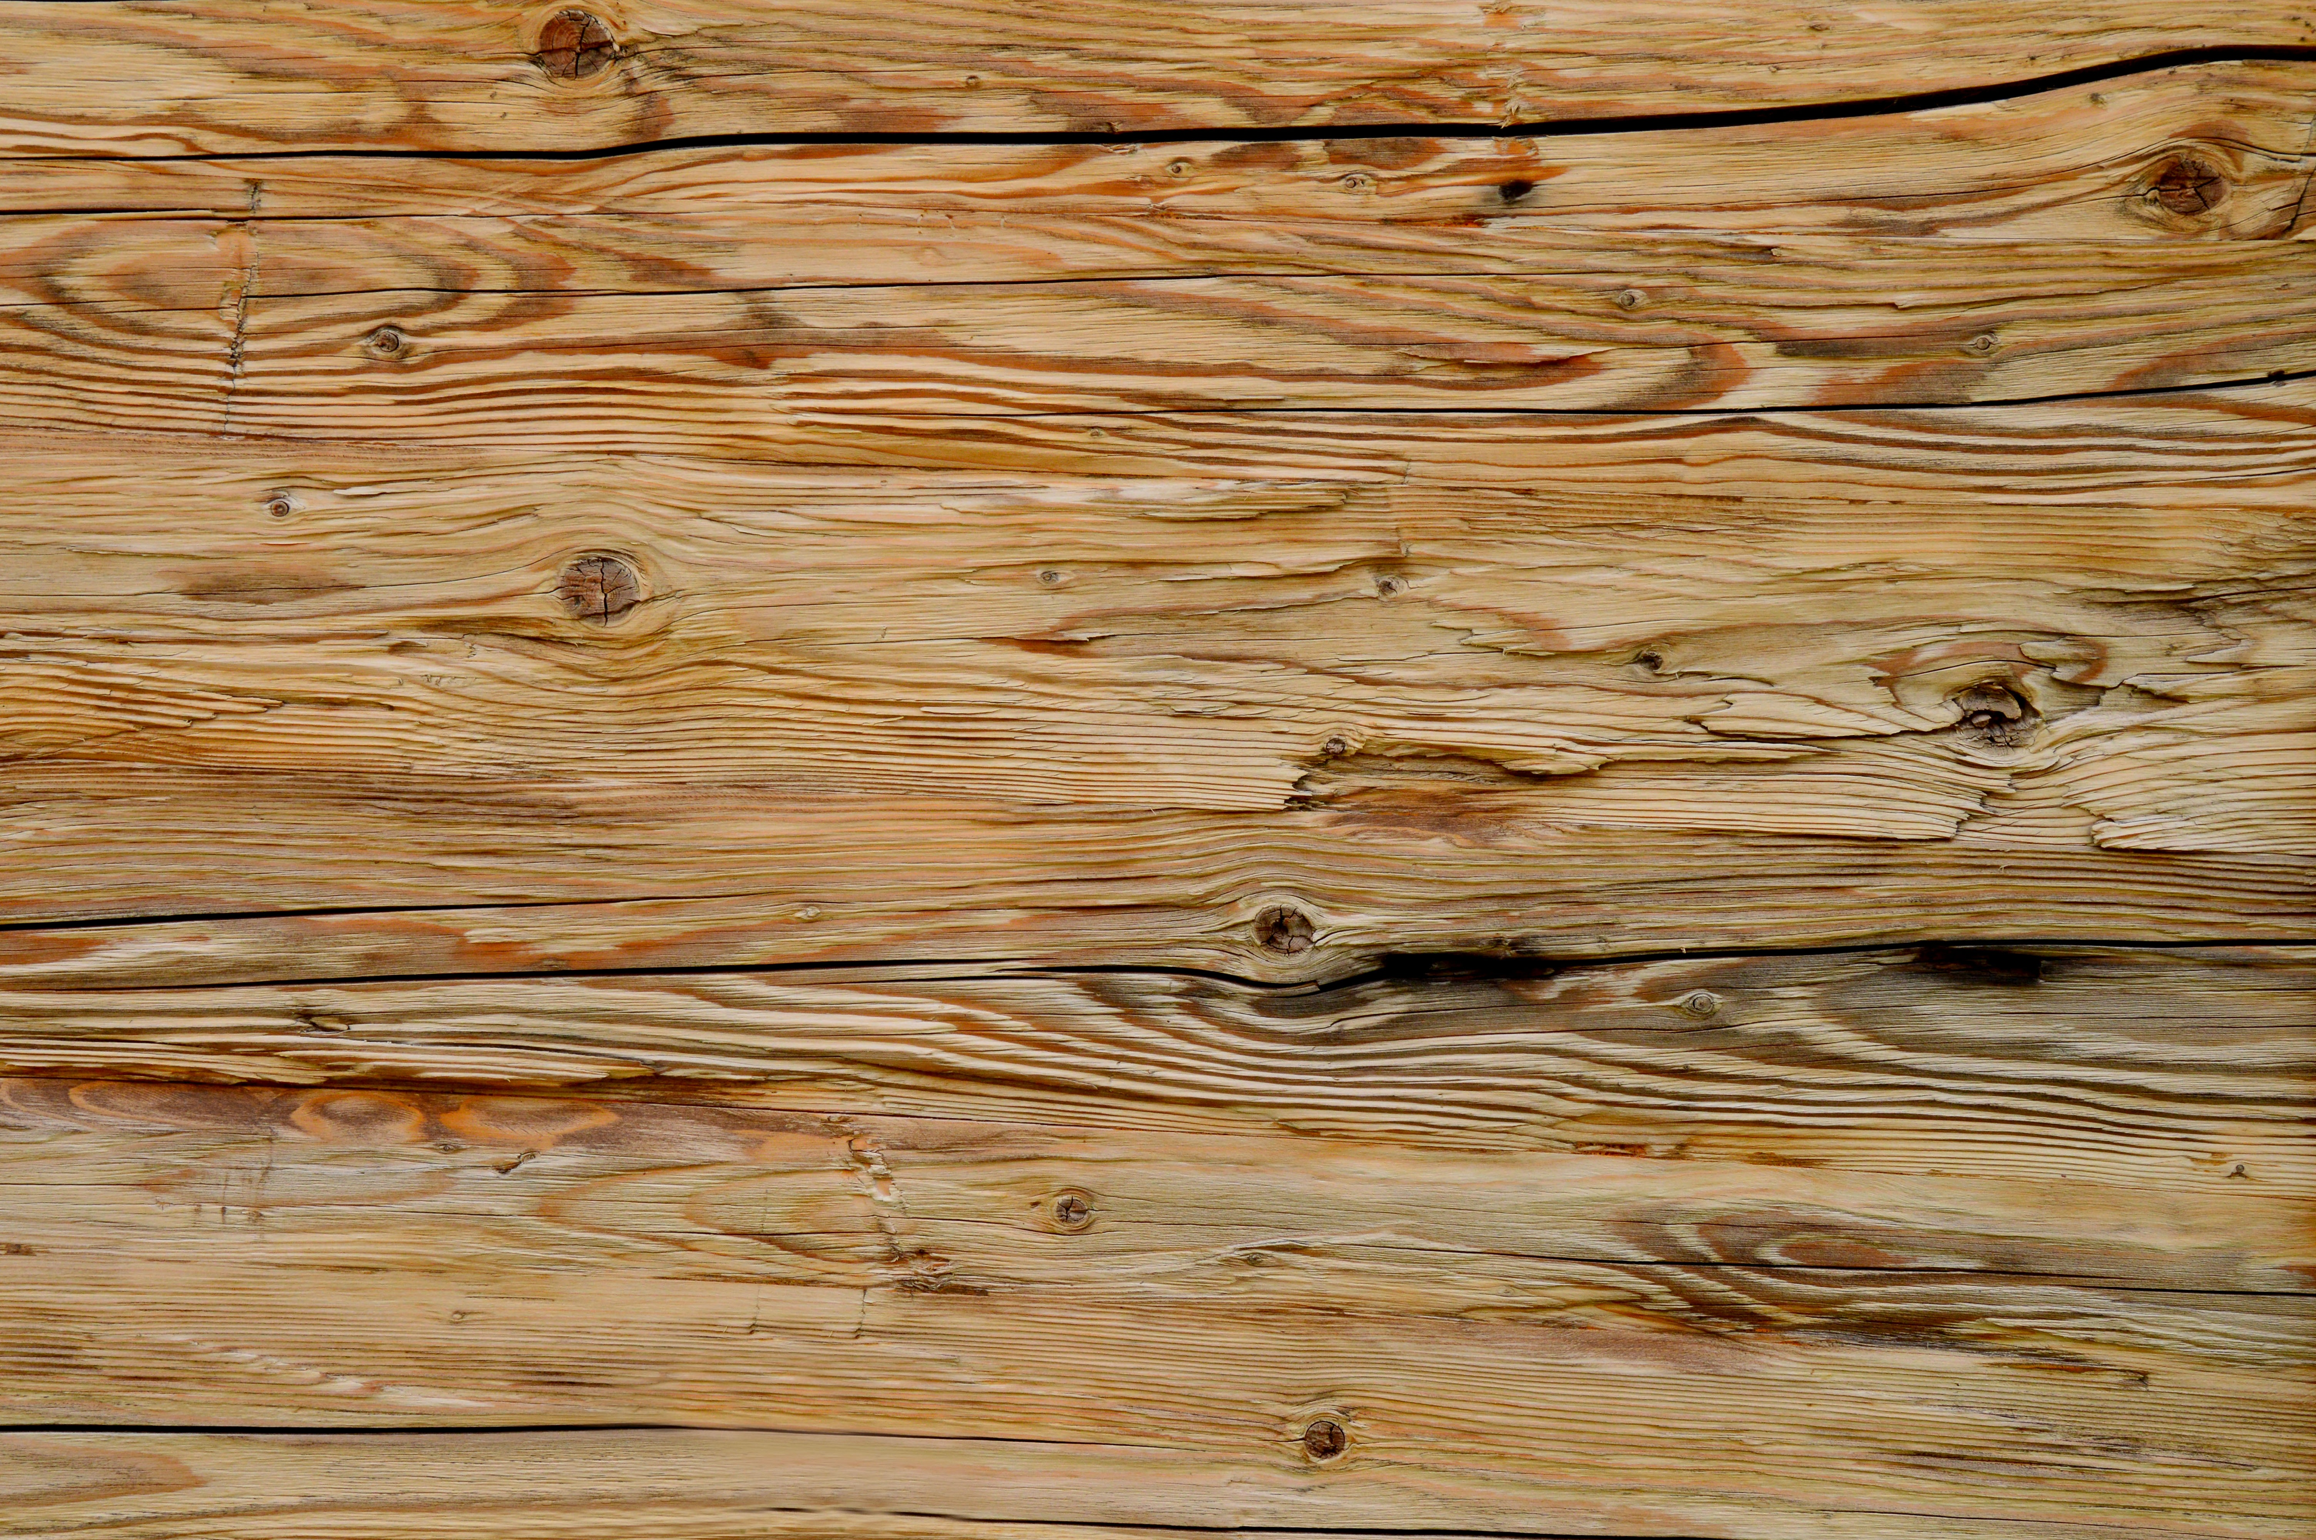
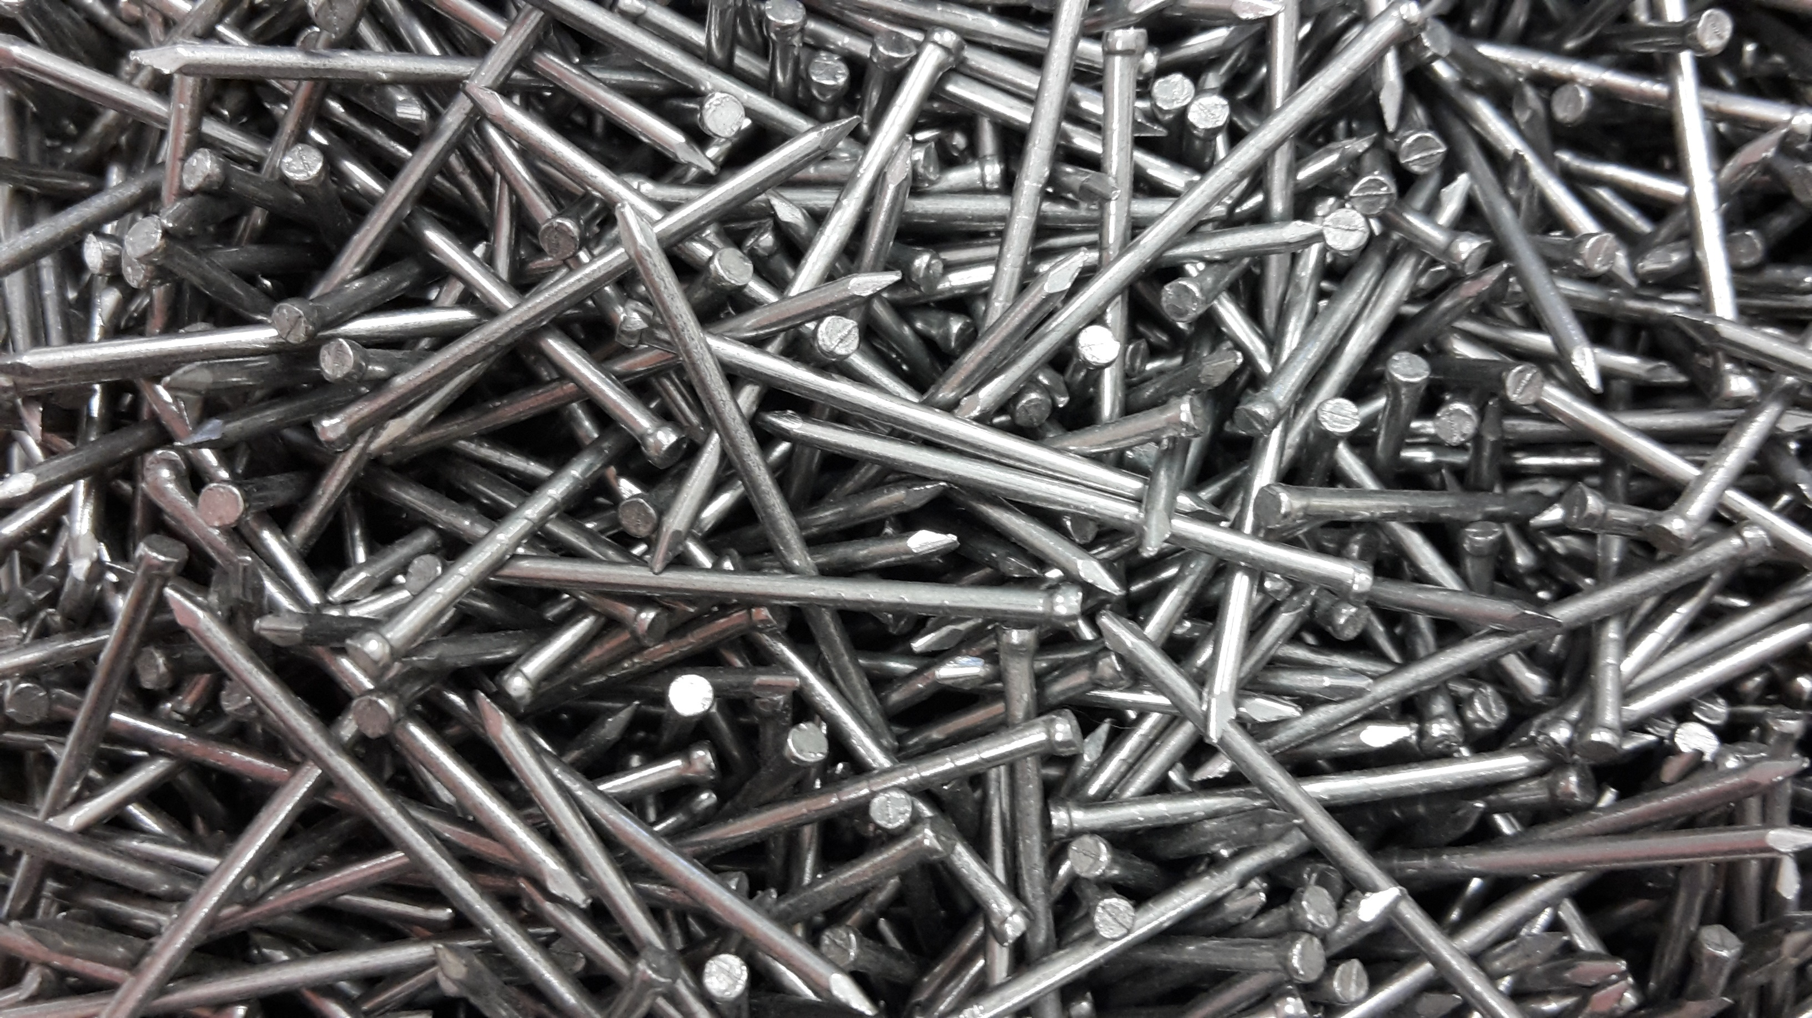

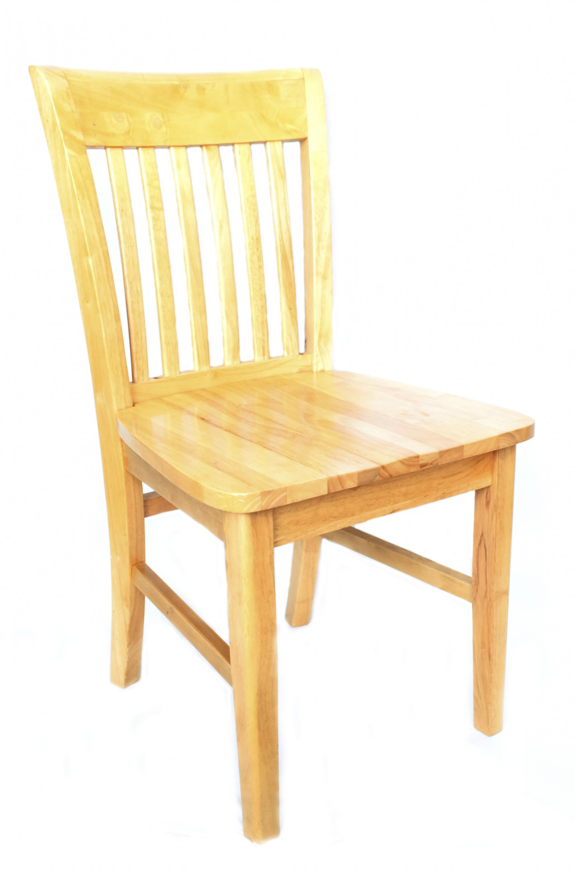
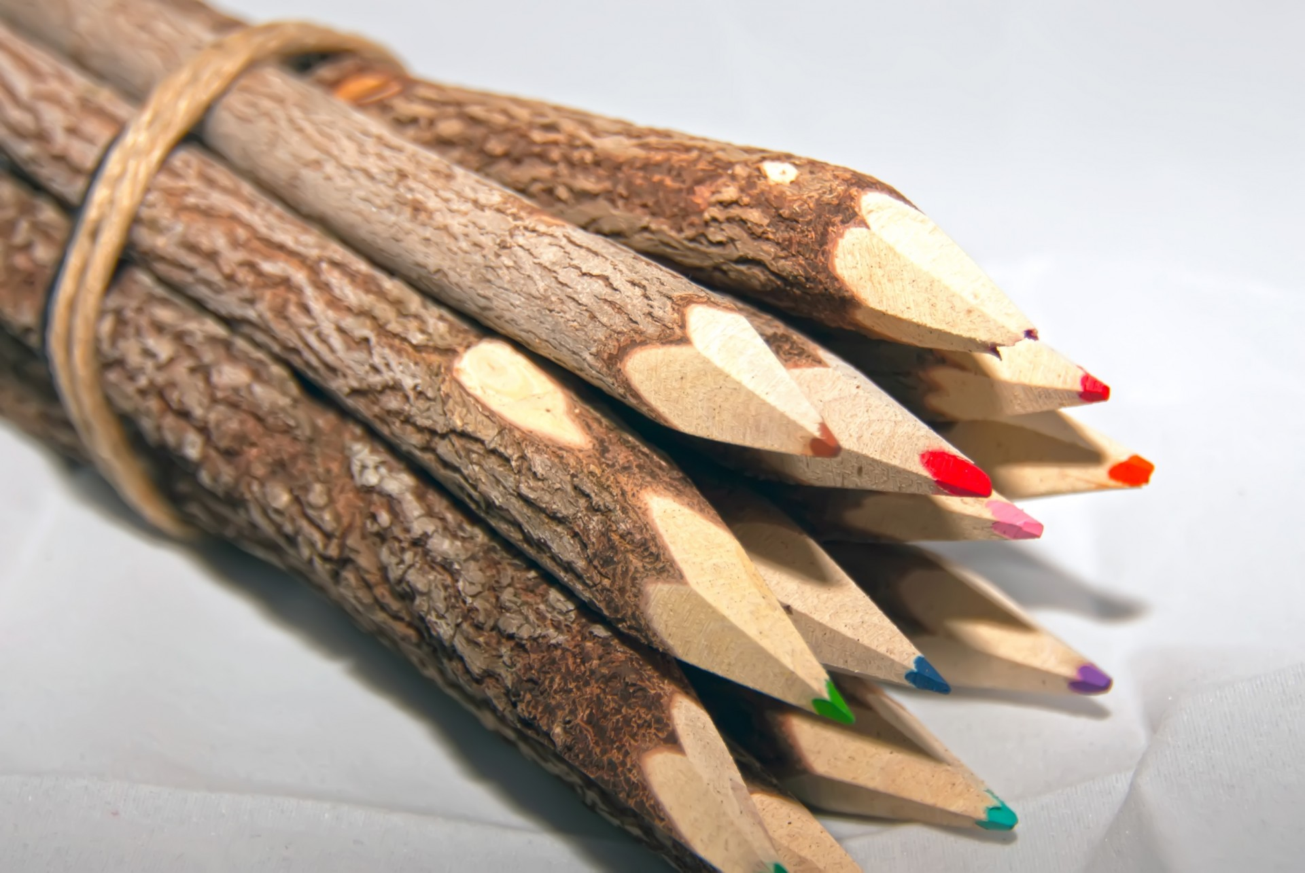
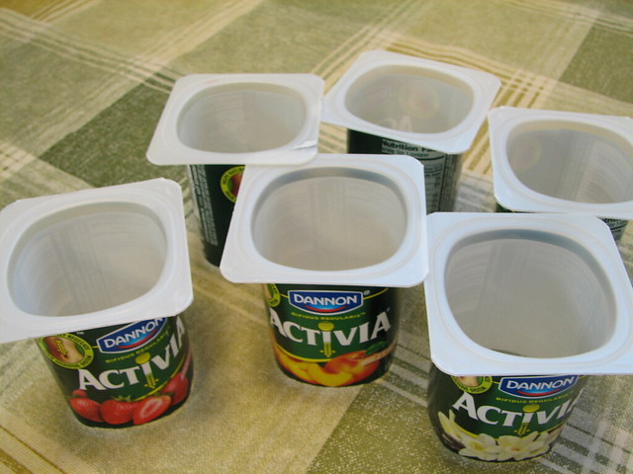
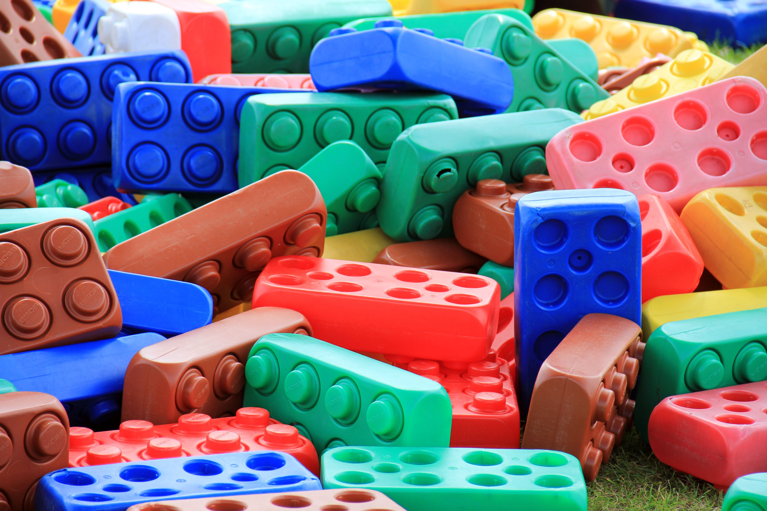
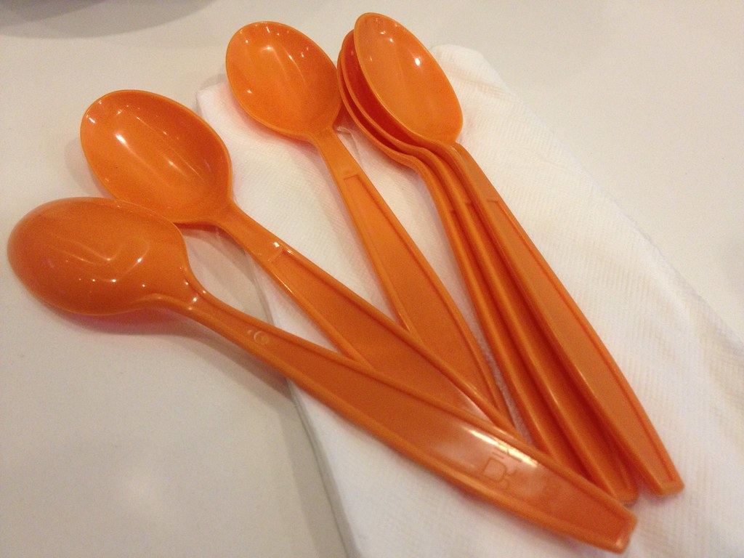


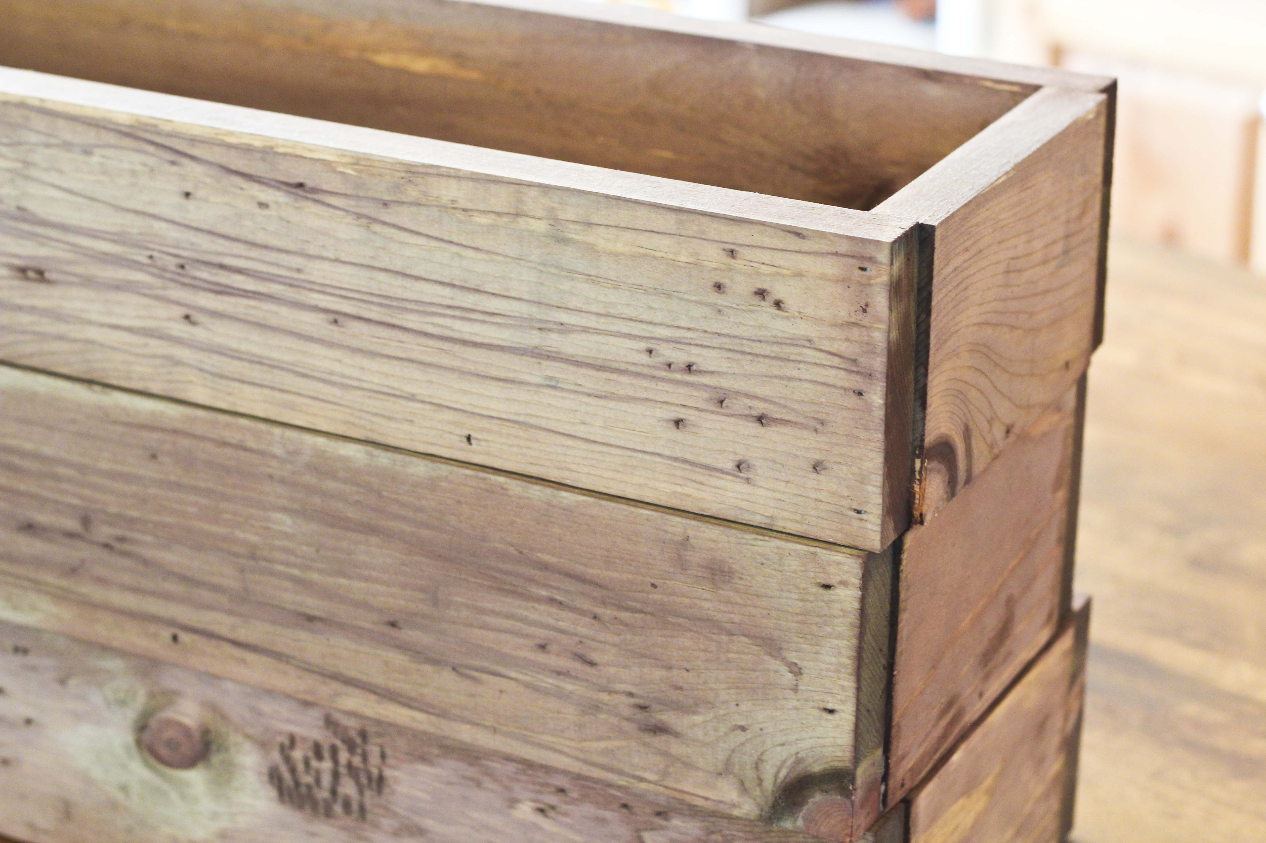
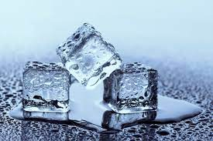


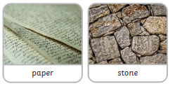
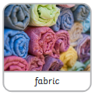
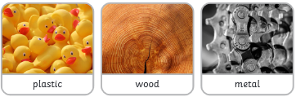



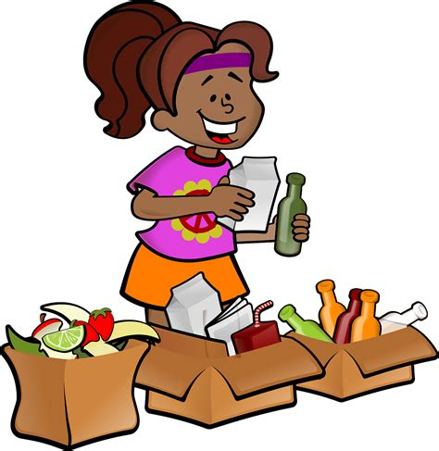
Year One | Science – Autumn 2 | Materials
Prior Learning
1 |  | Talk about similarities and differences between objects and materials
2 |  | Identify features of objects in our classroom
Key Learning
1 |  | All objects are made from one or more materials. glass wood metal paper
2 |  | We can describe the properties of materials: shiny, dull, stretchy, flexible, rigid, smooth, soft.
3 |  | We can group objects based on the material they are made from.
4 |  | Water is a material. When water freezes it turns to ice. When ice melts it turns to water.
5 |  | Some materials float in water. This means they stay at the top. Some materials sink in water. This means they fall to the bottom.
Key vocabulary
object | A thing that can be used
material | What an object is made from
hard | Not easily broken or bent
soft | Easy to cut, fold or break
shiny | Reflects light
dull | Doesn't look bright or shiny
stretchy | Can be pulled to make it longer or wider without breaking
smooth | With no lumps or bumps
rough | An uneven surface
solid | A solid keeps it shape
liquid | Liquids can flow and be poured
melt | When a solid changes to liquid
freeze | When a liquid changes to solid
absorb | When liquid is taken in by a material
transparent | Materials you can see through
opaque | Materials you cannot see through
Common materials
Key Science Skills
Identify | Describe | Compare | Group/Sort

