Slide 1

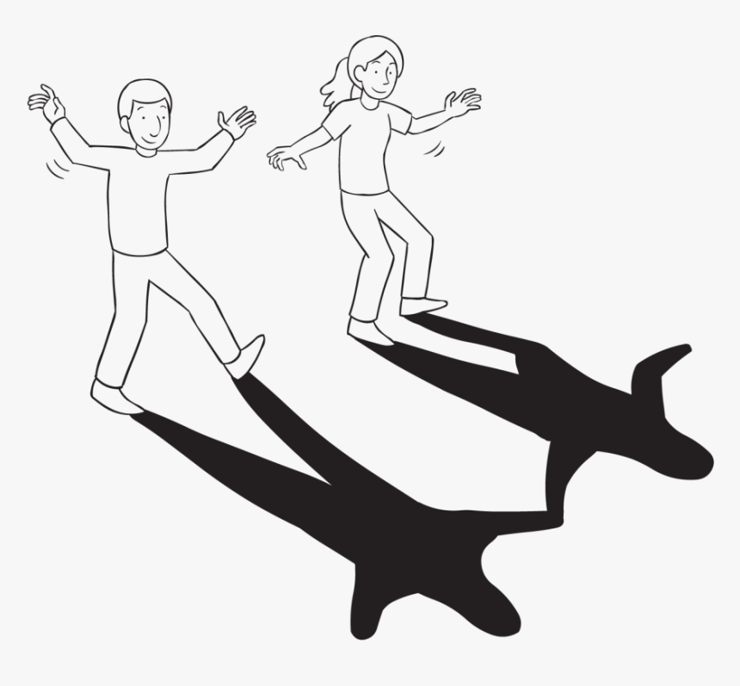
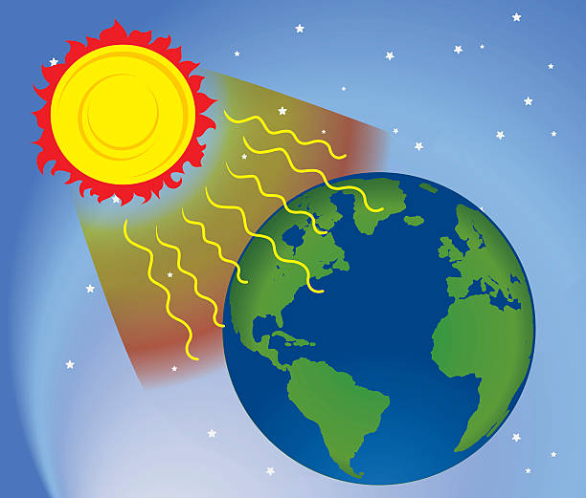
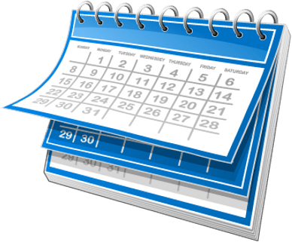
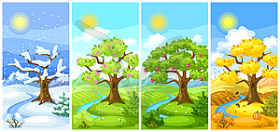


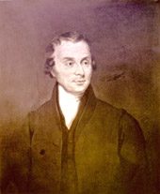


Year One | Science |Seasonal Change – Revisited throughout Year
Prior Learning
1 |  | We can talk about our immediate environment and how environments are the same and different.
2 |  | We can observe animals and plants and explain why some of their changes happen.
Key Learning
1 |  | Days are longest in the middle of summer and get shorter each day until the middle of winter, when they begin to get longer again.
2 |  | The weather changes with the seasons, which changes many other things – plant growth, number of minibeasts found outside, clothes we wear and whether the trees have leaves.
Key vocabulary
Weather words – sunny, rainy, windy, snowy
winter | The coldest season.
summer | The warmest season.
spring | The season when weather gets warmer.
autumn | The season when weather gets cooler.
sunrise | When the sun comes up in the morning.
sunset | When the sun goes down at night.
Key Science Skills
Observe over time | Pattern seeking
Research | Fair testing
Key Scientist
 | Luke Howard 1772-1864 Known as the 'father of meteorology', Howard recorded weather in London from 1801 to 1841, and wrote essays which transformed the study of and people's views on weather.

