Slide 1

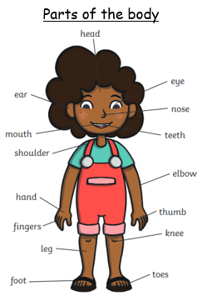








Year One – Autumn Term 1 – Science Knowledge Organiser – Human Bodies
Key vocabulary
loud - when a sound is easy to hear
quiet – when a sound is hard to hear
sweet
salty
bitter
sour
savoury
rough – an uneven surface
soft – doesn’t feel rough or hard
smooth – an even surface
scent – a smell left by an object
sniff – to breathe in a smell
stench – a smell that is strong and unpleasant
 | Our five senses​
1 | sight​ | Your eyes help you to see what is around you.​
2 | hearing​ | Your ears detect sounds around you.​
3 | touch​ | Your skin and brain work together to tell you how something feels, without you having to see it.​
4 | taste​ | You use your tongue to experience taste.​
5 | smell​ | You can smell using your nose.​
Key Science Skills in this unit
Identifying and grouping Observation Research (asking questions)

