Slide 1

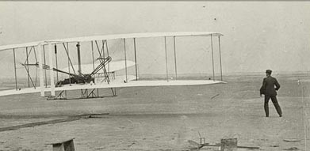
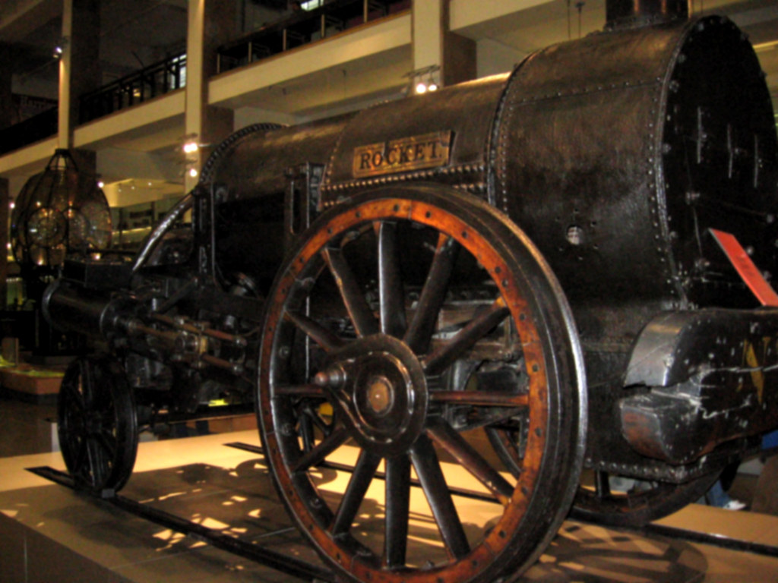
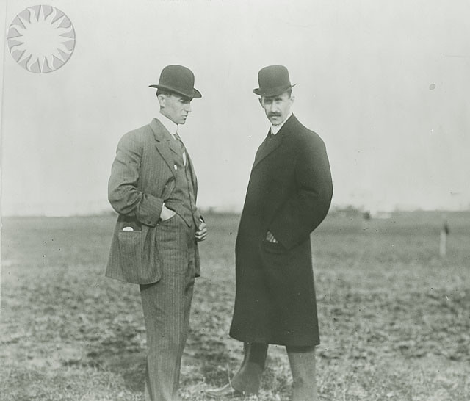
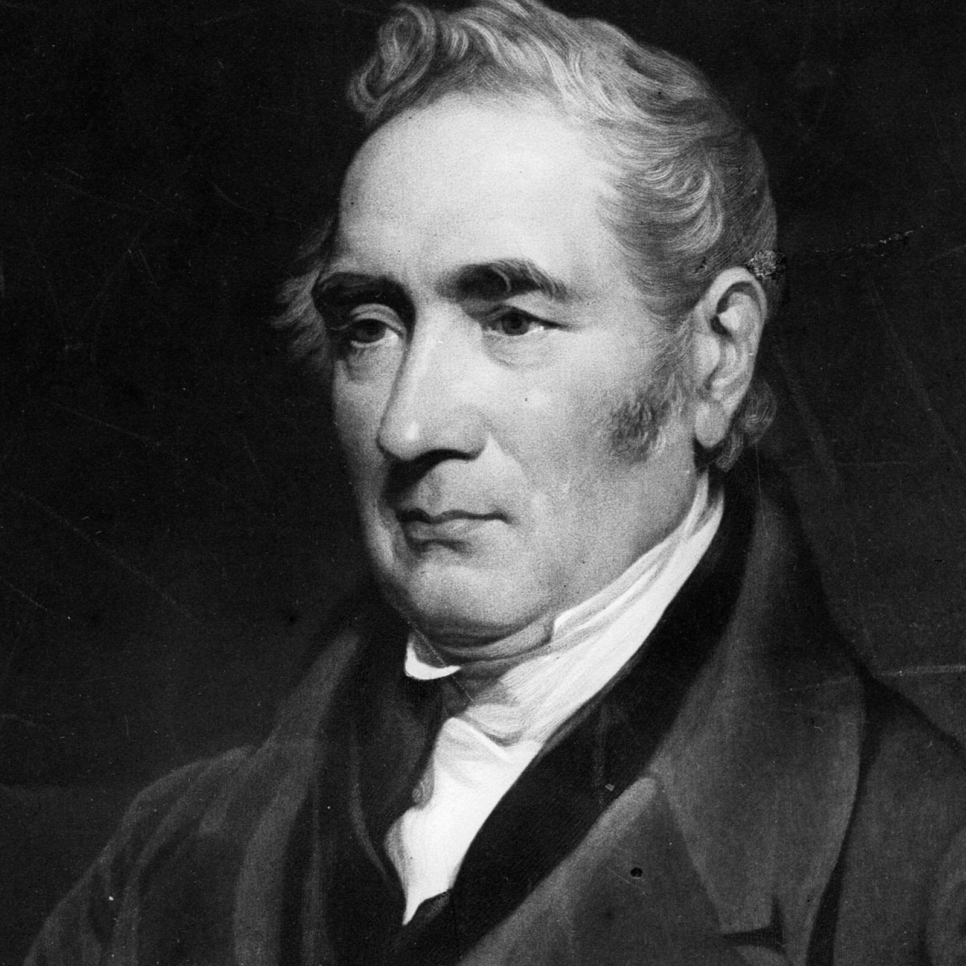
Year One – History – Summer 2 – Great Inventions: Transport
Key learning in this topic
1 | Orvile and Wilbur Wright invented, built and piloted the world's first flight in 1903. Their aircraft was called The Flyer.
2 | The aeroplane is a significant invention because it made long-distance travel fast, easy and cheap, for people and for goods like foods.
3 | Before railways were developed, travel was mainly by road on horseback, which was slow.
4 | The first steam train was developed in 1804. In 1825 George Stephenson demonstrated a powerful new steam train in the northeast of England.
5 | In 1829, Stephenson entered his locomotive The Rocket in a competition to find an engine for the first passenger railway between Manchester and Liverpool. This was the first inter-city railway in the world
Prior Learning
Children can discuss how they travel to various places, and enjoy stories involving different modes of transport. Question words have been introduced and children are beginning to ask questions of their own. They have begun to describe similarities and differences.
Key vocabulary
transport | How people and goods are moved from one place to another
inventor | Someone who creates new things
century | One hundred years
eyewitness account | A description of an event from someone who was there at the time
locomotive | A powered railway vehicle
significance | The importance of something
Key history skills
Understand how we can find out about the past
Ask and answer questions
Identify similarities and differences
Significant individuals
Orville and Wilbur Wright
George Stephenson

