Slide 1

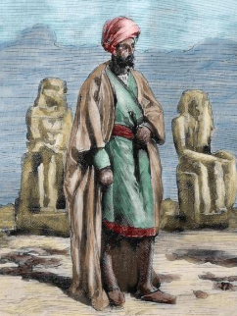
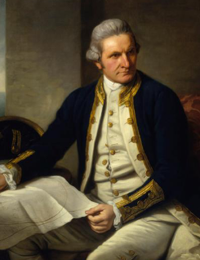
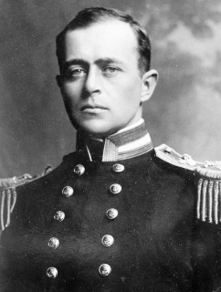
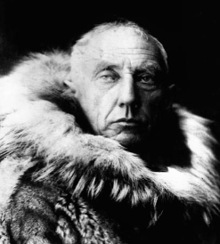
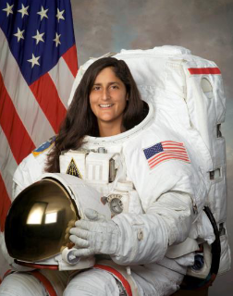
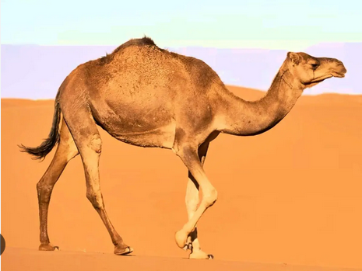
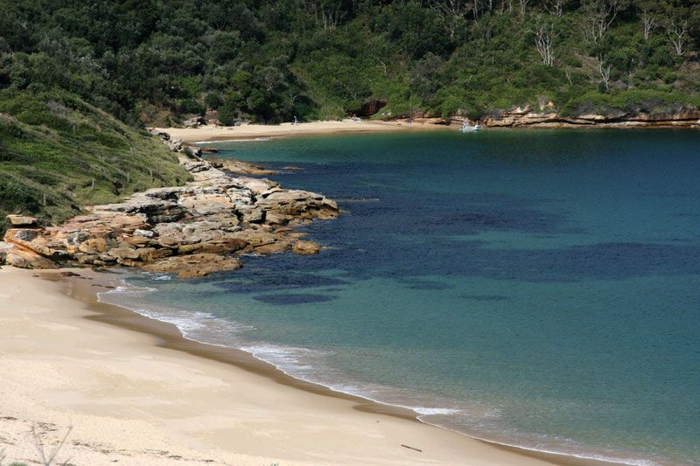
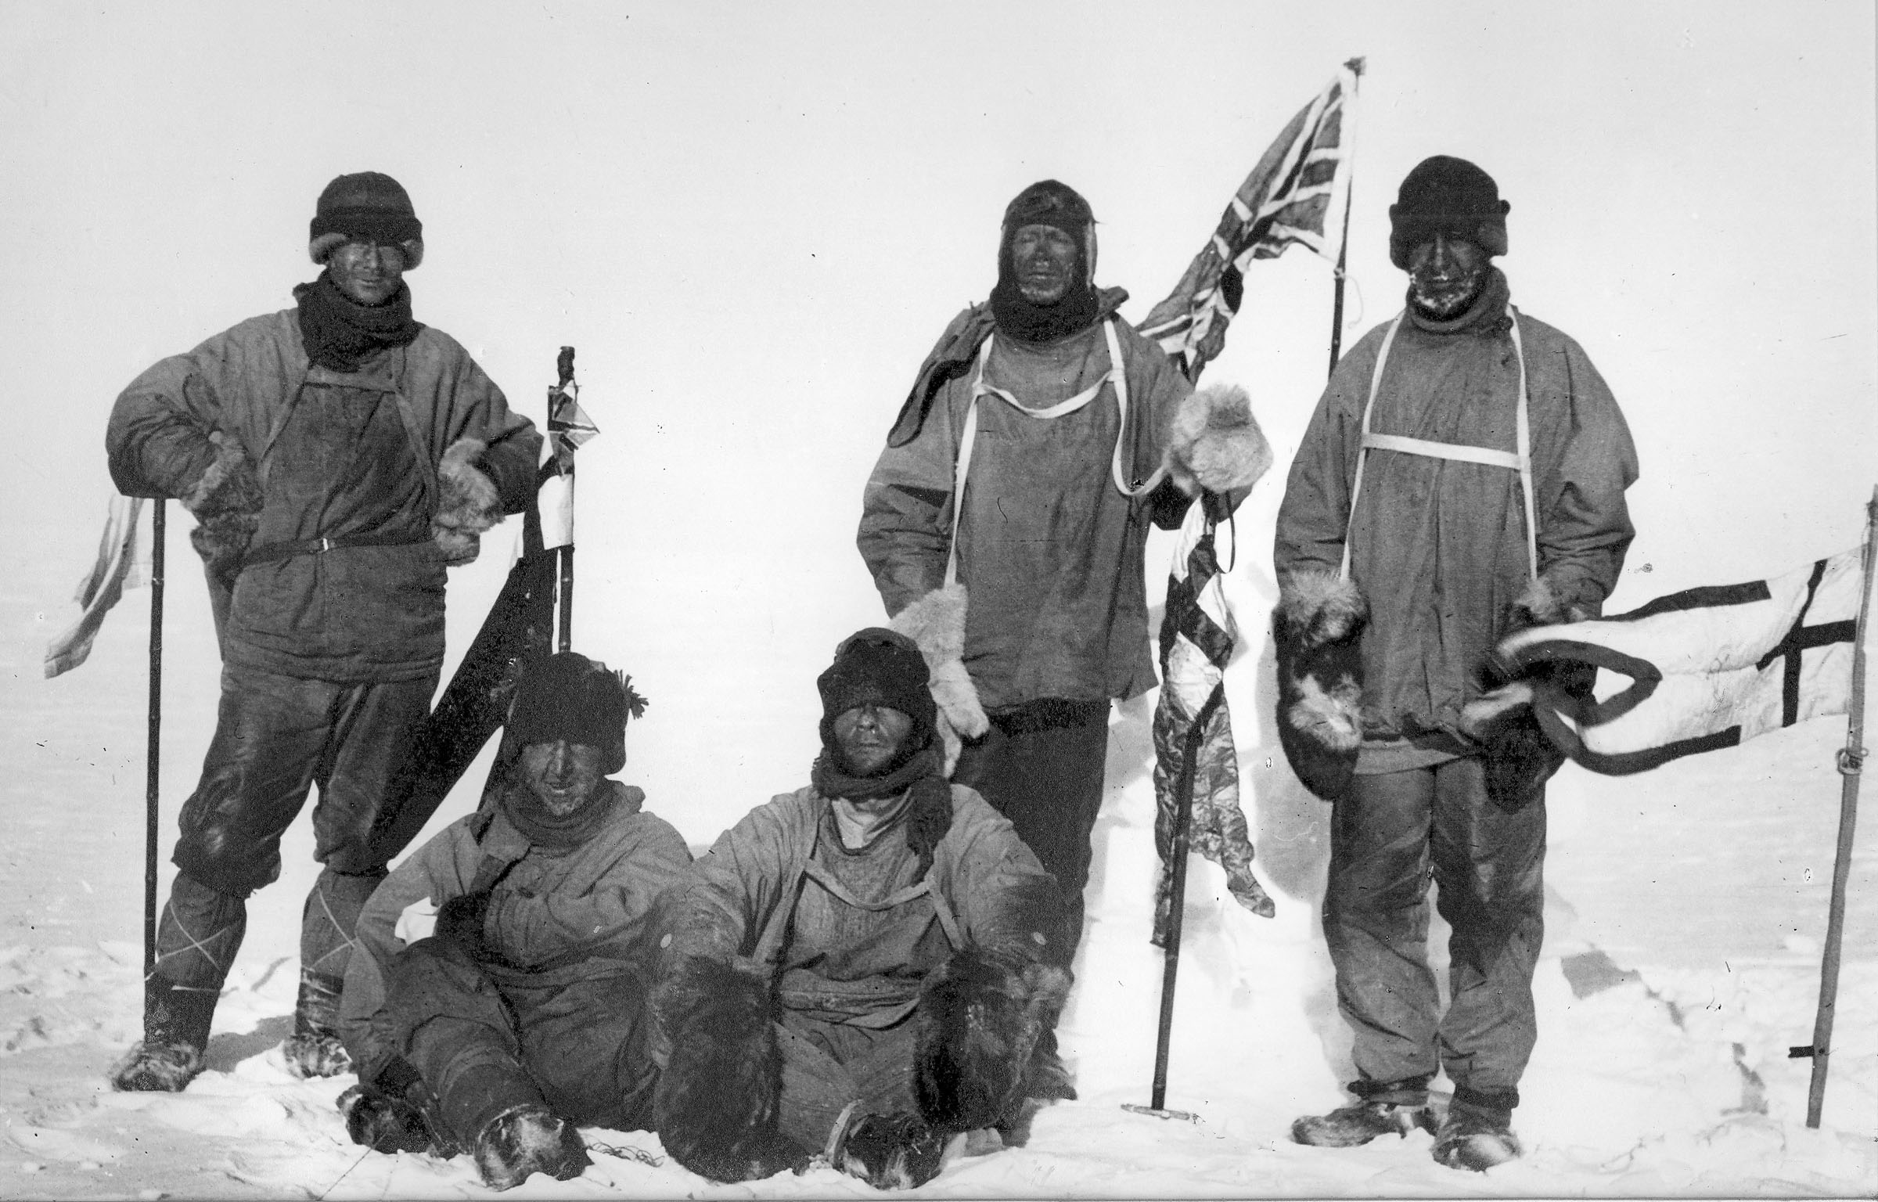
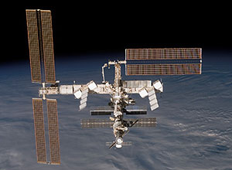
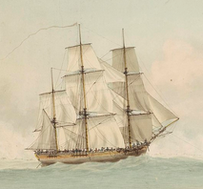
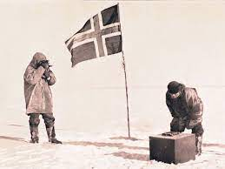
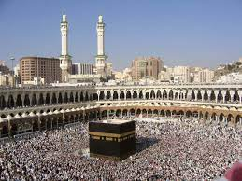
Year One - History- Spring Term – Who were the greatest explorers?
Key vocabulary
1 |  | explorer
2 |  | recent past / distant past
3 |  | timeline
4 |  | significant
5 |  | discovery
6 |  | maps
Key learning
1 | We will learn about 5 explorers from the past. Some were a long time ago while others were more recent.
2 | We will learn about how they travelled and the places they explored.
3 | We will think about why these people were significant.
What I should already know
The children will have some understanding about the past. Use vocabulary linked to things that have already happened and the past. Understand some ways that we can find out about the past. Ask and answer questions.
Key historical skills
Comparing similarities and differences
Chronology
Use a variety of historical sources to find out about a significant figure

