Slide 1

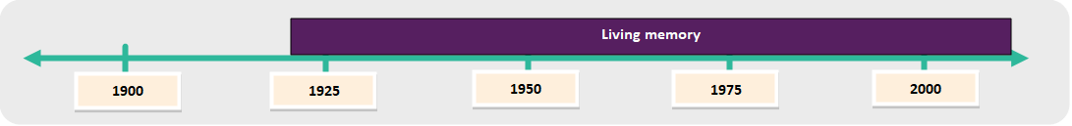
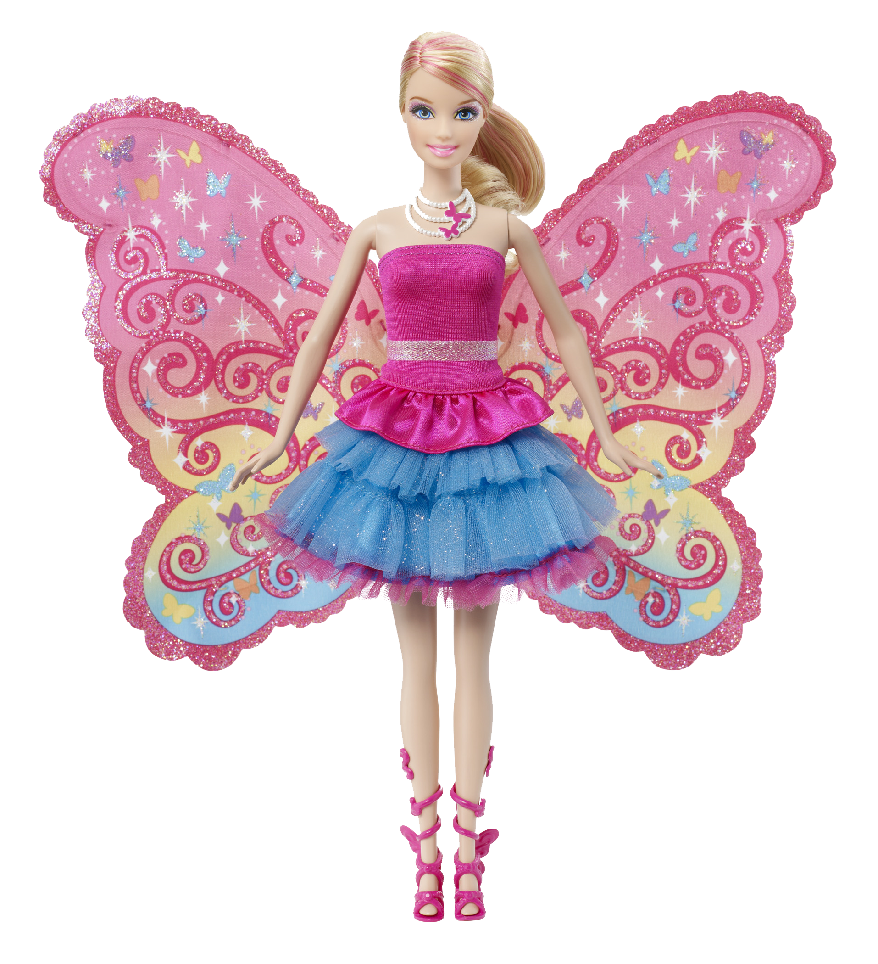
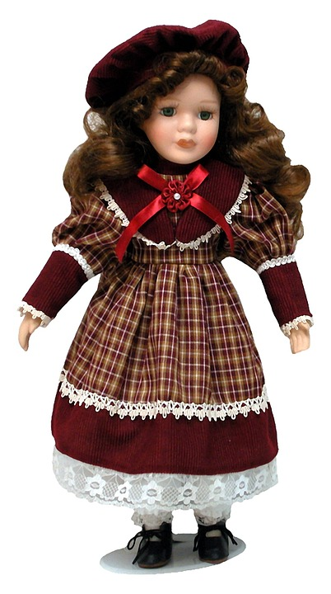
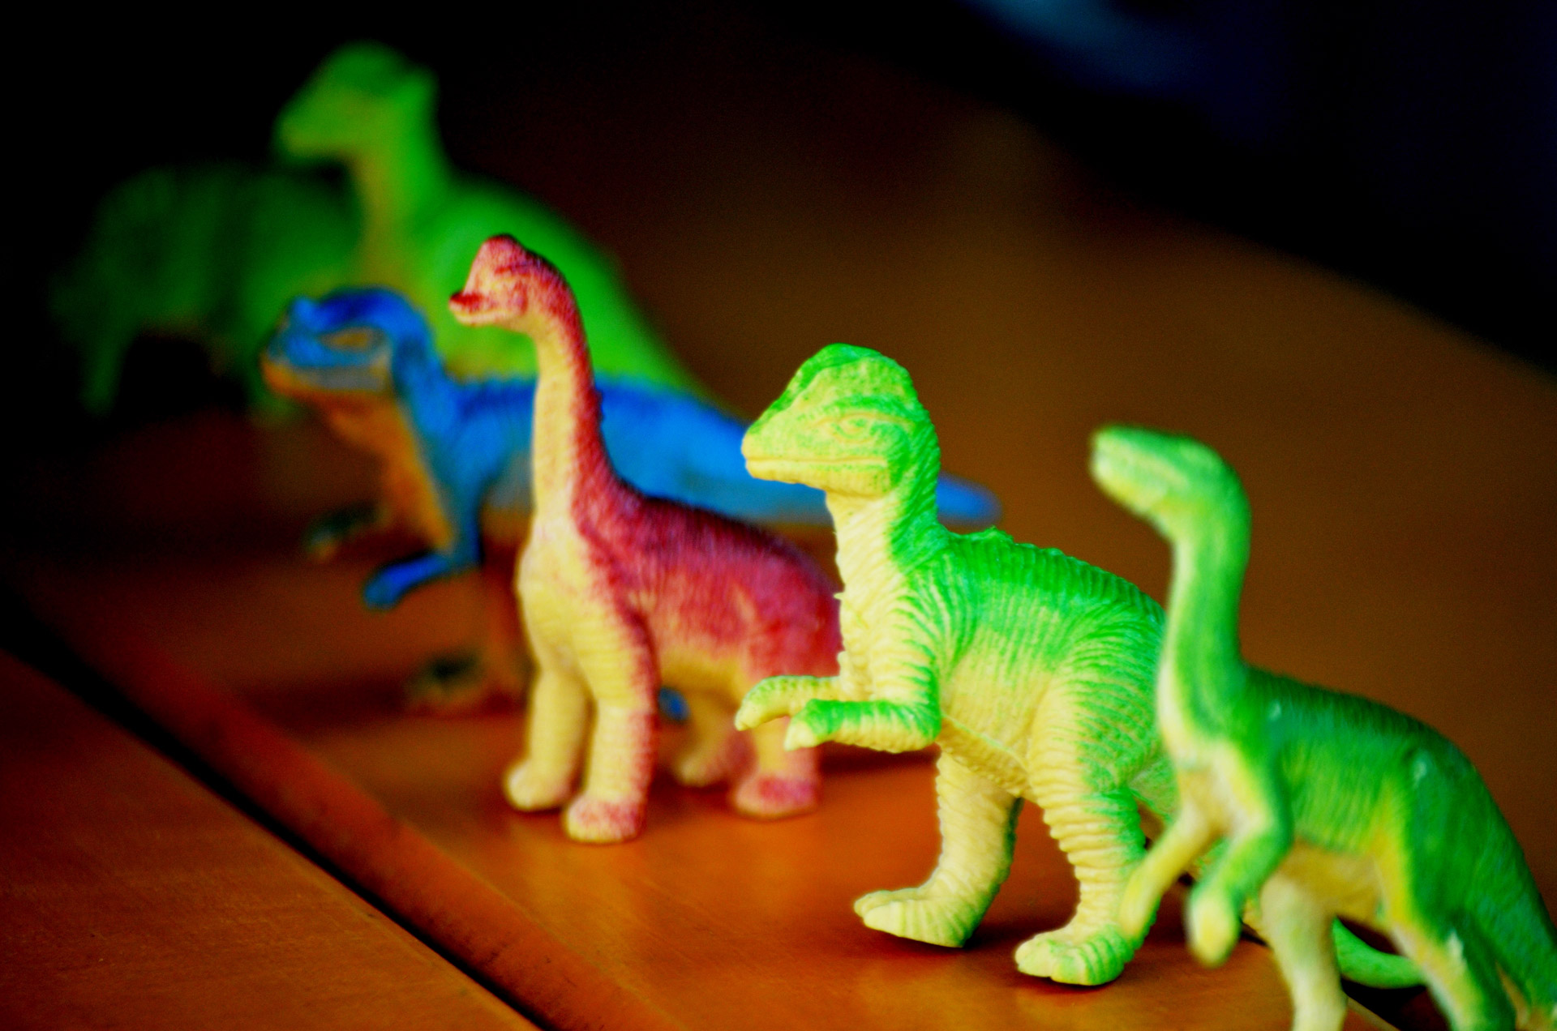
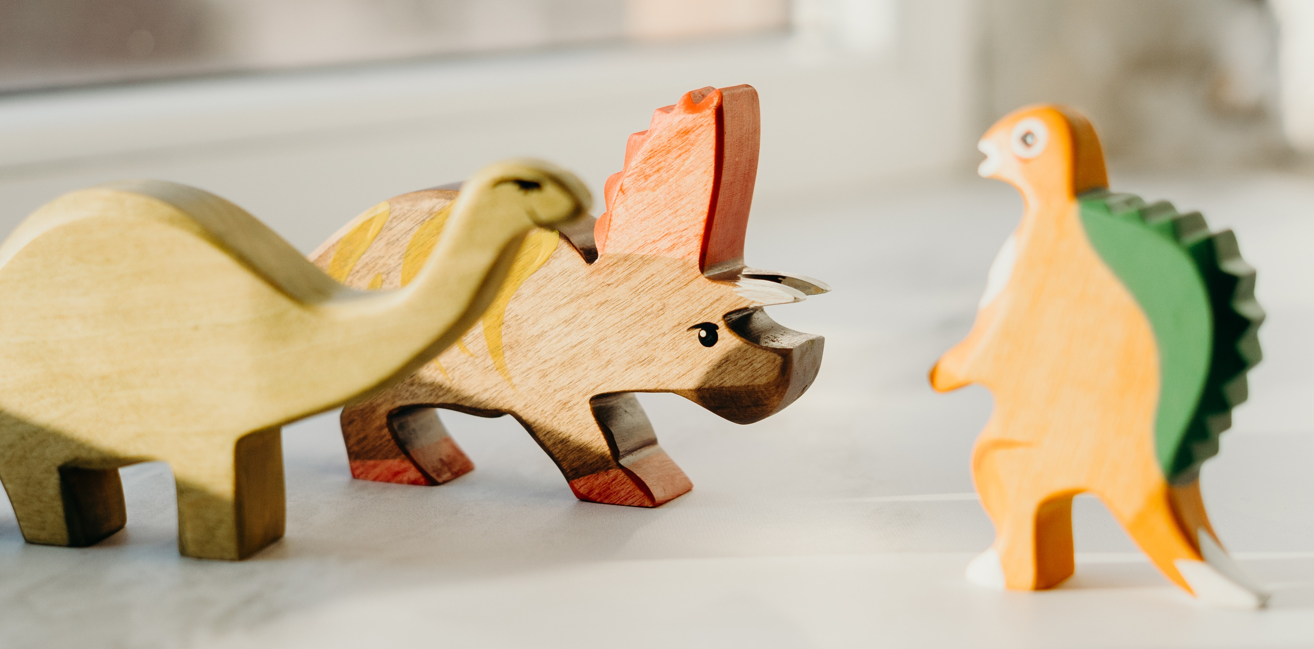
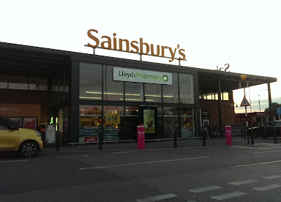
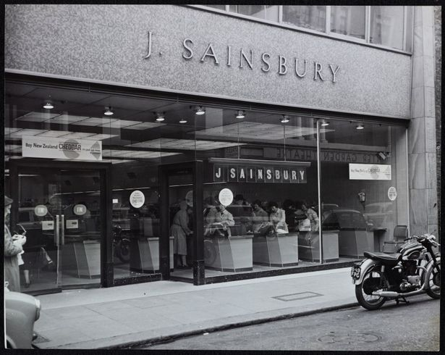
Year One - History- Autumn Term 1 - My family history: What was it like when my grown-ups were young?
Key vocabulary
1 |  | Oral history
2 |  | Chronology / Chronological order
3 |  | Timeline
4 |  | Similar and different
5 |  | Living memory
6 |  | Month / Year / Decade / Century
Key learning
1 | Finding out about the recent past by talking to our grown-ups is called oral history. They can tell us about their lives, and events in living memory.
2 | We can look at photographs and objects to find out about the recent past.
3 | We use special words when describing time (chronology) - a decade is 10 years, a century is 100 years.
4 | Some of our toys are similar to what our grown-ups had when they were children, but they are often made of different materials.
5 | Some of the shops our grown-ups used to use were very different from the shops we know.
What I should already know
Key historical skills
Comparing similarities and differences
Chronology

