Slide 1

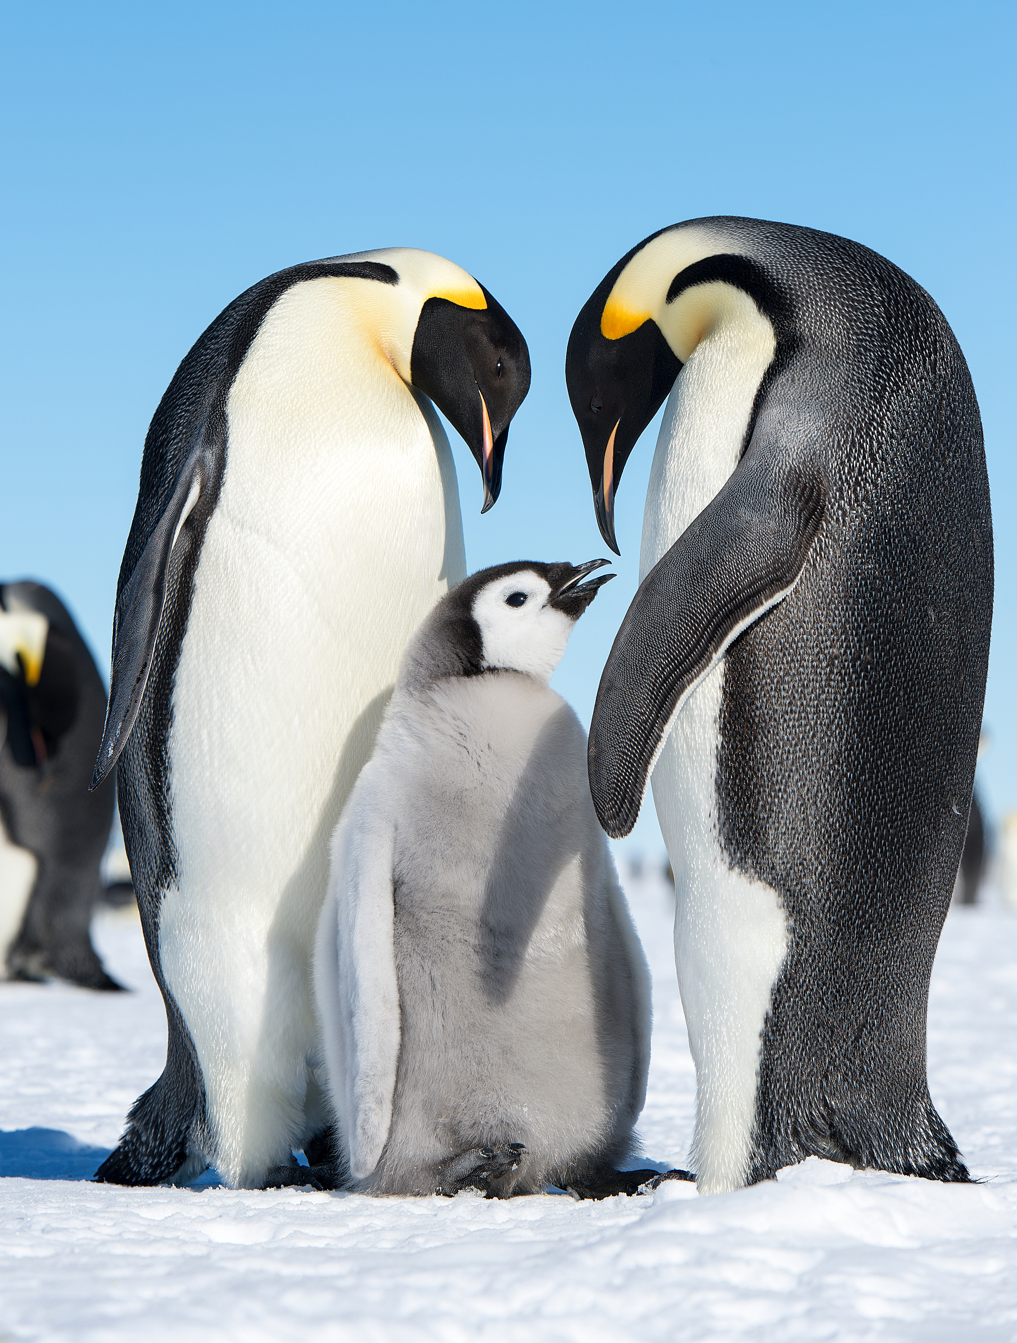
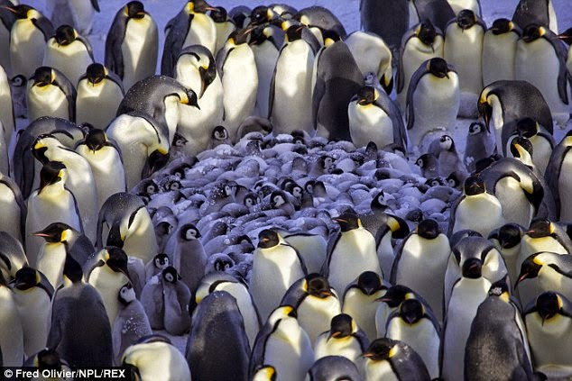
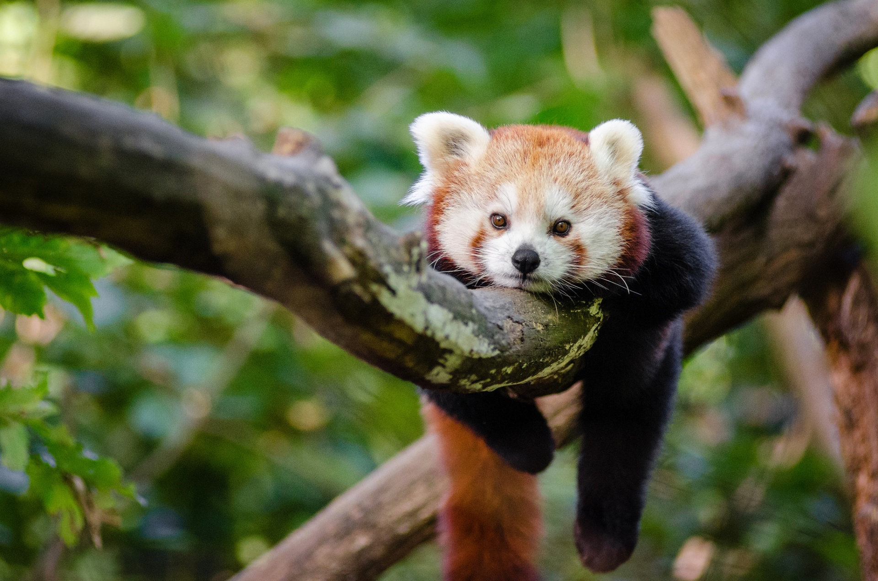
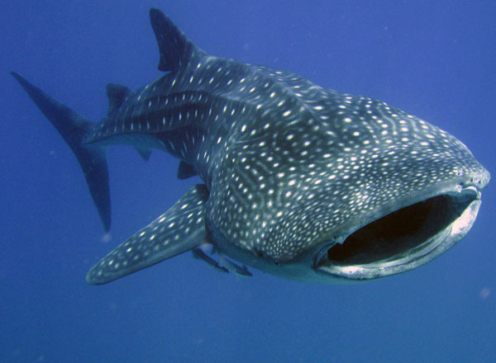
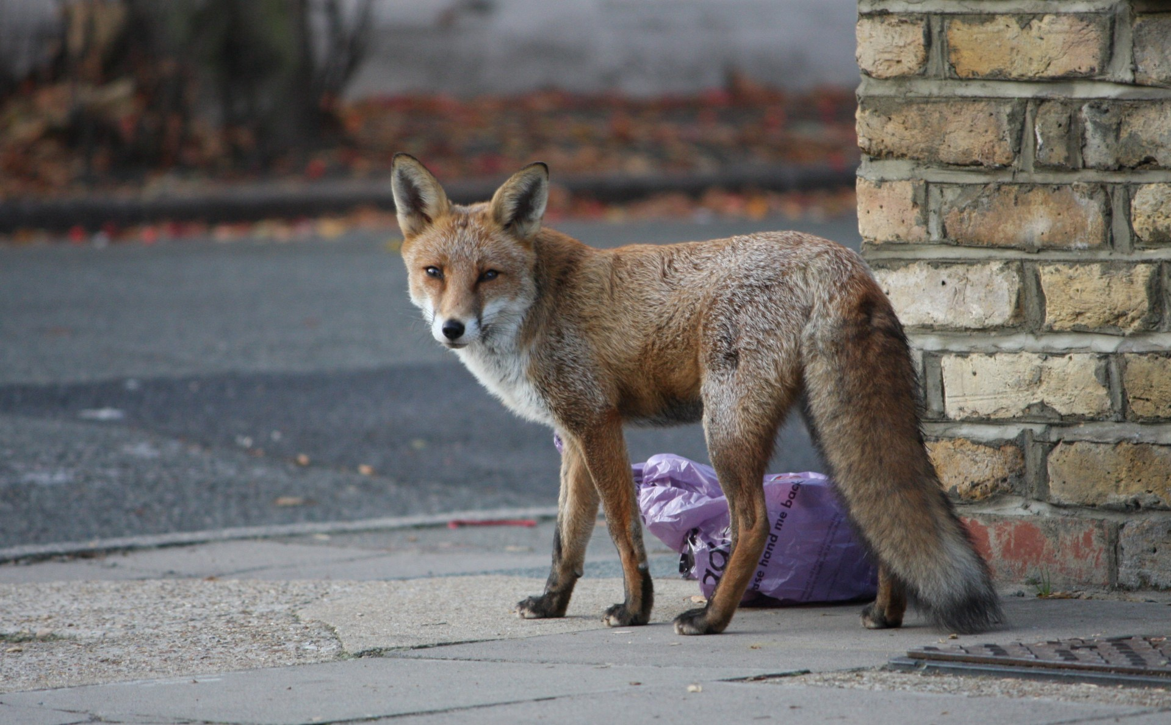
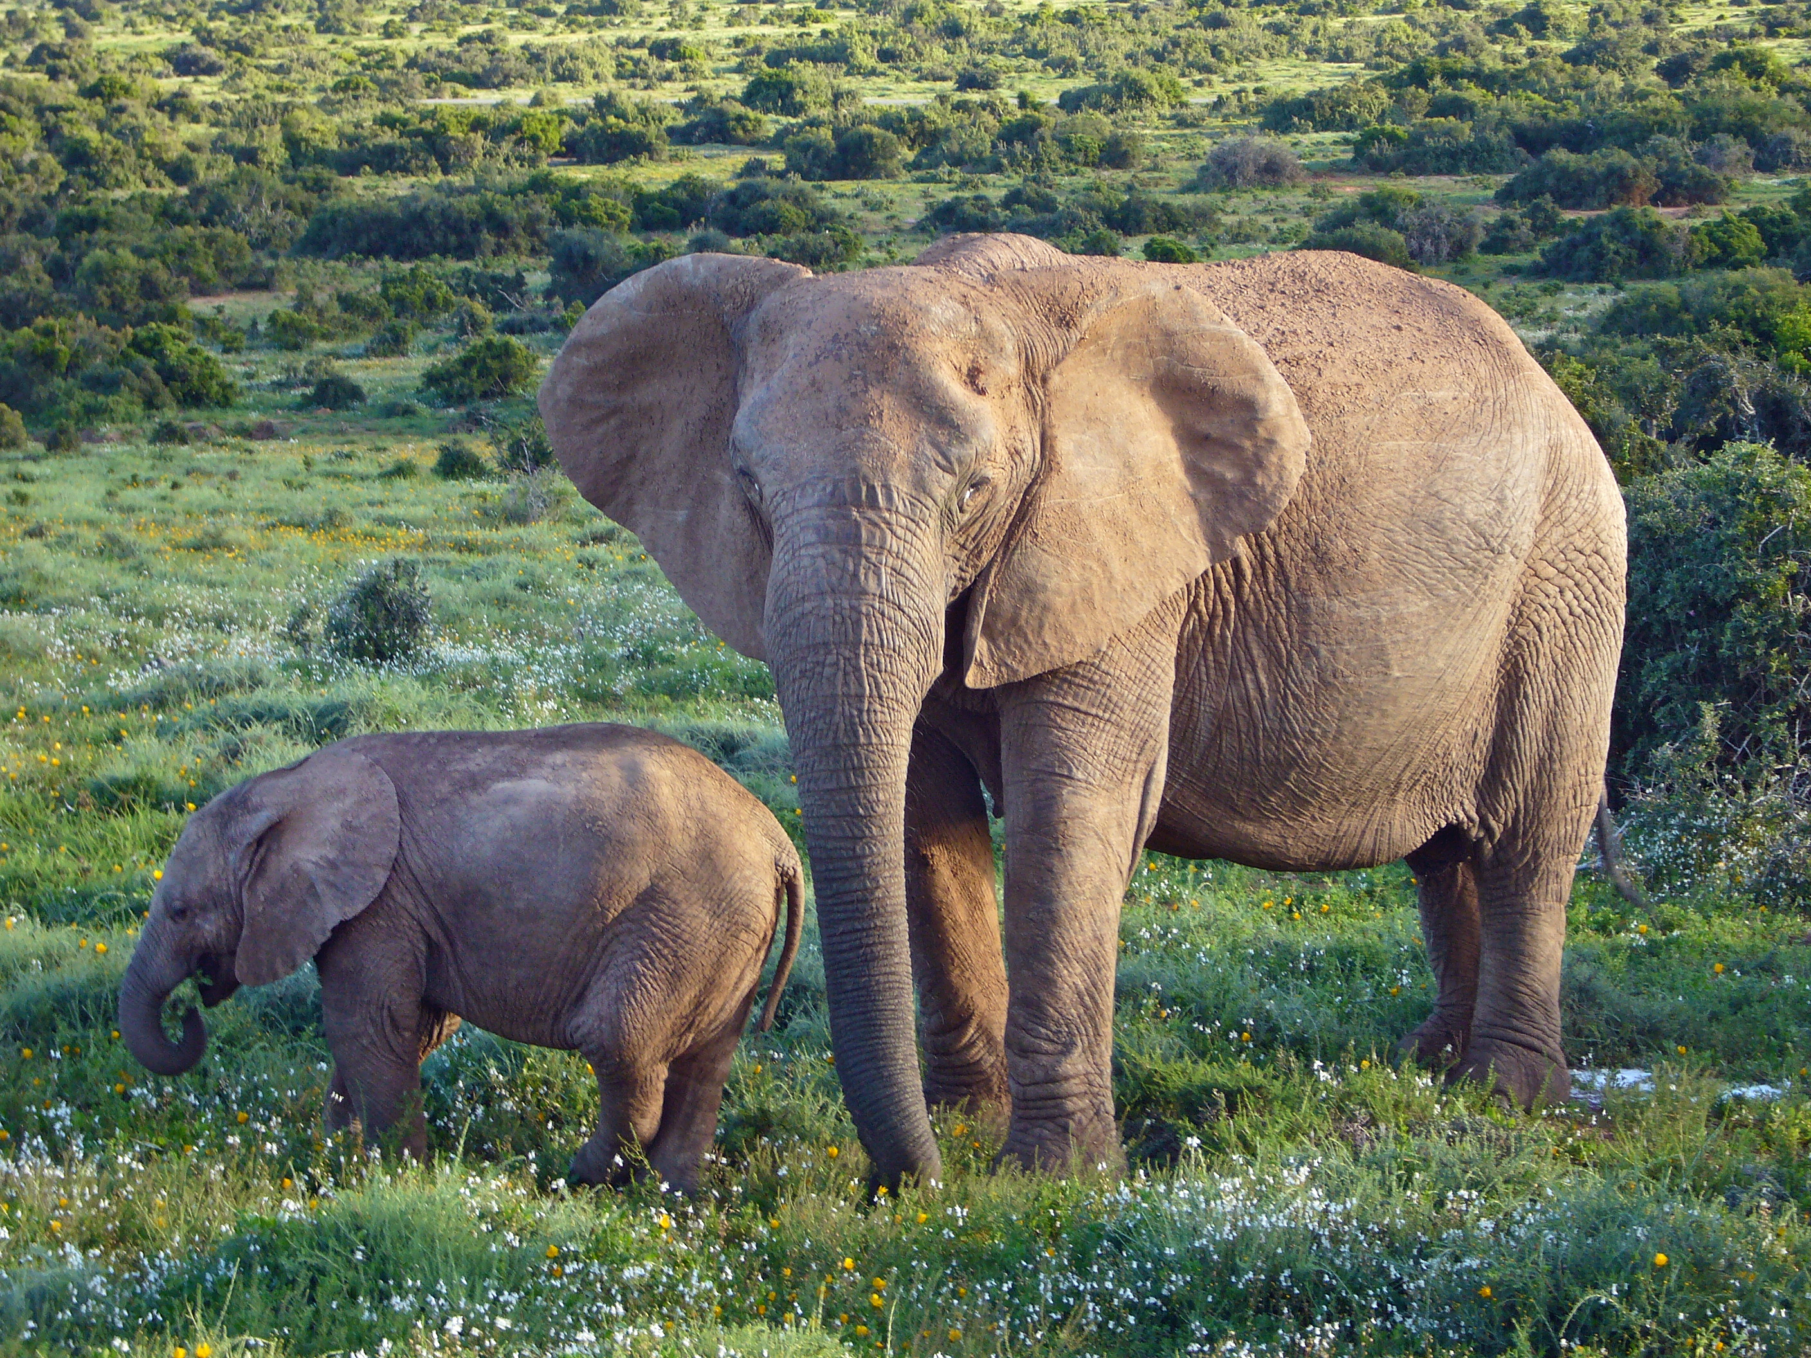
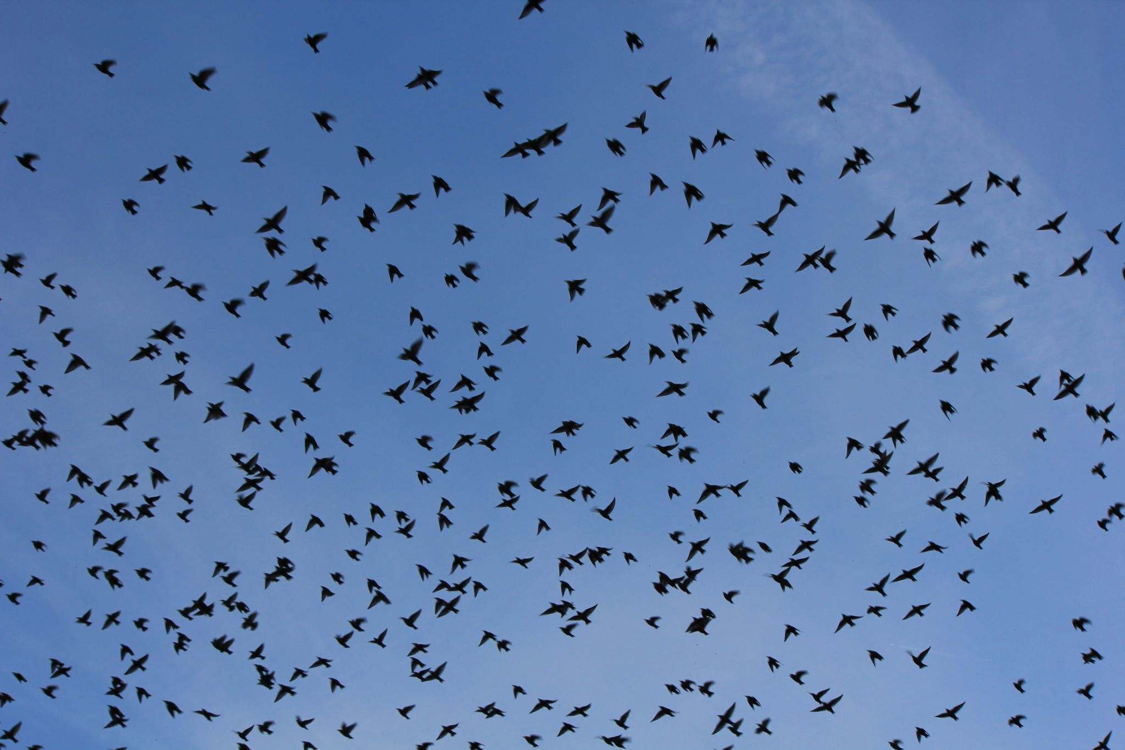
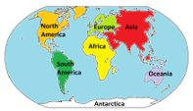
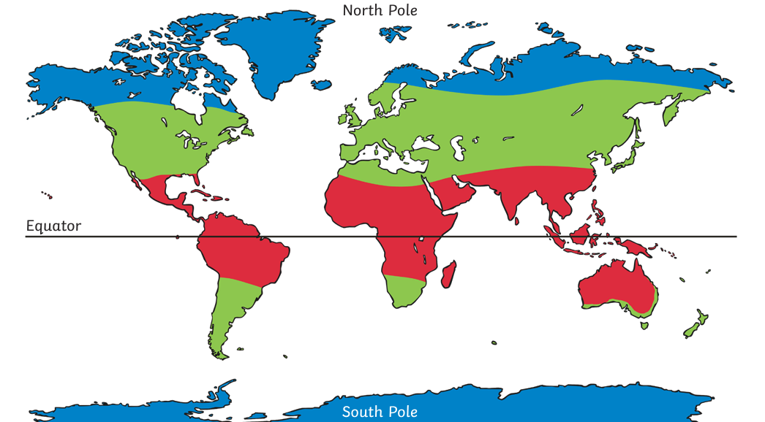
Year One| Geography, Summer Term| Where do our favourite animals live?
Key vocabulary
1 |  | World
2 |  | Continent
3 |  | Equator
4 |  | North Pole
5 |  | South Pole
6 |  | Ocean
7 |  | Migrate
Key learning
1 |  | To name, locate and describe the homes and habitats of several animals around the world.
2 |  | To name and locate the seven continents and five oceans, and begin to understand climate zones around the globe.
What I should already know
Compass points: north, south, east, west
We can use a globe or atlas to locate countries.
Animals live in different places, called habitats.
Key geographical skills
Name and locate the continents and oceans.
Use maps, atlases and globes.
Use simple fieldwork and observational skills.

