Slide 1

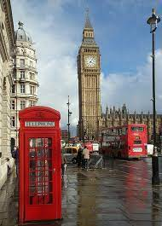
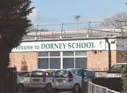
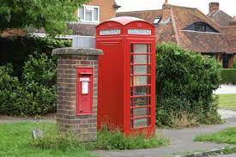
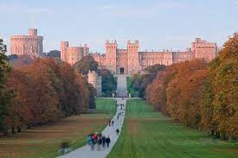
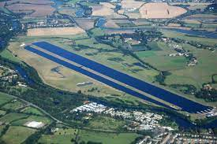
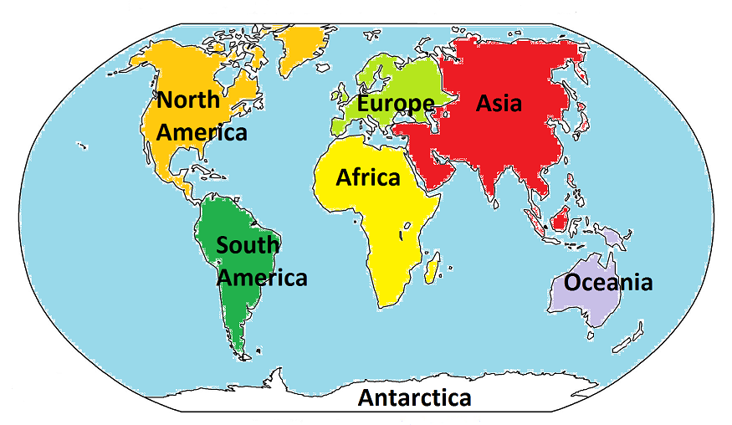
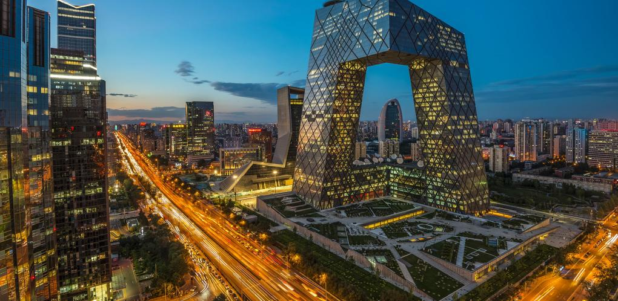
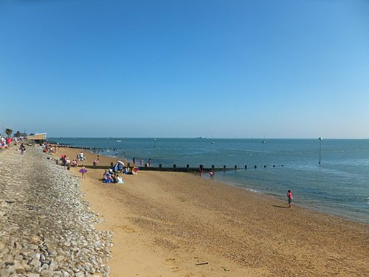
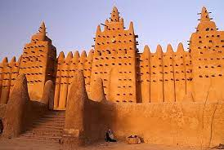
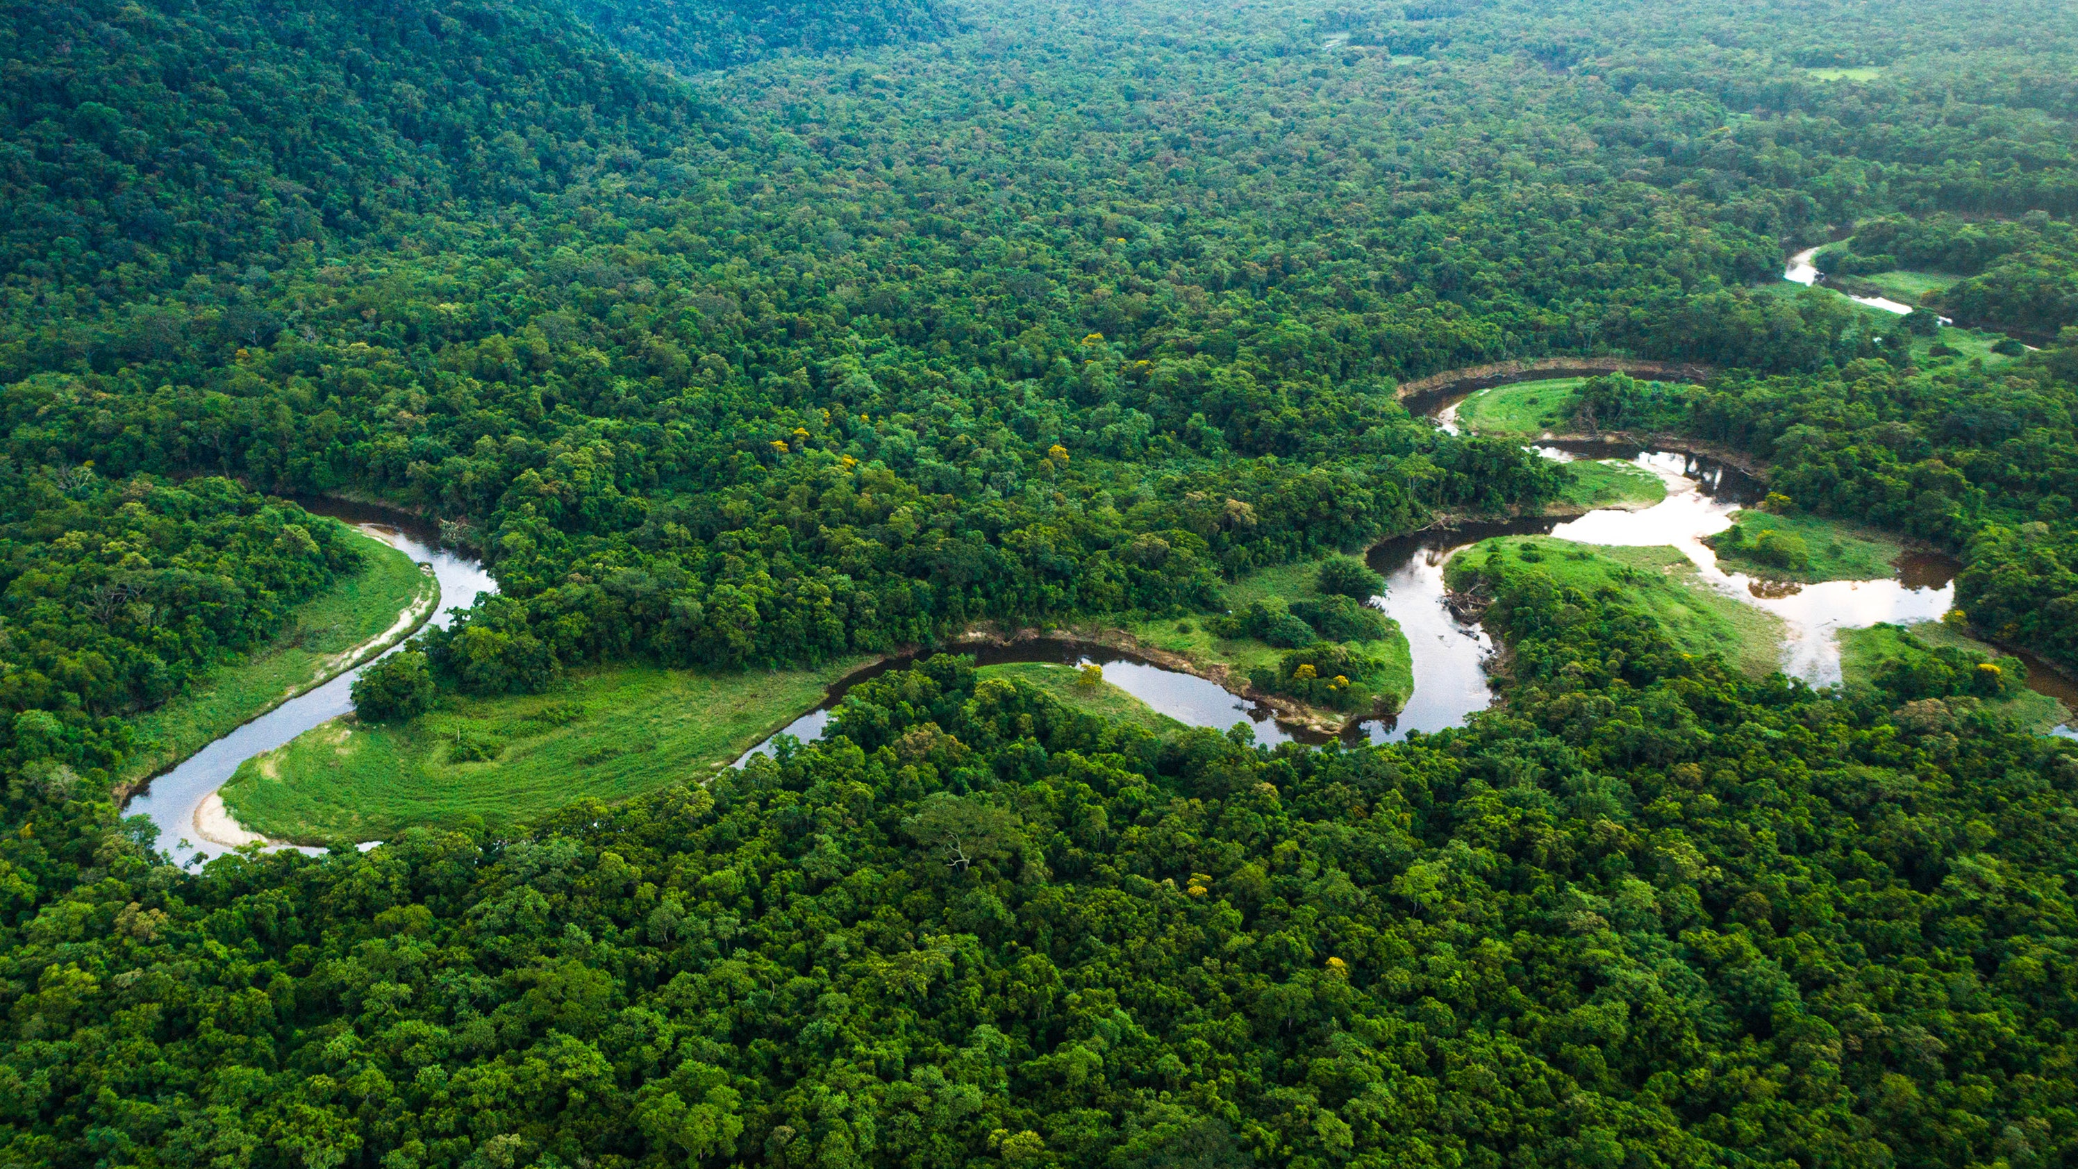

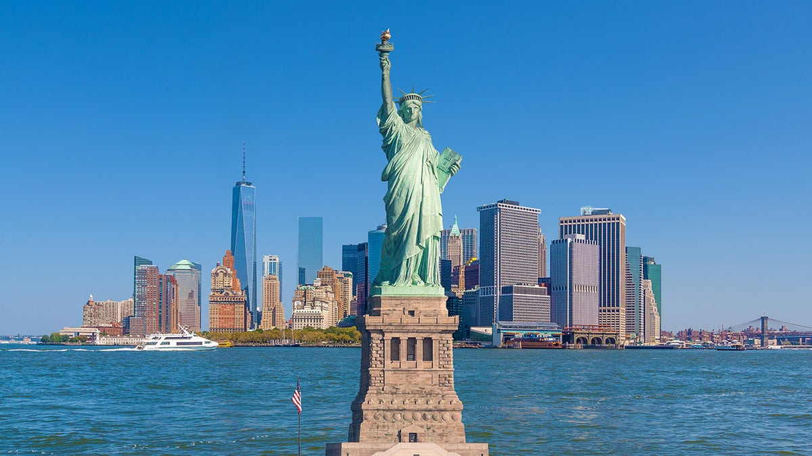
Year One - Geography – Spring Term 1 – People and their communities: Where in the world do these people live?
Key vocabulary
1 |  | Village / Town / County
2 |  | Country
3 |  | Continent
4 |  | Human geography
5 |  | Physical geography
6 |  | Rainforest / jungle / desert / city / coast
7 |  | Map / atlas / globe
Key learning
1 | To know and understand my locality.
2 | To name and locate the world's seven continents:
3 | To learn about the human and physical geography of small areas in non-European countries.
What I should already know
Children have used personal observation, discussion and stories to begin to form an understanding of the world they live in. They have begun to explore the grounds of the school and the local area. They have described the immediate vicinity using observation, discussion, simple maps and small world play.
Key geographical skills
Read images, maps, atlases and globes
Ask and answer questions
Use basic geographical vocabulary

