Slide 1

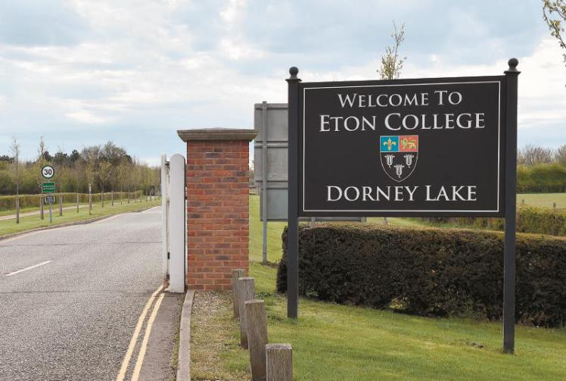
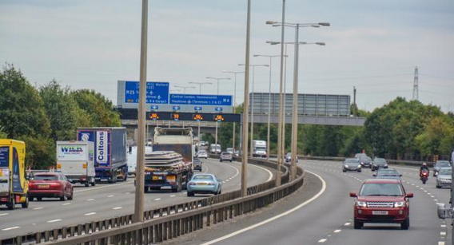
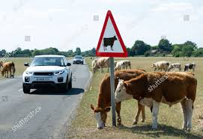
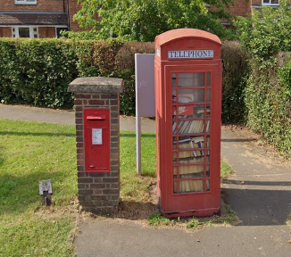
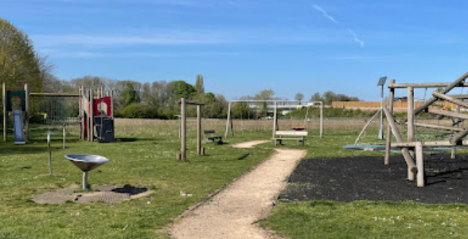
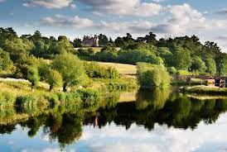
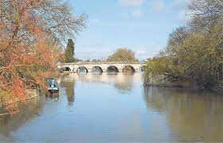
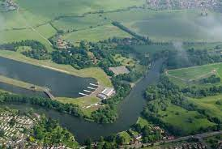
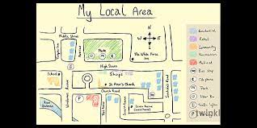
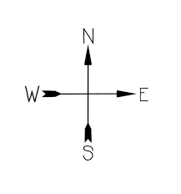
Year One - Geography - Autumn Term 1 - Our Local Area: What is it like, where we live?
Key vocabulary
1 |  | Locality
2 |  | Landscape
3 |  | North, South, East and West
4 |  | Map
5 |  | Landmarks – human physical and natural
6 |  | Symbols
7 |  | Fieldwork
8 |  | Journey
Key learning
1 | To know about the local area, and be able to name and locate key landmarks that would include a list of the human and physical features of the local area. To be able to describe these features and locate them on a map using images or drawings.
2 | To be able to recognise a natural environment and describes it using key vocabulary.
3 | To be able to describe a journey on a map of the local area using simple compass directions and locational and directional language.
What I should already know
Children have begun to make sense of the world around them, using personal experiences of local travel and where they live, alongside school experiences of stories, songs, walks around our school site, the local park and trails together with Guest Speakers on People in the Community.
Key geographical skills
Know the difference between maps, plans and aerial photographs.
Use locational and directional language.
Simple fieldwork and observation – creating maps based on local area knowledge.

