Slide 1

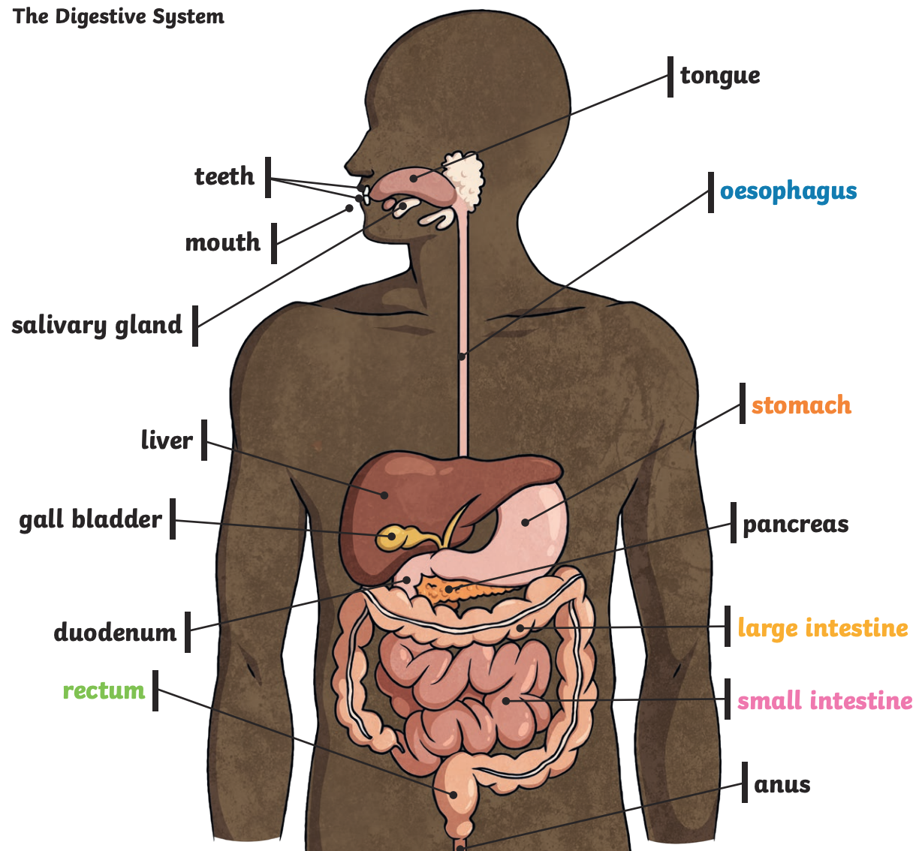
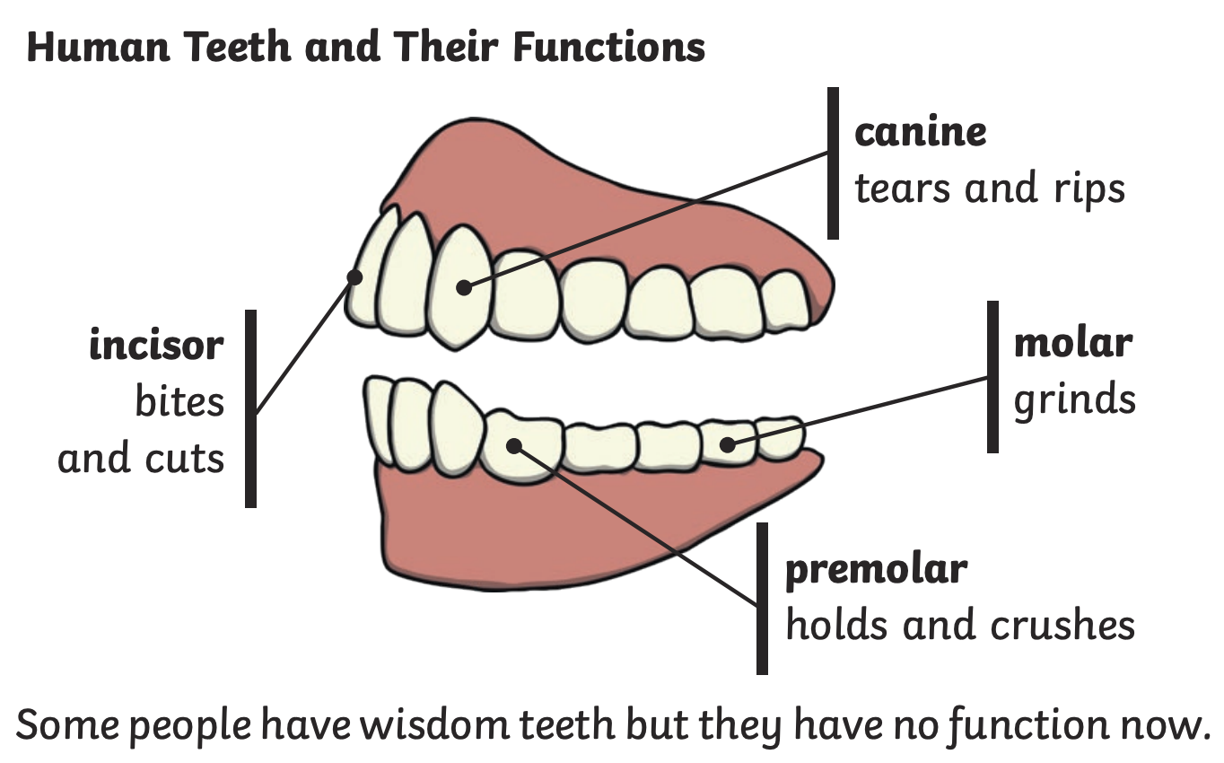
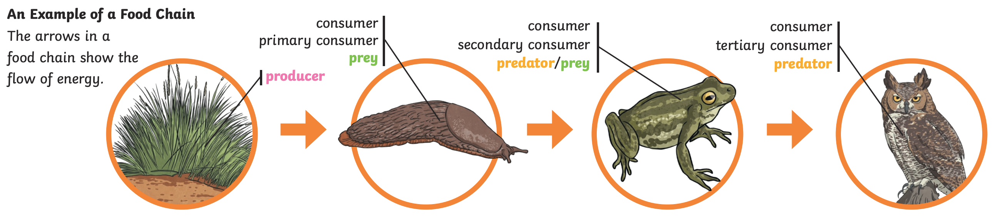
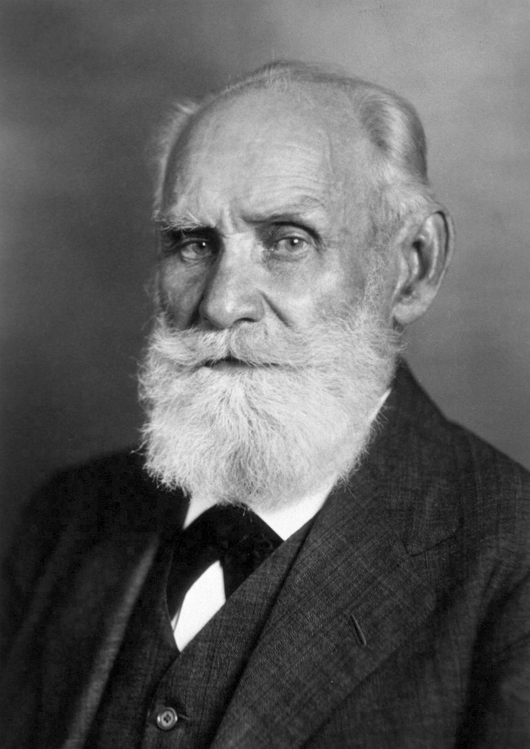
Science Knowledge Organiser – Animals and Humans - Year 4 - Summer 2
Key Vocabulary and Definitions
1 | Digestion | The break down of food so it can be used by the body.
2 | Saliva | The watery liquid that forms in your mouth and helps you to chew and digest food.
3 | Oesophagus | A muscular tube which moves food from the mouth to the stomach.
4 | Small Intestine | Part of the intestine where nutrients are absorbed into the body.
5 | Large Intestine | Part of the intestine where water is absorbed from remaining waste food. Faeces are formed in the large intestine.
6 | Rectum | Part of the digestive system where faeces are stored before leaving the body through the anus.
7 | Incisor | The teeth at the front of your mouth which you use for biting into food.
8 | Canine | Pointed teeth near the front of the mouth in humans and some animals.
9 | Molar | The large, flat teeth towards the back of your mouth that you use for chewing food.
10 | Premolars | A tooth situated between the canine and the molar teeth.
11 | Herbivore | An animal that eats plants.
12 | Carnivore | An animal that feeds on other animals.
13 | Omnivore | An animal that eats plants and animals.
14 | Producer | An organism, such as a plant, that produces its own food.
15 | Prey | An animal that gets hunted and eaten by another animal.
16 | Predator | An animal that hunts and eats other animals.
17 | Food Chain | Describes the order in which organisms, or living things, depend on each other for food.
Key Facts
1 | Food enters the body through the mouth. Digestion starts when the teeth start to break the food down.
2 | Saliva is added and the tongue rolls the food into a ball. The food is swallowed and passes down the oesophagus to the stomach. Here the food is broken down further by being churned around and other chemicals are added.
3 | The food passes into the small intestine. Here nutrients are removed from the food and leave the digestive system to be used elsewhere in the body. The rest of the food then passes into the large intestine.
4 | Here the water is removed for use elsewhere in the body. What is left is then stored in the rectum until it leaves the body through the anus when you go to the toilet.
5 | Humans have four types of teeth: incisors for cutting; canines for tearing; and molars and premolars for grinding (chewing).
6 | Living things can be classified as producers, predators and prey according to their place in the food chain.
7 | Food chains are the connections between producers, prey and predators. All the living things in a food chain rely on each other.
8 | A food chain describes how different organisms eat each other, starting out with a plant and ending with an animal.
Diagrams/Pictures
What should I already know?
Identify and name a variety of common animals that are carnivores, herbivores and omnivores. (Y1 - Animals, including humans) Find out about and describe the basic needs of animals, including humans, for survival (water, food and air). (Y2 - Animals, including humans) Describe the importance for humans of exercise, eating the right amounts of different types of food, and hygiene. (Y2 - Animals, including humans) Identify that animals, including humans, need the right types and amount of nutrition, and that they cannot make their own food; they get nutrition from what they eat. (Y3 - Animals, including humans)
Scientist
Ivan Pavlov (1849-1936) Ivan Pavlov worked to discover the secrets of the digestive system. He also studied what signals physical reactions, such as the production of saliva through his famous Pavlov’s dog experiments.

