Slide 1

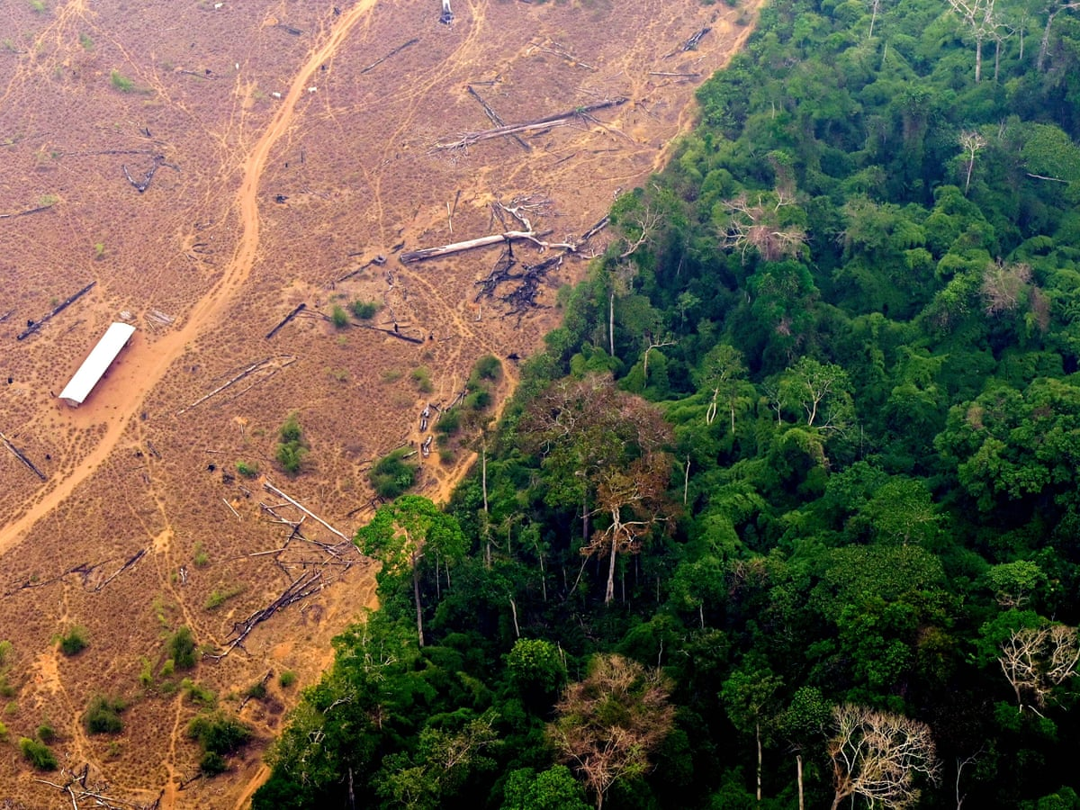
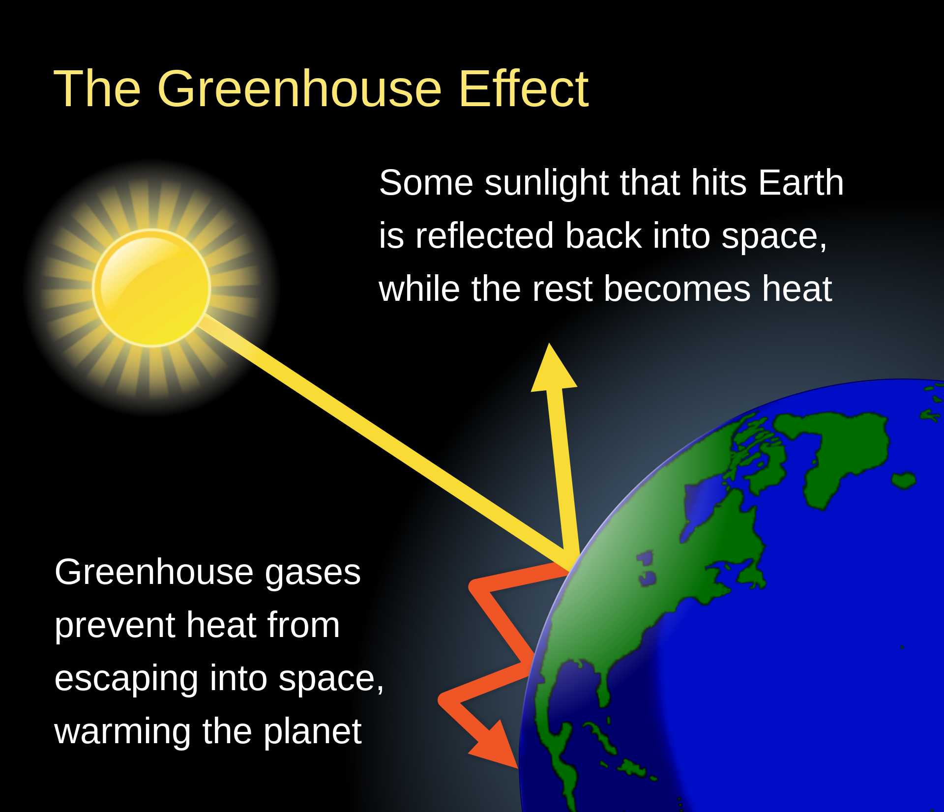
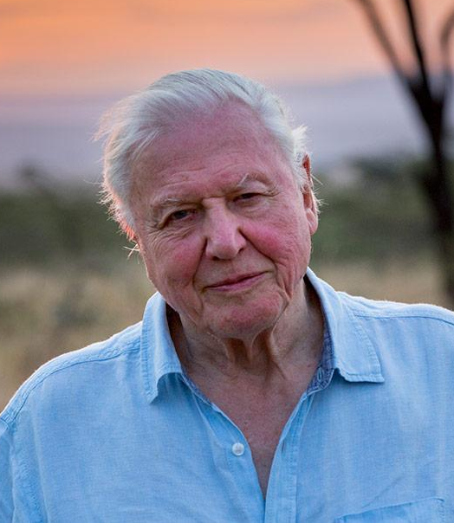
Science Knowledge Organiser – Summer 1 - Living things and their Habitats - Year 4
Key Vocabulary and Definitions
1 | Environment | All the physical surroundings on Earth including everything living and non-living.
2 | Habitat | The natural environment in which an animal or plant lives or grows.
3 | Micro-habitat | A small part of the environment that supports a habitat.
4 | Human impact | Human impact on the environment shows real-world effects of our actions on the environment.
5 | Migrate | Animals that move from one region or habitat to another according to the seasons.
6 | Hibernate | Animals or plants that spend the winter in a dormant state.
7 | Deforestation | The action of clearing wide areas of trees.
8 | Vegetation | Plants, trees and flowers.
9 | Extinct | When a species has no more members alive on the planet, it is extinct.
10 | Climate Change | Climate change refers to the long-term changes in global temperatures and other characteristics of the atmosphere.
Key Facts
1 | Living things live in a habitat which provides an environment to which they are suited. These environments may change naturally e.g. through flooding, fire, earthquakes etc.
2 | Humans also cause the environment to change. This can be in a good way (i.e. positive human impact, such as setting up nature reserves) or in a bad way (i.e. negative human impact, such as littering).
3 | These environments also change with the seasons; different living things can be found in a habitat at different times of the year.
4 | There are different people made threats that can affect the environment. Air-pollution from cars, e.g. carbon monoxide, and the burning of fossil fuels.
5 | Water pollution through industrial waste and farm fertilisers that can pollute rivers and streams.
6 | Rubbish - plastic and household waste ends up on the streets, in the sea or in rubbish dumps, destroying habitats and wildlife.
7 | Plants and animals rely on the environment to give them everything they need. Therefore, when habitats change, it can be very dangerous to the plants and animals that live there.
8 | Climate has changed throughout Earth's long history, but this time it's different. Human activity is causing worldwide temperatures to rise higher and faster than any time we know of in the past.
Diagrams/Pictures
deforestation
Scientist
Sir David Attenborough is an English broadcaster, biologist, natural historian and author. He is an advocate for preventing climate change and supporting environmental causes.
What should I already know?
Identify and name a variety of plants and animals in their habitats, including microhabitats. (Y2 - Living things and their habitats) Understand why it is important to look after our environment.

