Slide 1

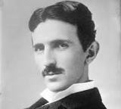
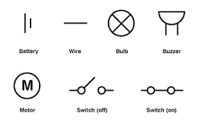
Science: Electricity (Spring 2) YEAR: 4
Vocabulary
1 | Circuit | A complete route which an electric current can flow around.
2 | Current | A flow of electricity through a wire.
3 | Battery | A small device that provides power for electrical items.
4 | Cell | A device used to generate electricity. A battery is an example of a cell.
5 | Conductor | Any material that electricity can pass through or along.
6 | Insulator | Any material that electricity cannot pass through or along.
7 | Energy | the power from sources such as electricity that makes machines work or provides heat.
8 | Electricity | a form of energy that can be carried by wires and is used for heating and lighting, and to provide power for devices.
Key Knowledge
1 | Some appliances using electricity plug in to the mains and others run on batteries.
2 | An electrical circuit consists of a cell or battery connected to a component using wires.
3 | If there is a break in the circuit, a loose connection or a short circuit, the component will not work.
4 | A switch can be added to the circuit to turn the component on and off.
5 | Metals are good conductors so they can be used as wires in a circuit. Non-metallic solids are insulators except for graphite (pencil lead).
6 | Water, if not completely pure, also conducts electricity.
Key Scientist
Nikola Tesla (1856-1943) was a Serbian-American electrical and mechanical engineer. Without Tesla’s development of a type of electrical circuit (AC) we would not have electric lights in our homes.
Scientific enquiry & skills
Classify common appliances that run on electricity and battery (or both.)
Investigate electrical conductors and insulators.
Planning different types of scientific enquiries to answer questions.
Use relevant scientific language and illustrations to discuss, communicate and justify their scientific ideas

