Slide 1

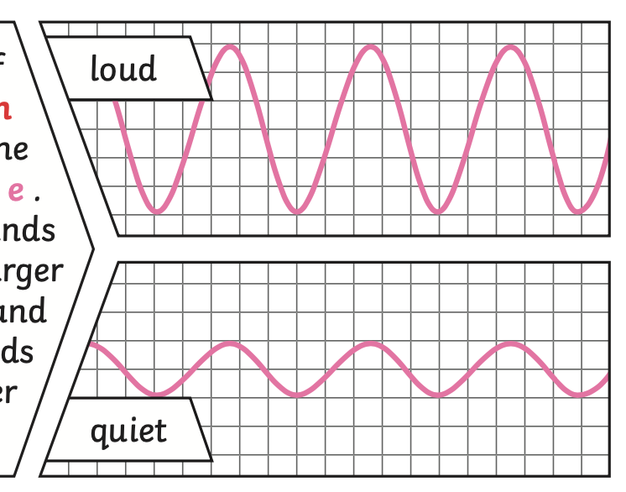
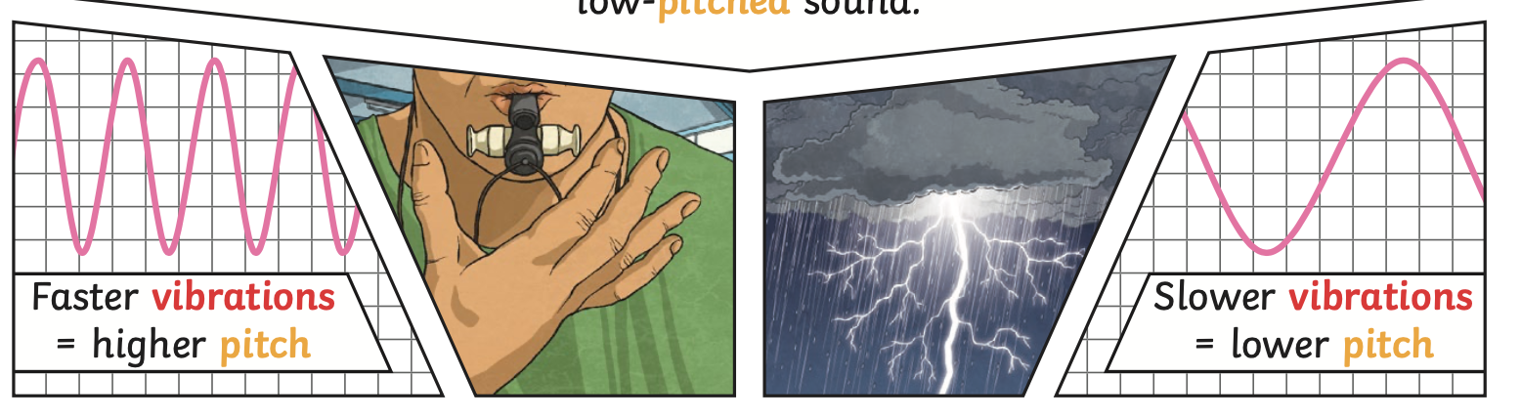
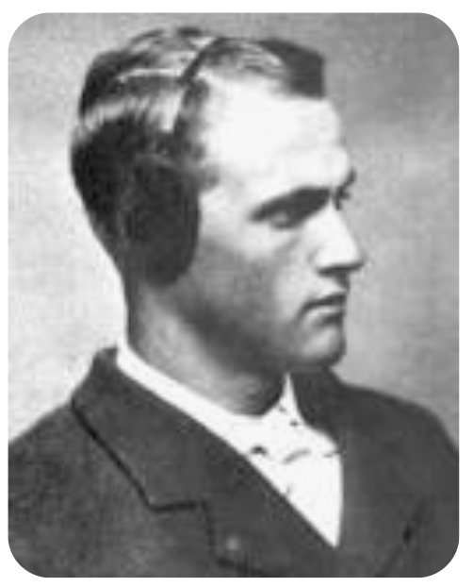
Science – Sound - Year 4 - Spring 1
Key Vocabulary and Definitions
1 | Vibration | A quick movement back and forth.
2 | Source | This is the place from which a sound comes from.
3 | Sound wave | Vibrations travelling from a sound source.
4 | Volume | The loudness of a sound.
5 | Amplitude | The size of a vibration. A larger amplitude = a louder sound.
6 | Pitch | How low or high a sound is.
7 | Particles | Solids, liquids and gases are made of particles. They are so small we are unable to see them.
8 | Soundproof | To prevent sound from passing through.
9 | Absorb sound | To take in sound energy. Absorbent materials have the effect of muffling sound.
10 | Vacuum | A space where there is nothing. There are no particles in a vacuum.
11 | Eardrum | A part of the ear which is a thin, tough layer of tissue that is stretched out like a drum skin. It separates the outer ear from the middle and inner ear. Sound waves make the eardrum vibrate.
Key Facts
1 | Sound is a type of energy. Sounds are created by vibrations. The louder the sound, the bigger the vibration.
2 | The vibrations cause parts of our body inside our ears to vibrate, allowing us to hear (sense) the sound.
3 | Different mediums such as solids, liquids and gases can carry sound, but sound cannot travel through a vacuum.
4 | The loudness (volume) of the sound depends on the strength (size) of vibrations which decreases as they travel through the medium.
5 | Sound energy can travel from particle to particle far easier in a solid because the vibrating particles are closer together than in other states of matter.
6 | A sound insulator is a material which blocks sound effectively.
7 | Pitch is the highness or lowness of a sound and is affected by features of objects producing the sounds. For example, smaller objects usually produce higher pitched sounds.
8 | Louder sounds have a larger amplitude, and quieter sounds have a smaller amplitude.
Diagrams
Sound waves
Scientist
Chester Greenwood: (4 December 1858 – 5 July 1937). He was an American engineer, scientist and inventor, known for inventing the earmuffs in 1873. He reportedly came up with the idea while ice skating and he asked his grandmother to sew tufts of fur between loops of wire. His patent was for improved ear protectors.
What should I already know?
Identify, name, draw and label the basic parts of the human body and say which part of the body is associated with each sense.

