Slide 1

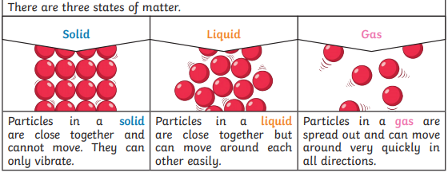
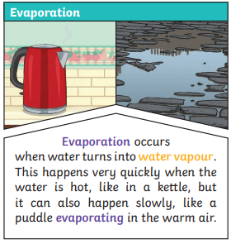
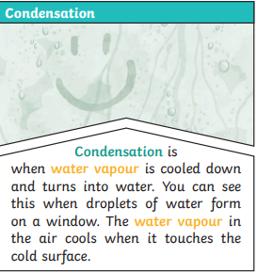
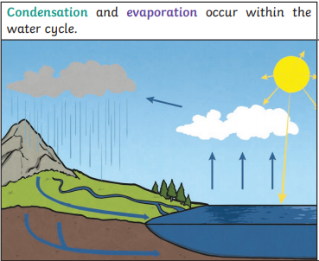
Year 4 Science Knowledge Organiser - States of Matter – Autumn 2
1
2
Water from lakes, puddles, rivers and seas is evaporated by the sun’s heat, turning it into water vapour. This water vapour rises, then cools down to form water droplets in clouds (condensation). When the droplets get too heavy, they fall back to the earth as rain, sleet, hail or snow (precipitation).
Definitions
Solid | A solid keeps its shape and has a fixed volume.
Liquid | A liquid has a fixed volume but changes in shape to fit the container. A liquid can be poured and keeps a level, horizontal surface.
Gas | A gas fills all available space; it has no fixed shape or volume.
Key Facts
Granular and powdery solids like sand can be confused with liquids because they can be poured, but when poured they form a heap and they do not keep a level surface when tipped. Each individual grain demonstrates the properties of a solid.
Melting is a state change from solid to liquid.
Freezing is a state change from liquid to solid.
The freezing point of water is 0oC.
Boiling is a change of state from liquid to gas that happens when a liquid is heated to a specific temperature and bubbles of the gas can be seen in the liquid.
Water boils when it is heated to 100oC.
Evaporation is the same state change as boiling (liquid to gas), but it happens slowly at lower temperatures and only at the surface of the liquid. Evaporation happens more quickly if the temperature is higher, the liquid is spread out or it is windy
Condensation is the change back from a gas to a liquid caused by cooling.
Water at the surface of seas, rivers etc. evaporates into water vapour (a gas). This rises, cools and condenses back into a liquid, forming clouds. When too much water has condensed, the water droplets in the cloud get too heavy and fall back down as rain, snow, sleet etc. and drain back into rivers etc. This is known as precipitation. This is the water cycle.
Key Vocabulary
Solid, liquid, gas, state change, melting, freezing, melting point, boiling point, evaporation, temperature, water cycle
When water and other liquids reach a certain temperature, they change state into a solid or a gas. The temperatures that these changes happen at are called the boiling, melting or freezing point.

Slide 2
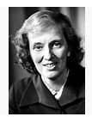
Year 4 Science Knowledge Organiser - States of Matter – Autumn 2
What should I already know?
Distinguish between an object and the material from which it is made. (Y1 )
Identify and name a variety of everyday materials, including wood, plastic, glass, metal, water, and rock. (Y1 )
Describe the simple physical properties of a variety of everyday materials. (Y1)
Compare and group together a variety of everyday materials on the basis of their simple physical properties. (Y1)
Identify and compare the suitability of a variety of everyday materials, including wood, metal, plastic, glass, brick, rock, paper and cardboard for particular uses. (Y2)
Scientific Enquiry and Skills
Observe closely and classify a range of solids and liquids.
Explore making gases.
Classify materials according to whether they are solids, liquids and gases.
Observe a range of materials melting.
Investigate how to melt ice more quickly.
Investigate the melting point of different materials
Observe the changes when making rocky road, cakes or ice-cream.
Find out how the shapes of solid objects made from some materials can be changed by squashing, bending, twisting and stretching. (Y2)
Scientific Enquiry and Skills
Scientist
Dorothy Crowfoot Hodgkin
Dorothy Crowfoot Hodgkin was an English chemist. She specialized in crystallography, a branch of science that is concerned with figuring out how atoms are arranged in crystals. Among her greatest successes were the discoveries of the structures of penicillin and vitamin B₁₂. For these achievements Hodgkin was awarded the 1964 Nobel Prize for Chemistry.
Explore freezing different liquids.
Use a thermometer to measure temperatures e.g. icy water (melting), tap water, hot water, boiling water (demonstration).
Observe water evaporating and condensing e.g on cups of icy water and hot water.
Set up investigations to explore changing the rate of evaporation e.g. washing, puddles, handprints on paper towels, liquids in containers.
Use secondary sources to find out about the water cycle.

