Slide 1

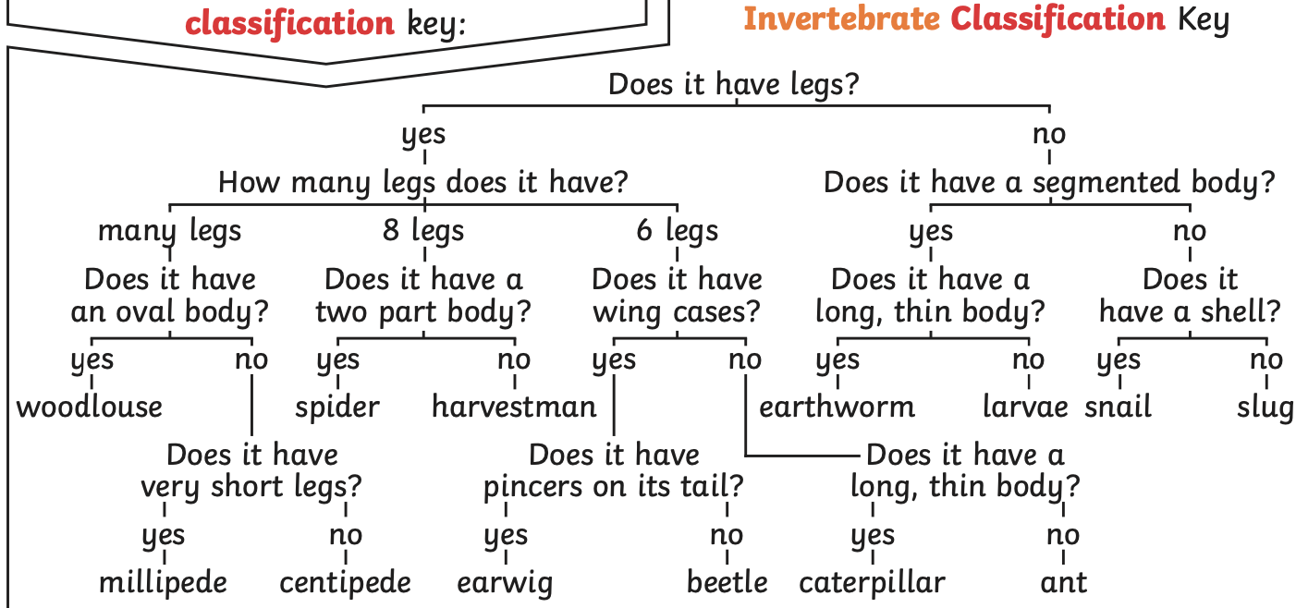
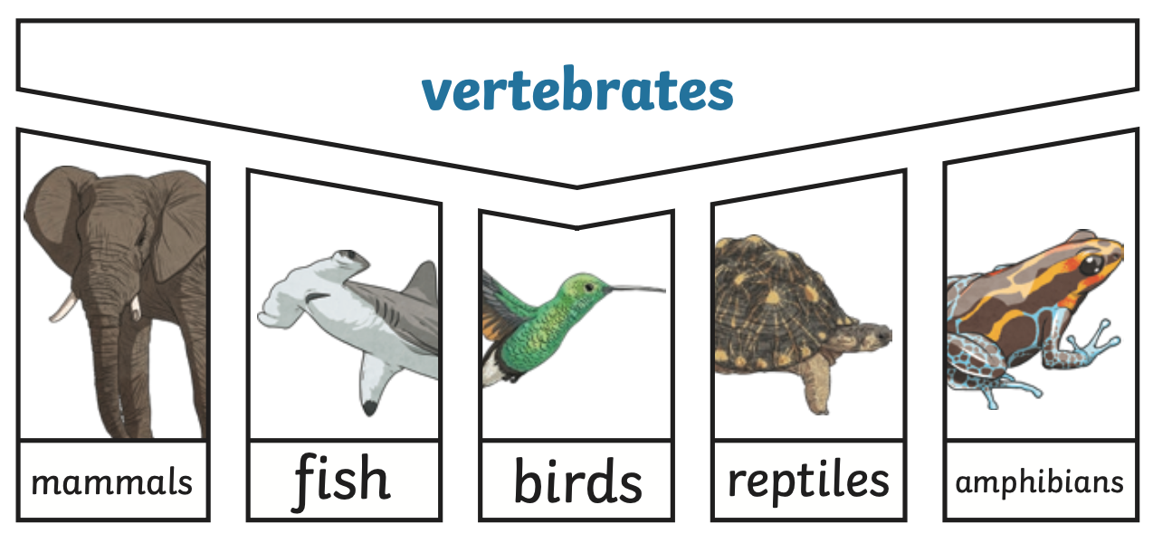
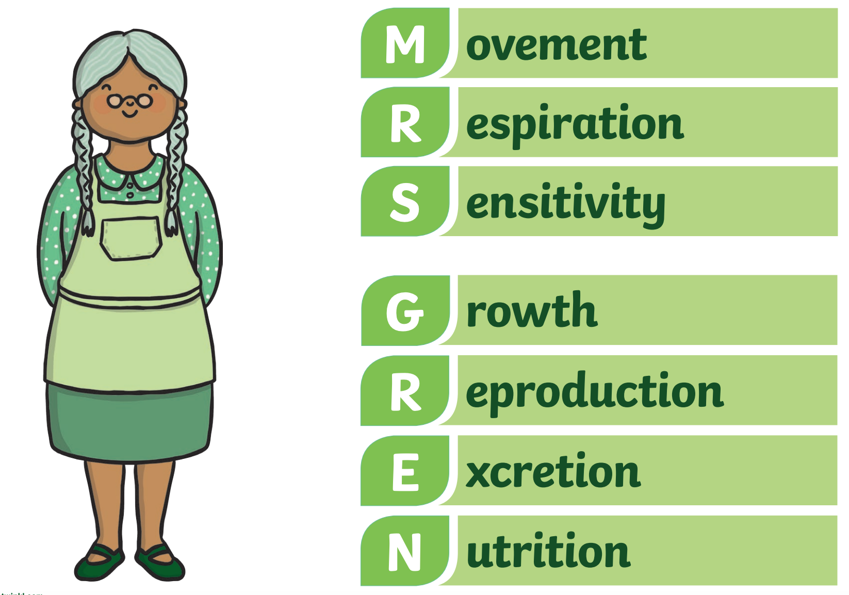
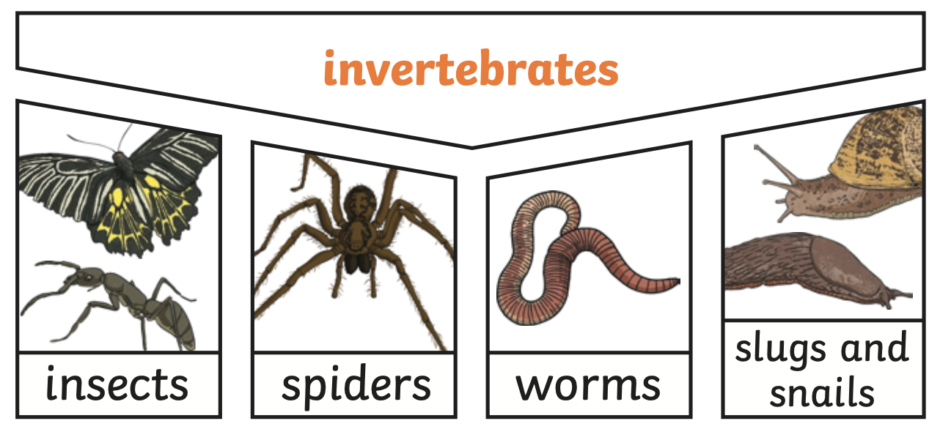
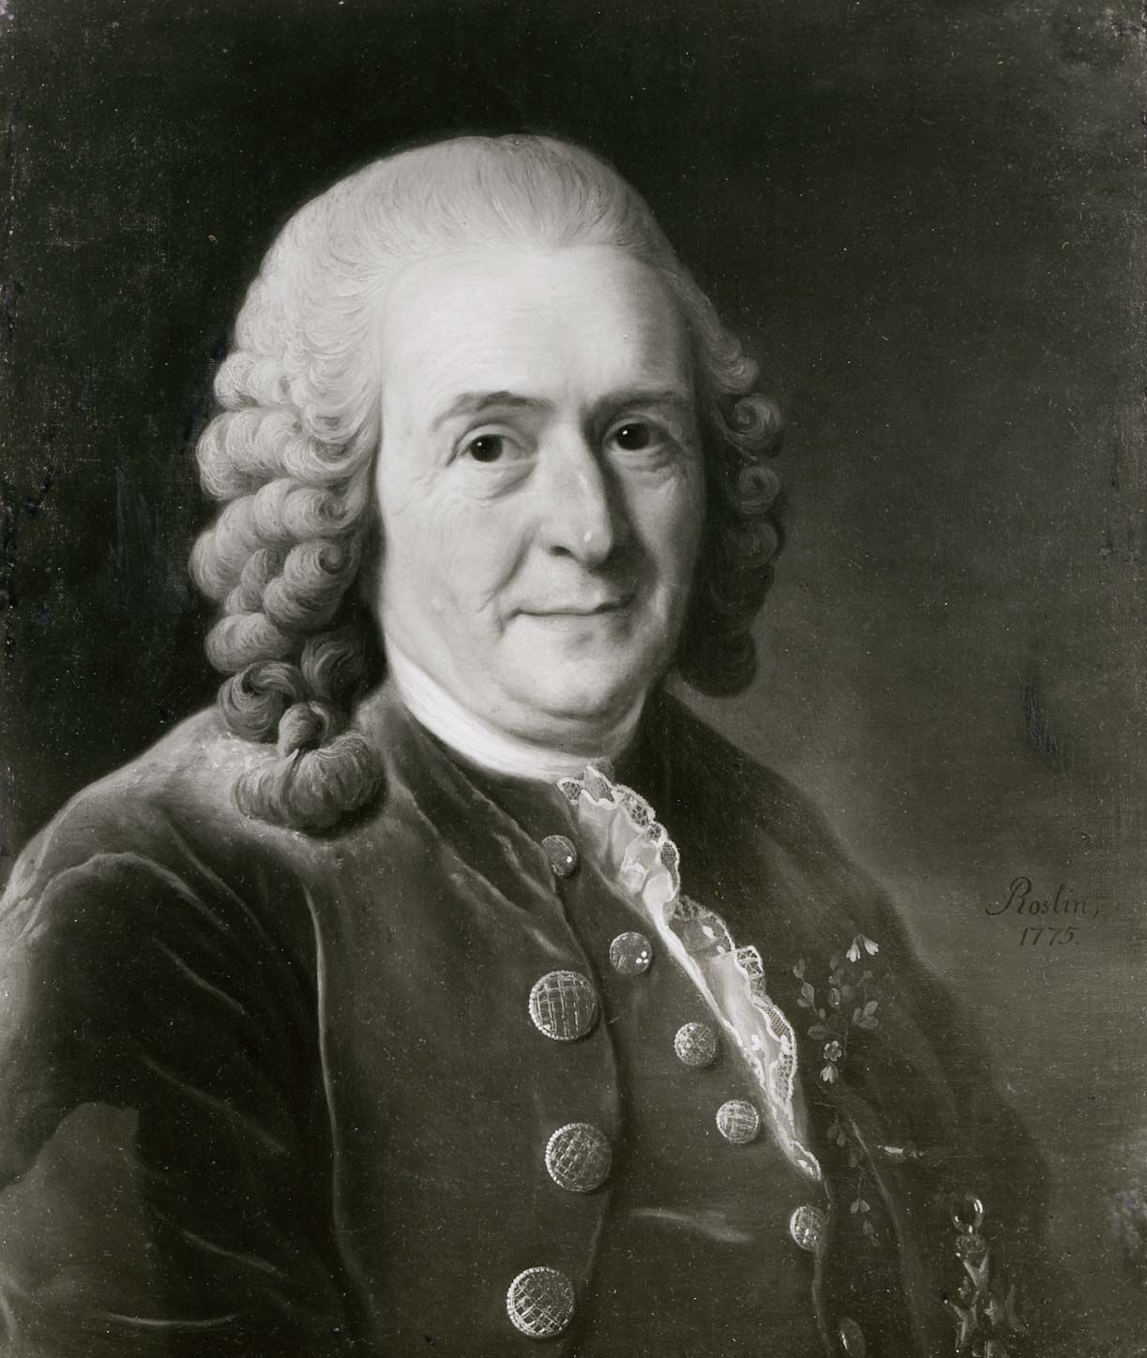
Science Knowledge Organiser – Living Things and their Habitats - Year 4 – Autumn 1
Key Vocabulary and Definitions
1 | Organisms | This is another word that can be used to mean ‘living things’.
2 | Life Processes | The things living things do to stay alive.
3 | Respiration | A process where plants and animals use oxygen gas from the air to help turn their food into energy.
4 | Sensitivity | The way living things react to changes in their environment.
5 | Reproduction | The process through which young are produced.
6 | Excretion | The process by which living things get rid of waste products.
7 | Nutrition | The process of obtaining food to provide living things with energy to live and stay healthy.
8 | Classification | This is where plants or animals are placed into groups according to their similarities.
9 | Vertebrates | Animals with a backbone.
10 | Invertebrates | Animals without a backbone.
11 | Specimen | A particular plant or animal that scientists study to find out about its species.
12 | Characteristics | The distinguishing features or qualities that are specific to a species.
Key Facts
1 | To stay alive and healthy, all living things need certain conditions that let them carry out the seven life processes.
2 | MRS GREN is a helpful way to remember the seven life processes.
3 | Living things can be grouped (classified) in different ways according to their features.
4 | Classification keys can be used to identify and name living things.
5 | Animals can be grouped in lots of different ways based upon their characteristics.
6 | Vertebrates can be separated into five broad groups.
7 | You could sort invertebrates you might see around school in different ways, such as in this example. The vast majority of living things on the planet are invertebrates.
8 | Plants can be sorted into many different groups. For example flowering and non-flowering plants.
Diagrams/Pictures
What should I already know?
Identify and name a variety of common wild and garden plants, including deciduous and evergreen trees. (Y1 - Plants) Identify and describe the basic structure of a variety of common flowering plants, including trees. (Y1 - Plants) Identify and name a variety of common animals including fish, amphibians, reptiles, birds and mammals. (Y1 - Animals including humans) Describe and compare the structure of a variety of common animals (fish, amphibians, reptiles, birds and mammals, including pets). (Y1 – Animals, including humans)
Scientist
Carolus Linnaeus was a Swedish naturalist. He created two scientific systems: the system for classifying plants and animals and the system for naming all living things.

