Slide 1

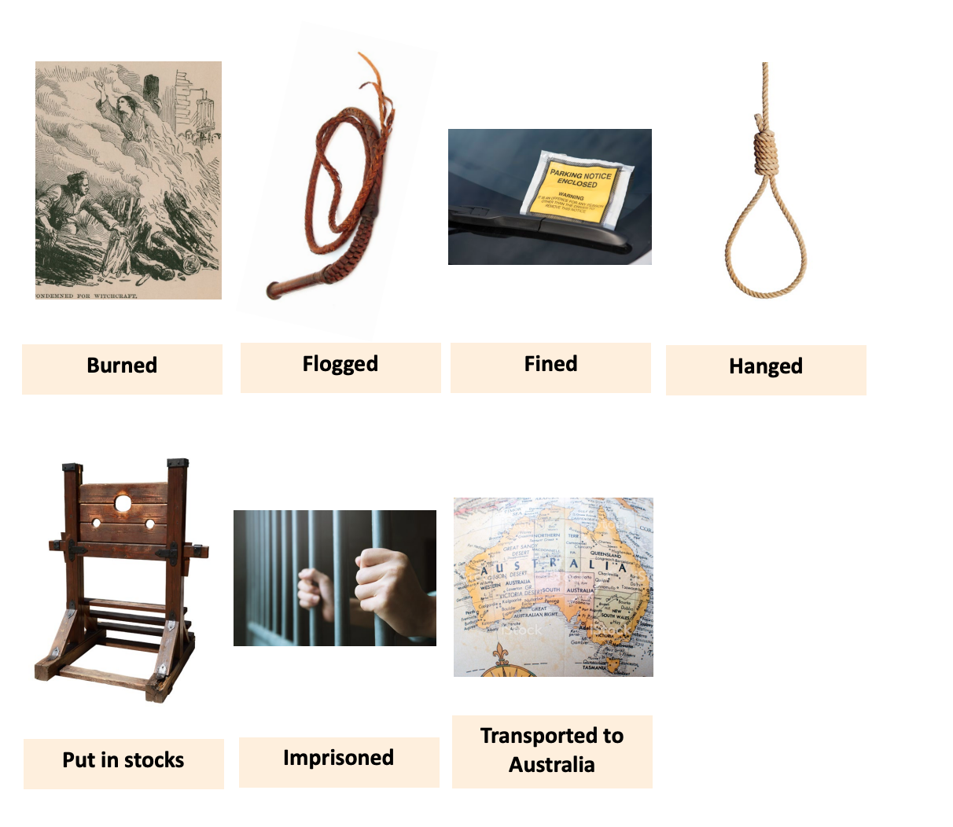
Year 4 – History – Crime and Punishment – Summer 2
Key Vocabulary and Definitions
1 | Society | The term used to describe a group of human beings.
2 | Crime | An illegal act which means someone can be punished for.
3 | Punishment | The penalty for a crime or wrong doing.
4 | Execution | The sentence of death for a crime.
5 | Poaching | Stealing wild creatures from those who own the land or water they live in.
6 | Witchcraft | The practice of magic and/or spells.
7 | Riot | A violent disturbance of the peace by a crowd.
8 | Pillory | A wooden frame with holes for the head and the hands where offenders were placed – usually in a public place.
9 | Transportation | Moving convicts to another country.
10 | Flogging | Punishment where someone is hit with a whip or stick.
11 | Highwayman | A man, usually on horseback, who held up people to rob them.
12 | Smuggling | Illegal movement of goods into or out of a country.
13 | Truncheon | Short, thick stick carried as a weapon by police officers.
What I need to know
1 | Punishments for crimes have changed over a period of time. What a crime is has also changed over time.
2 | Rich people influenced how crimes were punished, and were responsible for passing laws around punishment.
3 | Before the police were formed, towns employed watchmen to patrol the streets.
4 | Transportation was used to remove criminals from the country – most were sent to Australia.
5 | Prisons only became popular in the 1800s.
6 | The campaign for women’s suffrage gained momentum from the 1860s onwards.
Diagrams
What should I already know?
1 | Changes occur over time – for example life has changed between now and the Vikings.
2 | Use a range of sources when researching the past.

