Slide 1

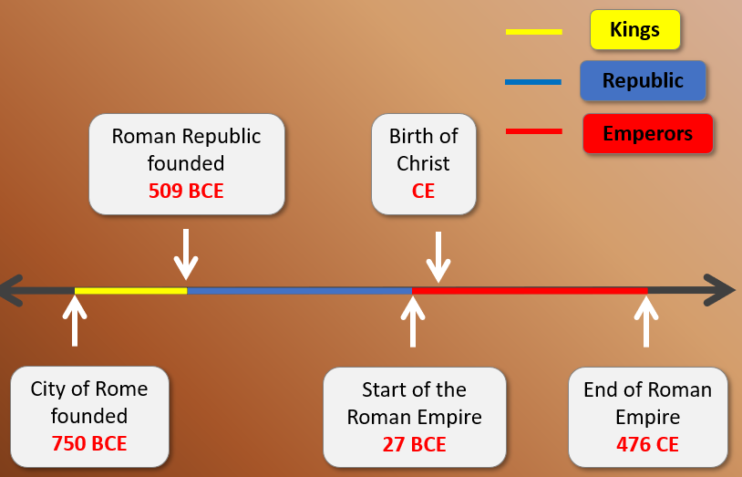
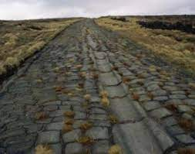
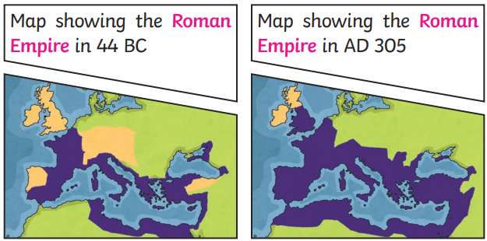
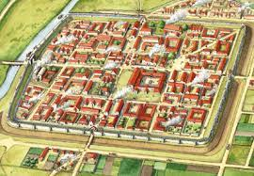
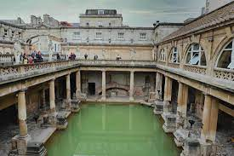
History Knowledge Organiser – Romans – Spring – Year 4
What should I already know?
B.C. means before Christ. A date such as 750BC means 750 years before the year 1 AD (there was no year zero) Sometimes this is called BCE (before common era). A.D. – means Anno Domini in Latin which means ‘in the year of our lord’. A date 43AD means 43 years after Jesus is believed to have been born. Sometimes this is called CE (common era). Between 800BC and 43AD, the land in Britain was inhabited by Iron Age people, later known as Celts. These people lived and farmed in small tribes within hill forts in wooden roundhouses and travelled little.
Key Dates
750 BC | Rome is founded (myth of Romulus and Remus)
55BC | Julius Caesar attempts first invasion of Britain
27BC | Augustus Claudius becomes first Roman Emperor
43AD | Second Roman invasion of Britain
60AD | Tribes lead by Boudicca attack Roman force
410AD | Romans leaves Britain and return to Italy
What I need to know
The Romans came from Rome, a city in the country of Italy. First a King ruled Rome, then it be came a republic and later still it was ruled by an Emperor. Rome started to grow from a small town into a larger city around the Year 750 B.C. The city continued to grow in power and developed into a successful empire which ruled over nearly all of Europe and most of north Africa, including Egypt. In 55BC they first attempted to invade Britain, and in 43AD the invaded again successfully! The Romans settled in Britain until 410AD. It is thought that one of the reasons the Romans invaded Britain was to conquer land, gain more slaves and collect the many precious resources in Britain including metals such as iron, lead, tin, gold and silver.
What Changes Did the Romans make ?
Roads
Architecture
Towns

Slide 2
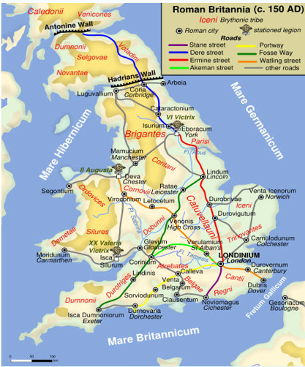
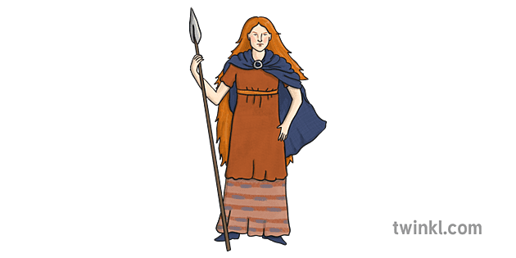
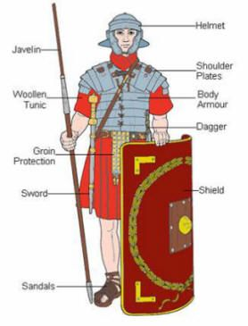
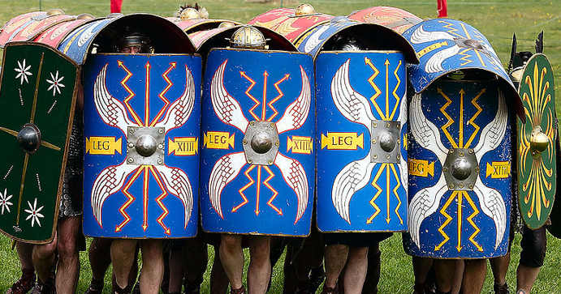
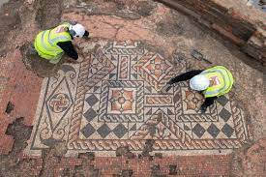
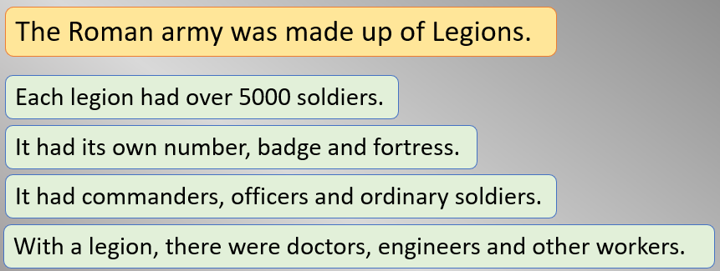
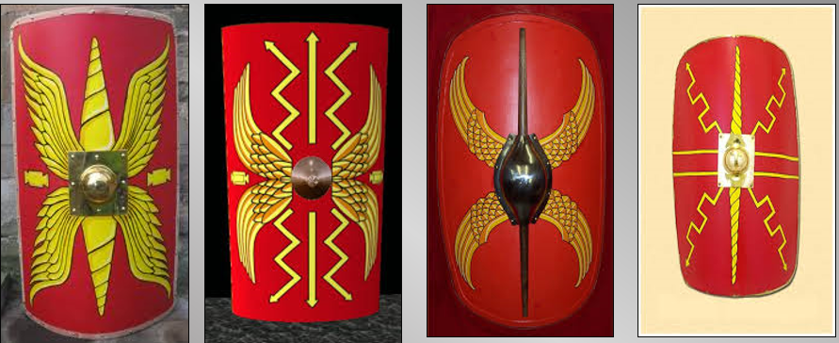
Key Vocabulary
ruling system | A way used to make decisions and lead a country
empire | A group of countries ruled by a single person, government or country
emperor | The ruler of an empire
invade/ invasion | To enter a place in a forceful way
settle | Stay in order to live and develop a home
conquer | To take over
century | A period of 100 years
legion | A large group of soldiers who form and army
legionary | A soldier in the roman army
mosaic | A picture made up of thousands of small tiles
Key Historical Figure
Born: 30 AD Died : 61Ad -Boudicca was a member of the Iceni tribe who lived in Norfolk. The iceni tribe initially were on good terms with the Romans, but this changed -Boudicca was married to King Prasutagus and they had 2 daughters After the King died, the Roman army wanted to take over his land. -Boudicca and her army first attacked Colchester (Camulodunum) and then went onto London (Londonium) -Boudicca’s army was eventually defeated, and it is thought she poisoned herself to avoid capture.
Key Diagrams/Pictures
Roman Roads
Tortoise
Shields

