Slide 1

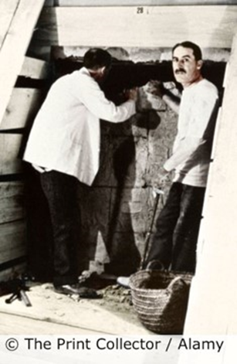
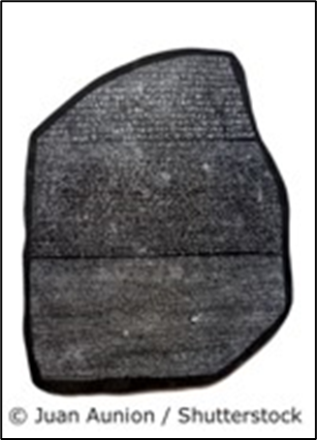
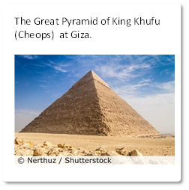


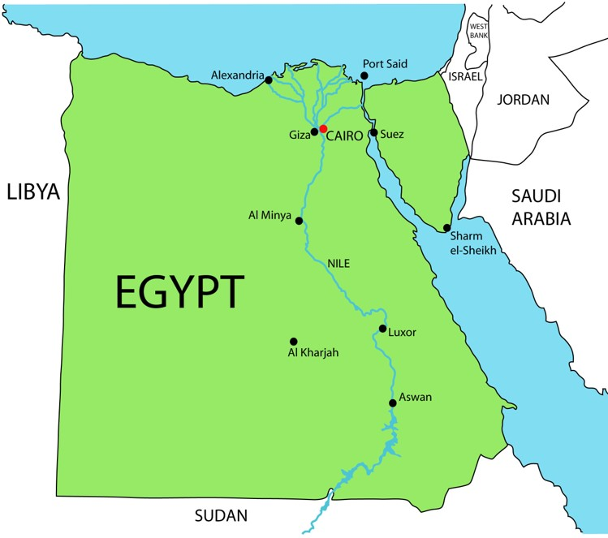
Year 4 -History Knowledge Organiser - The Ancient Egyptians – Autumn 1
Key Learning
We can find out about Ancient Egyptian civilisation by studying archaeological remains and writing. The River Nile was important because it made the land fertile, so the Egyptians could grow crops. It was also used for transport. Society was structured with the pharaoh at the top and slaves at the bottom. Most people in Ancient Egypt were farmers. Ancient Egyptians worshipped over 2000 gods and goddesses. The Ancient Egyptians believed in an afterlife. Archaeologists are able to read hieroglyphics following the discovery of the Rosetta Stone. Howard Carter discovered the tomb of Tutankhamun in November 1922. Many museums in the UK have an Ancient Egyptian collection. The Ancient Egyptians had many achievements in such areas as farming, building, religion, medicine, writing, mathematics and crafts.
Key Vocabulary
Pharaoh | the supreme ruler of Ancient Egypt
Civilization | a group of people living together with advanced ways of living, communicating and working
Achievement | something special reached through hard work or skill
Irrigation: | to bring water from rivers or lakes to the fields
Pyramid | a monument providing a tomb for the pharaoh
BC
AD
3000 | 2500 | 2000 | 1500 | 1000 | 500 | 500 | 1000 | 1500 | 2000 | 2500
The River Nile was important. Egyptians built irrigation systems along the Nile.
Sumer
Shang
Indus valley
Ancient civilisations
What was happening in Britain during this period?
Egypt

