Slide 1

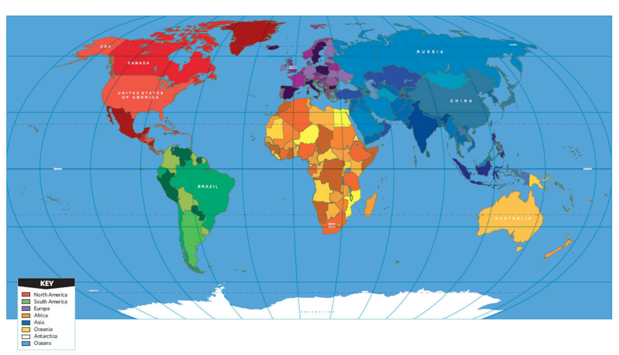
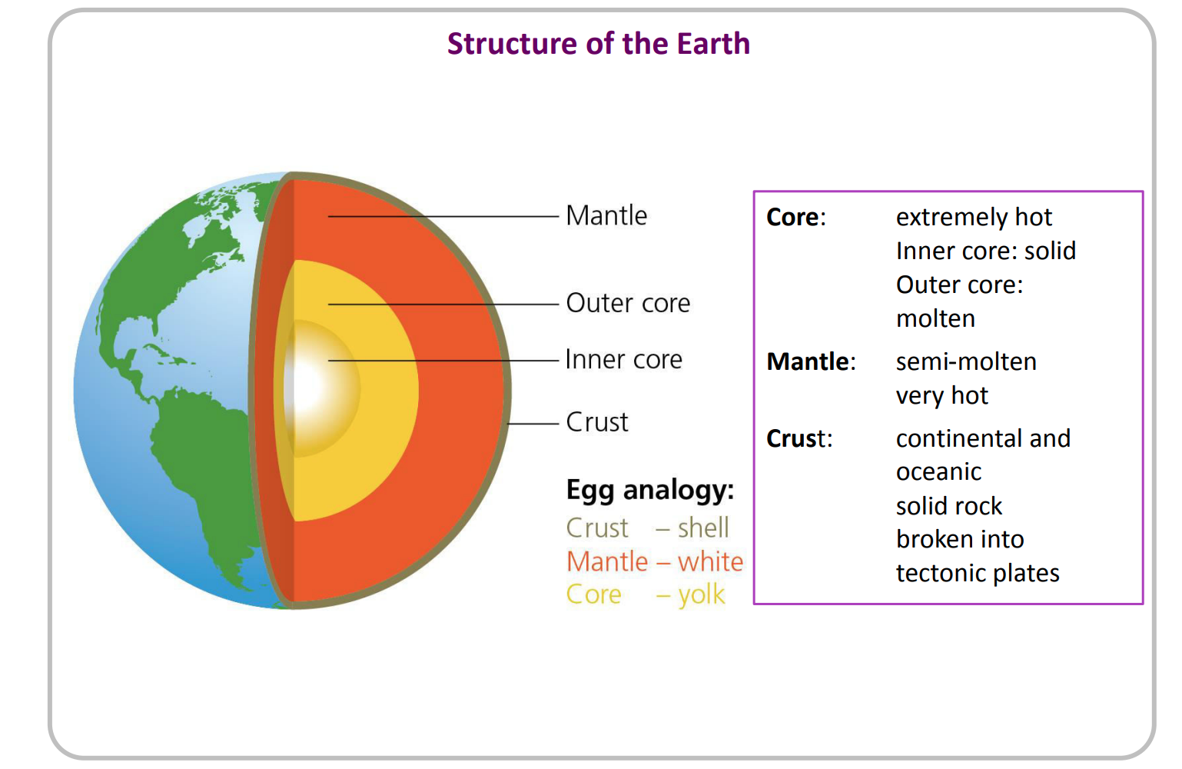
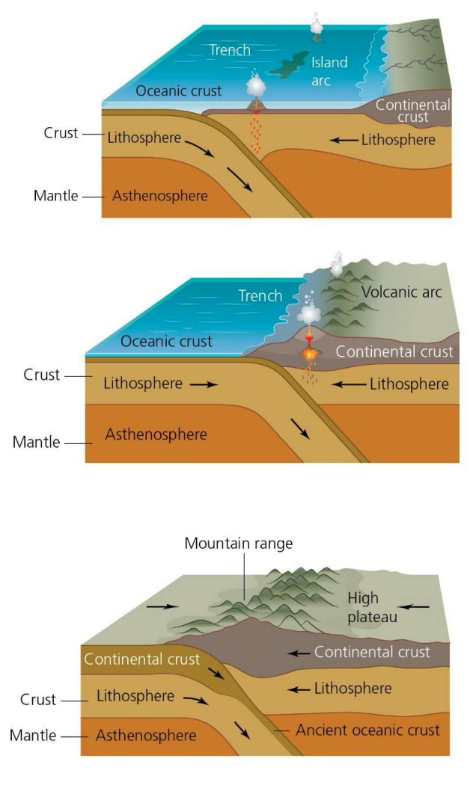
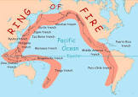
Geography – Earthquakes and Volcanoes - Summer – Year 4
Key Vocabulary and Definitions
1 | Earthquake | Movements, fractures and vibrations in the Earth’s crust as tectonic plates move.
2 | Tectonic Plate | A massive slab of rock that ‘floats’ on top of the mantle (and inner layer) of the Earth.
3 | Core | Extremely hot. Inner core: solid, outer core: molten.
4 | Mantle | Semi molten, very hot. Between the core and the crust.
5 | Crust | Continental and oceanic. Solid rock. Broken into tectonic plates.
6 | Volcano | A vent in the Earth’s crust where lava, steam and ash is ejected during an eruption.
7 | Eruption | The ejection of rock and gas from a volcano.
8 | Hazard | Something that can be dangerous.
9 | Richter Scale | A scale to measure the magnitude of an earthquake.
What I need to know
1 | Describe a volcano, volcanic eruption and an earthquake.
2 | Understand that the distribution of earthquakes and volcanoes follows a pattern.
3 | Understand that the crust of the Earth is made up of tectonic plates.
4 | Use an atlas to locate volcanoes and locations of major earthquakes.
5 | Know that people live in earthquake zones and close to active volcanoes.
6 | Explain how earthquakes occur and volcanoes erupt.
7 | Locate some countries in Europe, North and South America on a map.
8 | Use simple geographical vocabulary to describe significant physical features and talk about how they change.
9 | Learn about the Pacific Ring of Fire.
Diagrams
What should I already know?
1 | Locate some countries on a map in Europe and America.
2 | Compare where we live to a different country, noticing the similarities and differences between where we live, and somewhere else.
Key Volcanoes and Earthquakes
1 | Key Volcanoes | Mount Etna (Italy) Mount Fuji (Japan)
2 | Key Earthquakes | Sumatra (2004) Indonesia Haitian (2010) Caribbean

