Slide 1

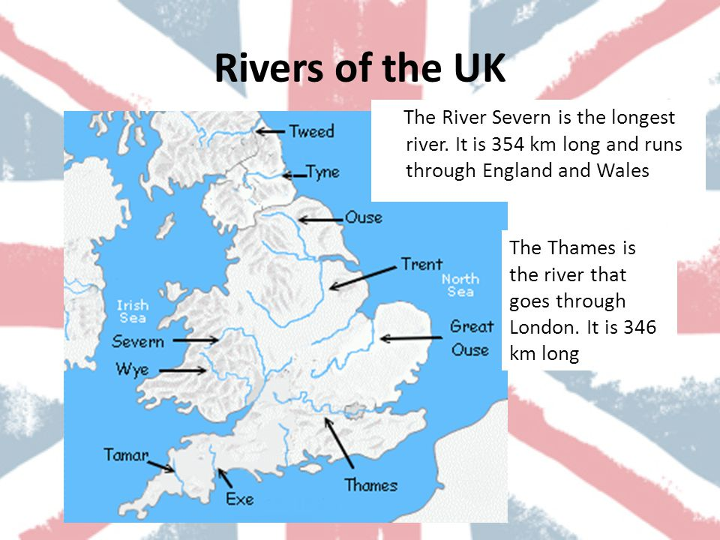
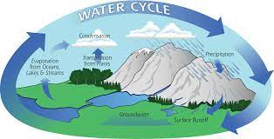
Geography – Rivers and the Water Cycle - Year 4 - Spring 2
Key Vocabulary and Definitions
1 |  | estuary: An estuary is an area where a freshwater river or stream meets the ocean.
2 |  | mouth: A river mouth is the part of a river where the river flows into another river, a lake, a reservoir, a sea, or an ocean.
3 |  | source: The source of a river is where it begins, usually in high ground.
4 |  | meander: A meander is a winding curve or bend in a river.
5 |  | waterfall: Waterfalls form where water rushes down steep hillsides in upland areas and erodes the rocks.
6 |  | erosion: erosion occurs when the fastest currents in the river carve intensely into the banks.
7 |  | deposition: rocks and sediments eroded from one part of the river is deposited in another part
8 |  | deposition: rocks and sediments eroded from one part of the river is deposited in another part
9 |  | stream: A stream is a small body of flowing water.
10 |  | delta: Deltas are often found at the mouth of large rivers.
11 12 |  | ox bow lake: Ox bow lakes are created when the meander is so deep that it cuts off a piece of the meander. tributary: When one stream meets another and merge together, the smaller stream is known as a tributary.
Key Facts
 | A meander is a winding curve or bend in a river. Ox bow lakes are created when the meander is so deep that it cuts off a piece of the meander. The River Nile is the world’s longest river and runs into the Mediterranean. The Amazon River is situated in Brazil and runs through the Amazon Rainforest. Erosion is the wearing away of the land by forces such as water, wind, and ice. Erosion has helped to form many interesting features of the Earth's surface including mountain peaks, valleys, and coastlines. Deposition is when the materials from erosion are dropped in a new location. The source of a river is where it begins, usually in high ground.
3
4
What I need to know
● Name and locate and geographical regions of the UK and recognise their identifying physical characteristics. ● Describe and understand key aspects of physical geography including rivers, mountains and the water cycle. ● Establish an understanding of the interaction between physical and human processes. ● Use maps, atlases, globes and digital/computer mapping to locate countries and describe features studied. ● Use a range of methods including sketch maps, plans and graphs, and digital technologies. ● Use fieldwork to observe, measure, record and present features in the local area (e.g. of activities and models in the school grounds).
Thames
London river
that is 184
miles long
Seven
Britain’s
longest river
(220 miles)
from Wales to
Bristol.
Mersey
Liverpool river
that is 70
miles long
What should I already know?
• Locate and describe physical features (including hills, mountains, coasts, rivers) • The seven continents, five oceans and surrounding seas of the United Kingdom. • The names of some key rivers around the world including the Thames and the Nile. • The water cycle and where our water comes from. • How sedimentary rocks are formed.

