Slide 1

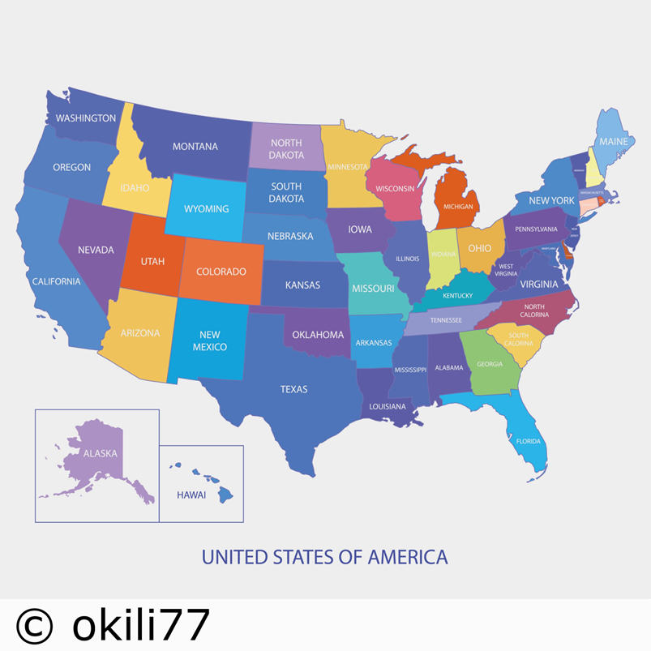
Year 4 -Geography Knowledge Organiser - The Americas - Autumn
Key Learning
To use an atlas to locate many countries, cities and key features in North and South America.
To use a map to locate the states of the USA.
To give direction instructions up to four compass points. .
To use the zoom function to explore places at different scales and add annotations (e.g. using Google Earth independently – starting at Denver, Colorado, near to the centre of the USA – zoom out to identify states, cities and physical features of the USA; locate them on a map)
To make a detailed map of a route with features in the correct order and in the correct places
To describe and compare the physical and human characteristics of some regions in North or South America.
To identify and sequence a range of settlement sizes from a village to a city.
Key Vocabulary
City | A large town. A large human settlement.
State | The United States of America is a federal republic consisting of 50 states.
Continent | any of the world's main continuous expanses of land (Europe, Asia, Africa, North and South America, Australia, Antarctica).
Northern hemisphere | the half of the earth that is north of the equator.
Southern hemisphere | the half of the earth that is south of the equator.
Atlantic ocean | the ocean lying between Europe and Africa to the east and North and South America to the west. It is divided by the equator into the North Atlantic and the South Atlantic oceans.
Pacific ocean | the largest of the world's oceans, lying between America to the east and Asia and Australasia to the west.
Region | any large, indefinite, and continuous part of a surface or space (Physical Geography)
Compass points | the points of the compass are an evenly spaced set of horizontal directions used in navigation and geography.
Landscape | A landscape is part of the Earths surface that can be viewed at one time from one place.
Country | A country is a distinct part of the world, such as a state, nation, or other political entity

Slide 2
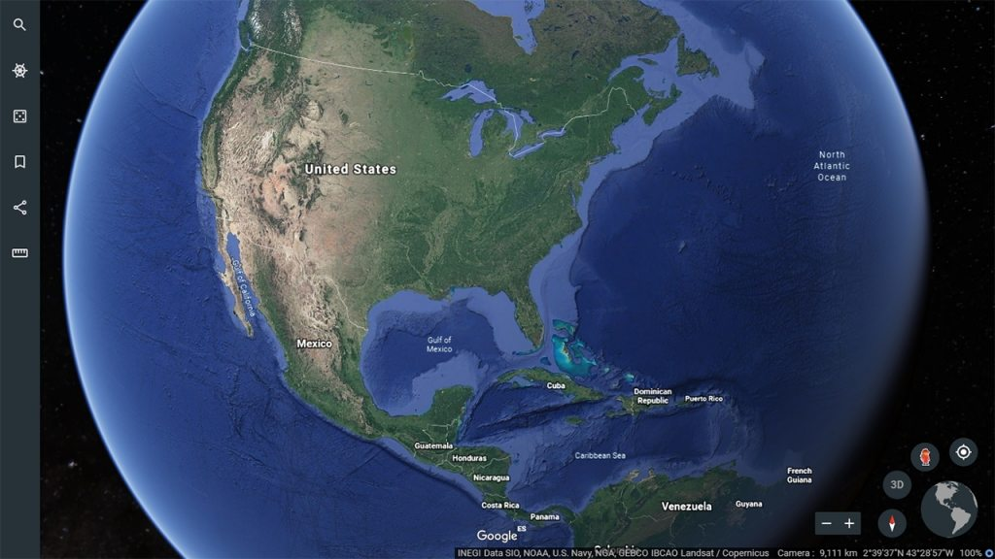
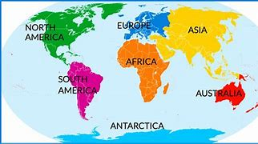
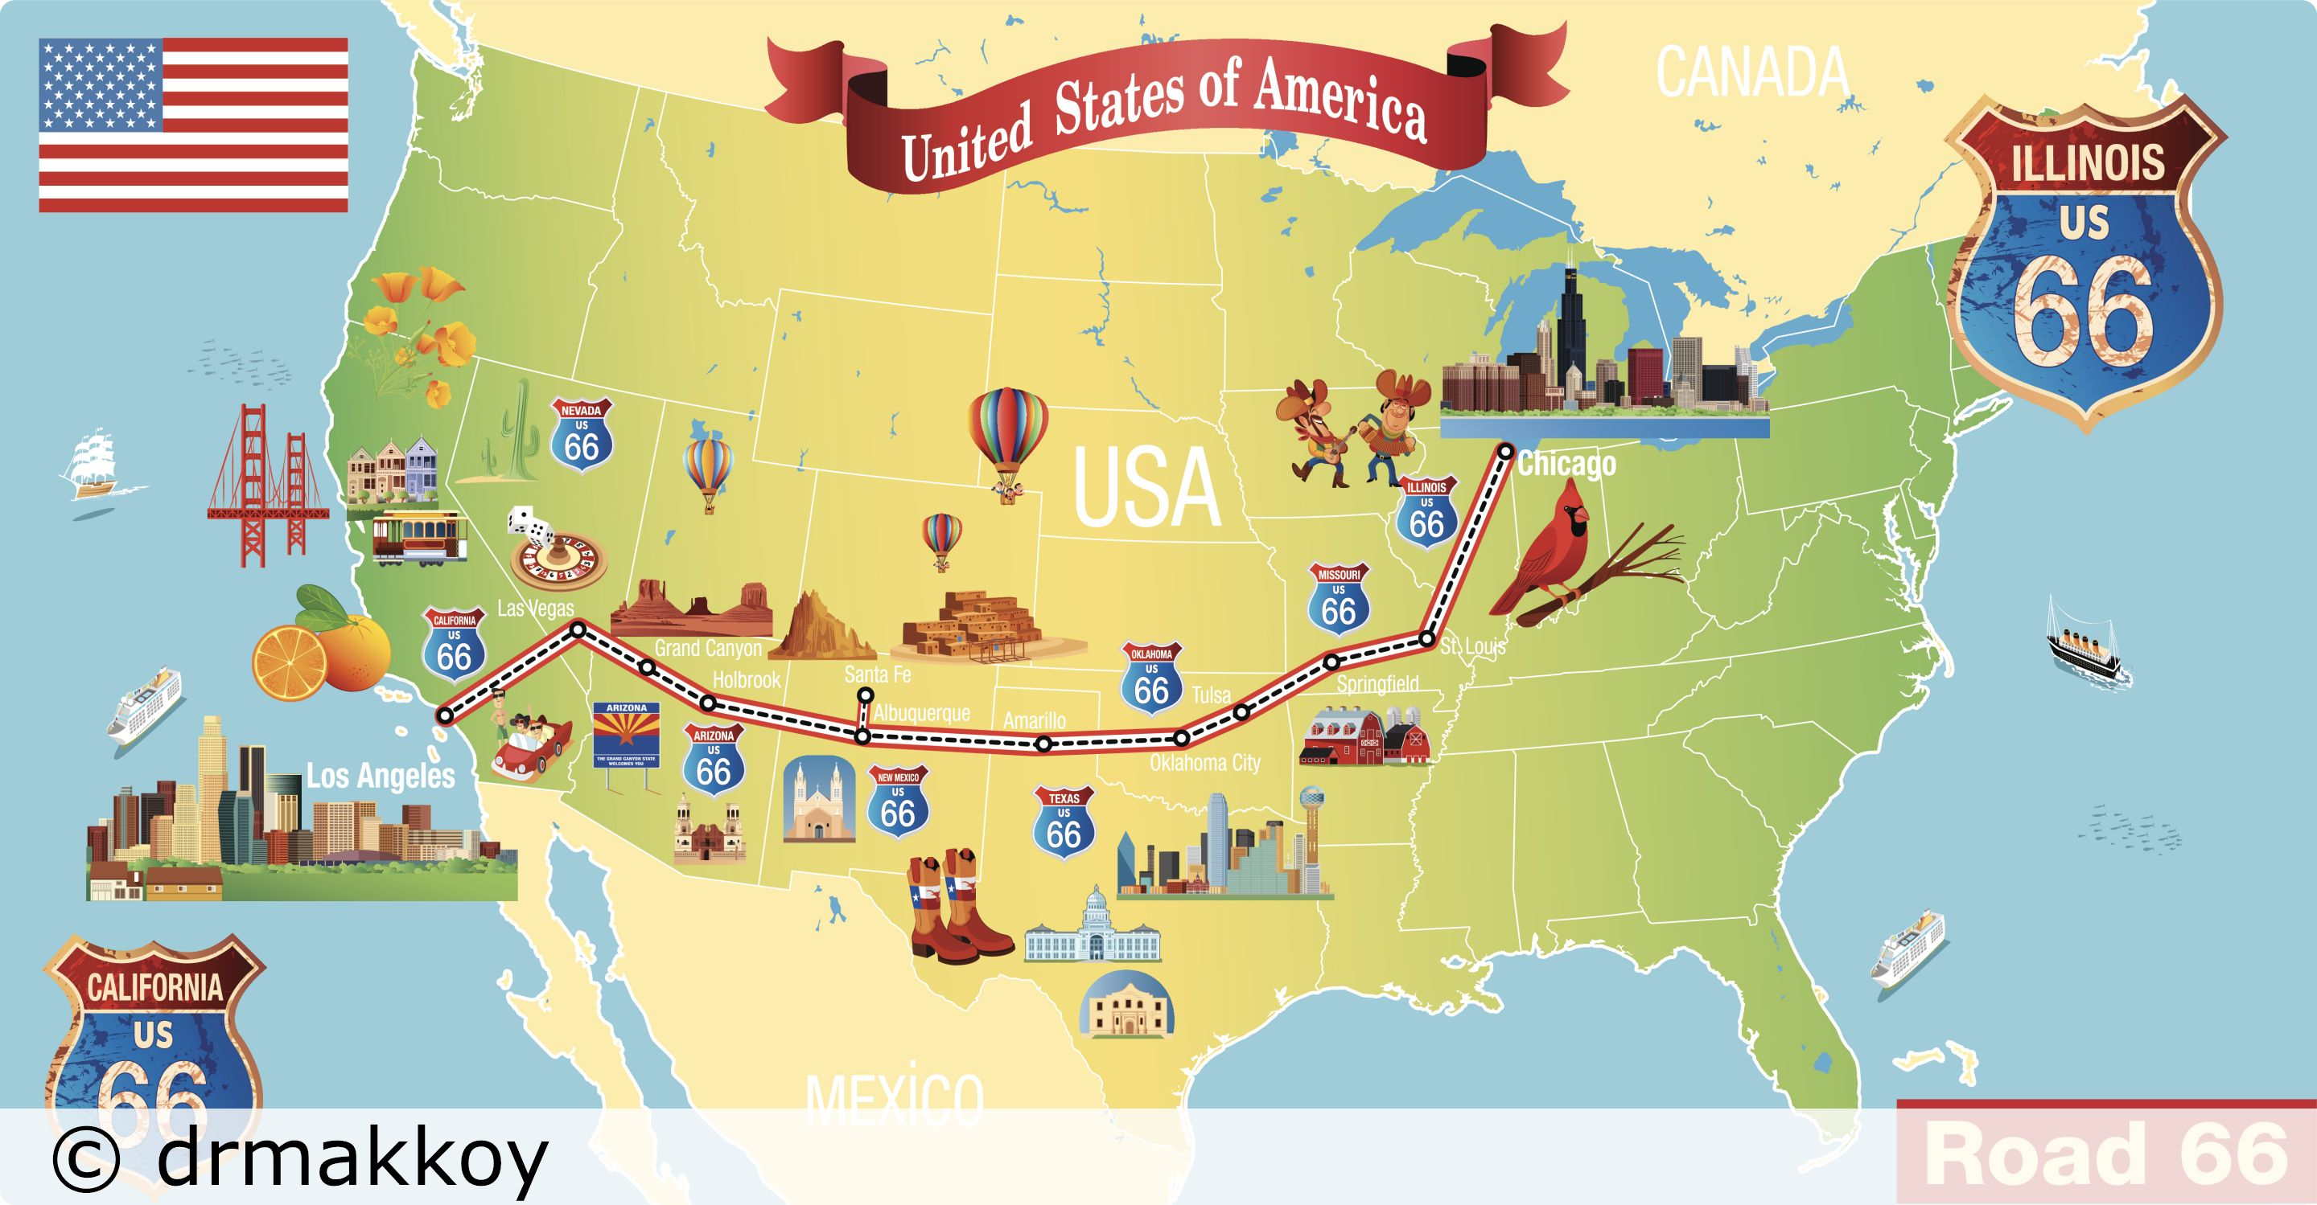
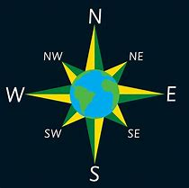
What should I already know?
The names and locations of continents across the world.
That America is split into North and South America.
Simple compass points – N,S,E,W.
Some key states or cities within America
Google Earth
Continents
Route 66
Can you come on a Great American Road Trip?
8 point compass

