Slide 1

DORNEY SCHOOL
We are a Forest School!
Welcome to Year 6
2024-25

Slide 2
Welcome
Your children have made a great start to what we believe is going to be a fantastic year!
The team working in your child’s year group includes:
Mrs Parkash
Mrs Hughes and Mrs Sitaru

Slide 3
Values and Ethos
Respect | Collaborate | Grow
Self | Self | Self
Community | Community | Community

Slide 4
At Dorney School, ours is an education of:
equality, empathy, enquiry, energy and excellence
Equality | Respectful, protected, safe, loyal, acceptance, trustworthy, honesty, conscience, humility
Empathy | Kind, humanity, caring, cooperative, responsible, courageous, appreciative, compassionate, eco-conscious, altruistic
Enquiry | Thirst for knowledge, problem solvers, curious, engaged, creative
Energy | Happy, playful, positive, joyful, friendly, passionate, activism, community
Excellence | Ready, Confident, disciplined, resilient, ambitious, aspirational, proud, determined, motivated, articulate, independent, persevere, risk taker
Notes:
https://www.dbd.group/blog/community-is-a-verb

Slide 5
Working Together
All staff at Dorney are committed to providing the very best for your child. We ask that pupils support us by working their hardest and doing their best every day – they have made an excellent start to this already.☺
We ask that parents and families support us by encouraging your children to be the best they can be at Dorney, by fostering a growth mindset, understanding that there may be occasions where things don’t go to plan and being positive about the school and learning.
The class teacher is always the first port of call for any ideas, queries or concerns (we will return to how best get in touch later in the meeting).

Slide 6
What to expect in Year 6 - Organisation
A reminder of full school uniform (this includes hair accessories, and appropriate shoes). The children currently look smart☺
No jewellery (unless it is for religious reasons), nail varnish, hair extensions
Only black, plain ankle boots in winter
PE days are Monday and Friday. Please refer to the uniform list on the school website.
Water bottle (named) - plain water only; no juices or flavoured drinks
Healthy snack (fruit or vegetable, no crisps or biscuits)
Pencil case – clear and basic equipment as requested
Healthy packed lunch if not booked for school packed lunch
Please have reading books in school everyday and reading records
Classroom staff will check records and change books on Fridays.
Book borrowing day will be Friday – so class library book will need to be brought in on this day.

Slide 7
What to expect in Year 6
Reading books have been sent out. When your child has finished their books please bring them into school and they will be changed (this can be Friday or any day as needed) as regularly as possible. The number of books will vary as children begin to access longer books.
If you need more reading material before the weekend, then children are welcome to ask us and we will facilitate this.
Try to aim to read with your child at least 3 - 4 times a week. This will greatly support your child’s progress.
Do read to your child and visit the local library.
In Year 6 we will continue to shift the focus of reading from learning to decode words, to develop a deeper understanding of texts and word choices within texts. Talking, discussing themes, characters, plots, phrases and new vocabulary with your child is so important.
Please record reading at home by writing comments on your child’s fluency or if they found the book particularly challenging. Teachers will not be recording in these books for most children but adults will read with all children as much as possible in a variety of ways. Teachers teach Guided Reading for a minimum of 30 minutes daily (in different lessons) and will discuss your child’s progress at parents evenings, or as and when necessary.
If volunteers read with your children, they may record in the reading record.

Slide 8
What to expect in Year 6 – Home learning
Any home learning will be set on a Friday via Purple Mash. This will be due in the following Thursday, again via Purple Mash.
Spellings will be set on a Friday via Purple Mash. There will be no formal ‘test’ in class, but learning is checked during spelling sessions, English lessons and through ongoing writing. We will do an informal check on Friday’s during our English lesson.
Please also try to access TTRS regularly to keep up times tables learning – this year the focus will be on revising on all times tables and apply this to division facts. This is essential for many different areas of Maths learning.

Slide 9
Curriculum - Autumn Overview
English – The Arrival- Shaun Tan, the Invention of Hugo Cabret- Brian Selznick, Windrush Child- Benjamin Zephaniah
Guided Reading – Fly Me Home- Polly Ho Yen, On the move poems about migration- Michael Rosen
Maths – Place Value, Addition/Subtraction, Multiplication/Division.
Science – Living things and their Habitats.
Geography/History – South America- Amazon Rainforest, The Maya Civilisation
P.E. – REAL PE- Personal Skills, Ball Games
Art/D.T – People in Action, Textiles
PSHE – Respectful relationships
R.E. – Islam. Christianity
Computing – Coding
Music – Exploring descriptive sounds
French – Greetings, classroom instructions, saying your name and colours
Forest School – outdoor exploration, tree logs and campfires!
All this, forest school and daily active minutes, daily story time and
assemblies/outdoor activities!

Slide 10
Year 6 Class Timetable
 | Monday | Tuesday | Wednesday | Thursday | Friday
AM | Assembly English Guided Reading | Open Book Assembly (fortnightly) English Reading For Pleasure | English Guided Reading | English Reading For Pleasure | English Spellings Guided Reading
AM | Maths Maths Fluency | Maths Maths Fluency | Maths Maths Fluency | Maths Maths Fluency | Maths Maths Fluency
PM | PE (Mrs Hughes) | Art/DT | French | History/Geography | RE
PM | Forest School Music (Mrs Hughes) | Lyfta PSHE Newsround | Science Newsround | Computing Newsround | PE Newsround
 | Active minutes will occur daily but will vary timings depending on lessons

Slide 11
Curriculum – Knowledge Organisers
We have been working hard in school to create knowledge organisers which are summaries of the key learning points and vocabulary connected to a topic.
We have created them and are currently using them to drive teaching in Science, Geography, History and RE.
These are available on the school website and will give you great insight to your child’s learning. It is a great way to support your child’s learning and have a summary of their learning to look at during and after the topic.

Slide 12
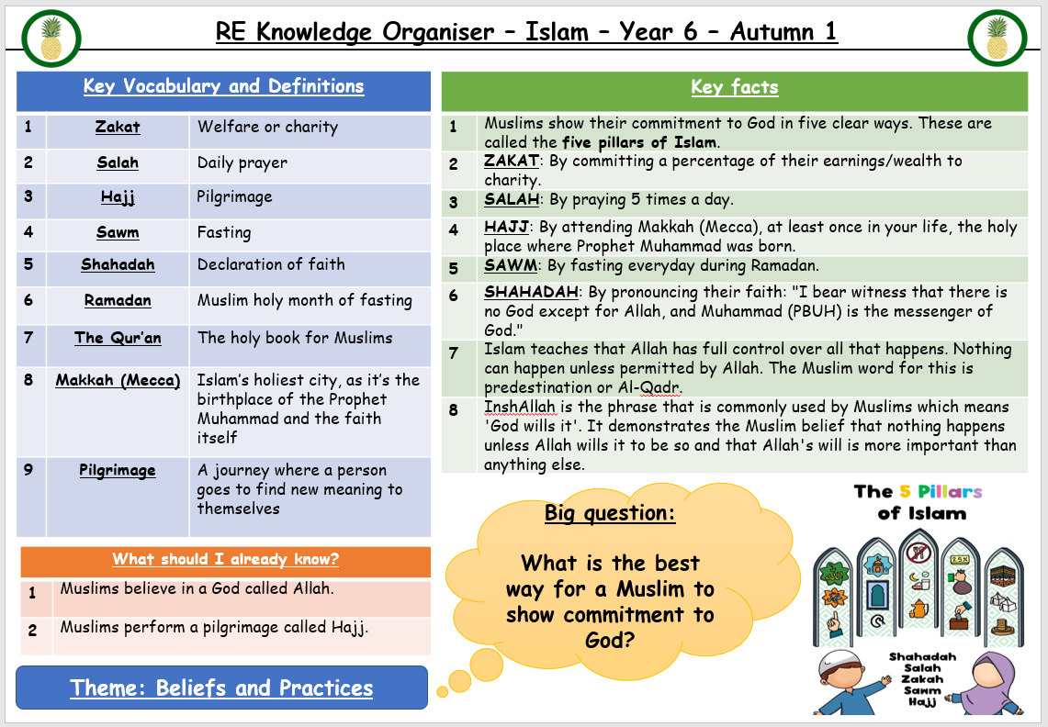

Slide 13
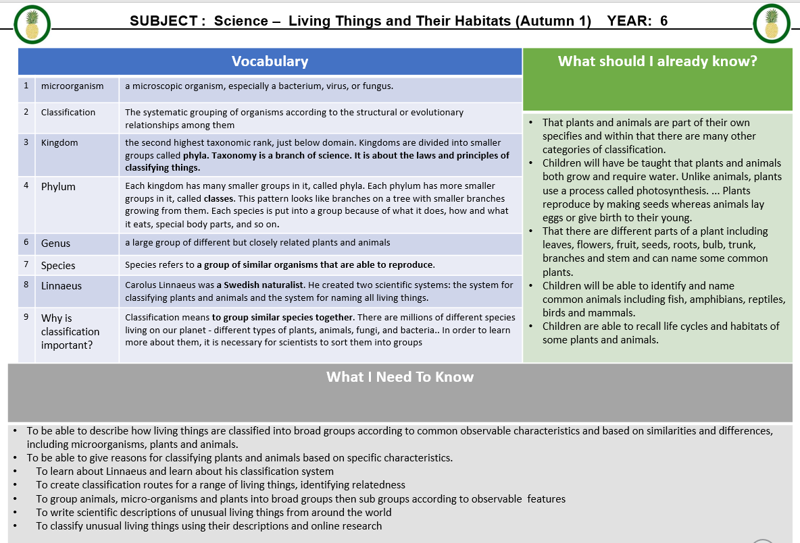

Slide 14
SATS Dates
SATS WC 12th May 2025
A more informative meeting will be held around April time next year on this.

Slide 15
WOODROW
WOODROW- Wednesday 11th- Friday 13th June 2025
Costing: £305 per pupil
We will be asking them for a £55 non-refundable deposit in the coming weeks, together with the parental consent form.
Once parents have confirmed, we can finalise the overall cost per pupil, we normally set up a payment plan over 5 months for £50 a month, we will need to have all funds received by the end of April.
You are welcome to pay the total up front should you choose to.

Slide 16
Communication
We encourage you to raise any concern or pass on suggestions as early as possible, so we can work as a team to support your child.
The first port of call if you have a worry is the class teacher where possible.
Best time to catch us face to face is at the end of the day, for a quick query or we can arrange a time to sit down and meet if more appropriate.
You can also reach us by emailing the school office or leaving a message on the school voicemail service. We will get back to you as soon as we can.
We are committed to building a positive partnership, so please do get in touch if you think it could be helpful.

Slide 17

Parent-Teacher Association
Amazing group
All parents are automatically members
Organises events for vital fundraising
Vacancies for roles or general help
Can you offer additional help for events?
They need you. We need you!
Infrequent meetings and meetings are mainly virtual
Get in touch:
dorneyschoolpta@gmail.com
office@dorneyschool.co.uk
Would be amazing to welcome parents from underrepresented groups

Slide 18


Thank you for listening
Does anybody have any questions ?

