Slide 1

DORNEY SCHOOL
We are a Forest School
Welcome to Year 4
2024-25

Slide 2
Welcome
Your children have made a great start to what we believe is going to be a fantastic year !
The team working in your child’s year group includes:
Mrs Wilson and Mrs Chaggar
Mrs Maguire supports our class in the morning
Don’t be concerned by job share – good communication and handover and fresh teacher halfway through the week.

Slide 3
Values and Ethos
Respect | Collaborate | Grow
Self | Self | Self
Community | Community | Community

Slide 4
At Dorney School, ours is an education of:
equality, empathy, enquiry, energy and excellence
Equality | Respectful, protected, safe, loyal, acceptance, trustworthy, honesty, conscience, humility
Empathy | Kind, humanity, caring, cooperative, responsible, courageous, appreciative, compassionate, eco-conscious, altruistic
Enquiry | Thirst for knowledge, problem solvers, curious, engaged, creative
Energy | Happy, playful, positive, joyful, friendly, passionate, activism, community
Excellence | Ready, Confident, disciplined, resilient, ambitious, aspirational, proud, determined, motivated, articulate, independent, persevere, risk taker
Notes:
https://www.dbd.group/blog/community-is-a-verb

Slide 5
Working Together
All staff at Dorney are committed to providing the very best for your child. We ask that pupils support us by working their hardest and doing their best every day – they have made an excellent start to this already ☺
We ask that parents and families support us by encouraging your children to be the best they can be at Dorney, by fostering a growth mindset, understanding that there may be occasions where things don’t go to plan and being positive about the school and learning.
The class teacher is always the first port of call for any ideas, queries or concerns (we will return to how best get in touch later in the meeting).

Slide 6
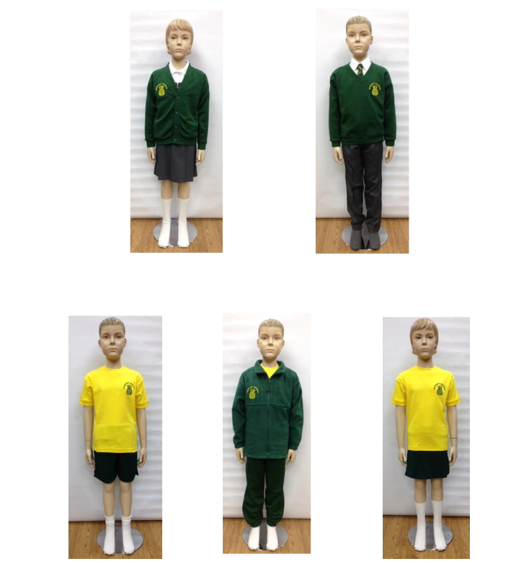
What to expect in Year 4 - Organisation
We’ll start with a gentle reminder of full school uniform (this includes hair accessories, and appropriate shoes). The children look smart currently ☺
PE days are Monday and Friday. Please refer to the uniform list on the school website.
Water bottle (named) - plain water only; no juices or flavoured drinks

Slide 7
What to expect in Year 4 - Organisation
A reminder of full school uniform (this includes hair accessories, and appropriate shoes). The children currently look smart☺
No jewellery (unless it is for religious reasons), nail varnish, hair extensions
Only black, plain ankle boots in winter
PE days are Mondays and Fridays. Please refer to the uniform list on the school website.
Water bottle (named) - plain water only; no juices or flavoured drinks
Healthy snack (fruit or vegetable, no crisps or biscuits)
Pencil case – clear and basic equipment as requested
Healthy packed lunch if not booked for school packed lunch
Please have reading books in school everyday and reading records
Classroom staff will check records and change books on Mondays.
Book borrowing day will be Monday – so class library book will need to be brought in on this day.

Slide 8
What to expect in Year 4 - Reading
If you need more reading material before the weekend, then children are welcome to ask us and we will facilitate this.
Try to aim to read with your child at least 4 times a week. This will greatly support your child’s progress. You will be invited to a reading workshop over the coming weeks.
Do read with your child, and visit the local library
In Year 4 we will continue to shift the focus of reading from learning to decode words, to develop a deeper understanding of texts and word choices within texts. Talking, discussing themes, characters, plots, phrases and new vocabulary with your child is so important.
Please record reading at home by writing comments on your child’s fluency or if they found the book particularly challenging. Teachers will not be recording in these books for most children but adults will read with all children as much as possible in a variety of ways. Teachers teach Reading for a minimum of 30 minutes daily and will discuss your child’s progress at parents evenings, or as and when necessary.
If volunteers read with your children, they may record in the reading record.

Slide 9
Autumn term Overview
English The Mermaid of Zennor Varmints | Maths Place Value Addition and Subtraction
Science: White rose Group and classify living things Data Collection A States of Matter | History Egyptians How much did the Ancient Egyptians achieve?
RE – Buddhism Is it possible for everyone to be happy? | Art/DT Viewpoints
Music Charanga | PE Unit 1: Personal FUNS 1: Static Balance FUNS 10: Co-ordination and Footwork
Reading :Literacy tree The Undefeated Zombierella | Phonics/SPAG (where relevant) Starting from Spring 1, week 4 of Phonics books
Extra curricular activities Visit Eton College for an Egyptian Workshop | Computing Coding and Online Safety
PSHE Relationships (Caring, freidnships, being safe, families and people who care for me, respectful relationships) Growth Mindset Learning Pit Zones of Regulations Lyfta | French Getting to Know you

Slide 10
What to expect in Year 4 – Home learning
Spellings will be set on a Friday via Purple Mash. There will be no formal test in class, but learning is checked during spelling sessions, English lessons and through ongoing writing.
Please also try to access TTRS regularly to keep up times tables learning.

Slide 11
What to expect in Year 4 – Home learning
Any home learning will be set on a Friday via Purple Mash. This will be due in the following Thursday, again via Purple Mash.
Spellings will be set on a Friday via Purple Mash. There will be no formal ‘test’ in class, but learning is checked during spelling sessions, English lessons and through ongoing writing. We will do an informal check on Friday’s during our English lesson.
Please also try to access TTRS regularly to keep up times tables learning – this year the focus will be on revising on all times tables and apply this to division facts. This is essential for many different areas of Maths learning.

Slide 12
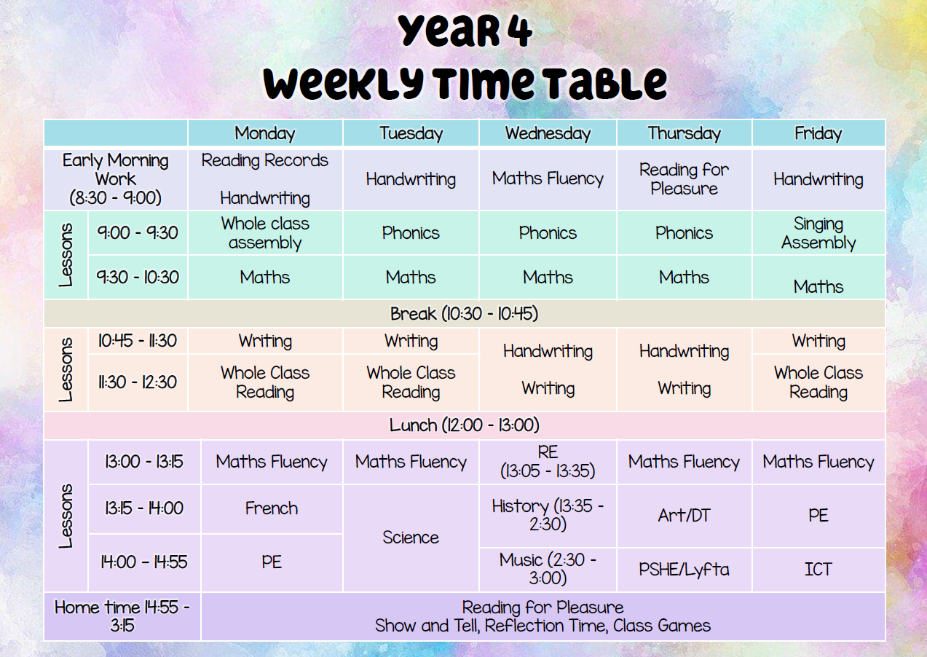

Slide 13
Curriculum – Knowledge Organisers
We have been working hard in school to create knowledge organisers which are summaries of the key learning points and vocabulary connected to a topic.
We have created them and are currently using them to drive teaching in Science, Geography, History and RE (please see website) and are a great way for children to have a summary of their learning to look at during and after the topic.

Slide 14
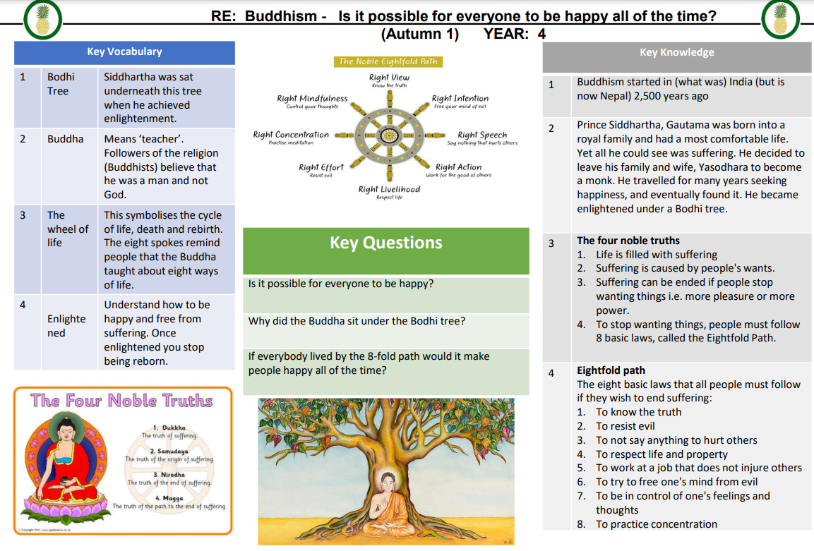

Slide 15
Curriculum – Knowledge Organisers
These are available on the school website and will give you great insight to your child’s learning and a great way to support your child’s learning

Slide 16
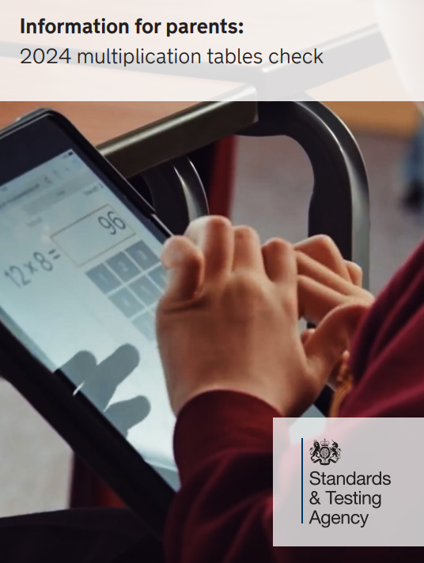
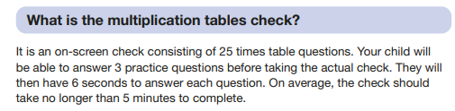
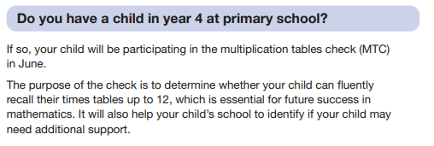

Slide 17
Communication
We encourage you to raise any concern or pass on suggestions as early as possible, so we can work as a team to support your child.
The first port of call if you have a worry is the class teacher where possible.
Best time to catch us face to face is at the end of the day, for a quick query or we can arrange a time to sit down and meet if more appropriate.
You can also reach us by emailing the school office or leaving a message on the school voicemail service. We will get back to you as soon as we can
We are committed to building a positive partnership, so please do get in touch if you think it could be helpful

Slide 18

Parent-Teacher Association
Amazing group
All parents are automatically members
Organises events for vital fundraising
Vacancies for roles or general help
Can you offer additional help for events?
They need you. We need you!
Infrequent meetings and meetings are mainly virtual
Get in touch:
dorneyschoolpta@gmail.com
office@dorneyschool.co.uk
Would be amazing to get parents from underrepresented groups

Slide 19
Thank you for listening
Does anybody have any questions ?

