Slide 1

DORNEY SCHOOL
We are a Forest School
Welcome to Year 3
2024-25

Slide 2
Welcome
Your children have made a great start to what we believe is going to be a fantastic year!
The team working in your child’s year group includes:
Miss Ambrose
Miss Semplis

Slide 3
Working Together
All staff at Dorney are committed to providing the very best for your child. We ask that pupils support us by working their hardest and doing their best every day – they have made an excellent start to this already ☺
We ask that parents and families support us by encouraging your children to be the best they can be at Dorney, by fostering a growth mindset, understanding that there may be occasions where things don’t go to plan and being positive about the school and learning
The class teacher is always the first port of call for any ideas, queries or concerns (we will return to how best get in touch later in the meeting)

Slide 4
What to expect in Year 3 - Organisation
We’ll start with a gentle reminder of full school uniform (this includes hair accessories, and appropriate shoes). The children look smart currently ☺
PE days are Tuesday and Wednesday. Please refer to the uniform list on the school website.
Water bottle (named) - plain water only; no juices or flavoured drinks
Healthy snack (fruit or vegetable)
Pencil case – clear and basic equipment as requested.
Healthy packed lunch if not booked for school dinner
Reading books – these are issued on Friday please have in school everyday with reading record books.
Library day will be Friday so library book will need to be brought in on this day

Slide 5
What to expect in Year 3 - Reading
Reading books will be given out on a Monday and will be changed the following Monday.
If you need more reading material before the weekend, then children are welcome to ask us and we will facilitate this.
Try to aim to read with your child at least 4 times a week. This will greatly support your child’s progress. You will be invited to a reading workshop over the coming weeks.
Do read to your child, and visit the local library
In Year 3 we will continue to shift the focus of reading from learning to decode words, to develop a deeper understanding of texts and word choices within texts. Talking, discussing themes, characters, plots, phrases and new vocabulary with your child is so important.
Please record reading at home by writing comments on your child’s fluency or if they found the book particularly challenging. Teachers will not be recording in these books for most children but adults will read with all children as much as possible in a variety of ways. Teachers teach Reading for a minimum of 30 minutes daily and will discuss your child’s progress at parents evenings, or as and when necessary.
If volunteers read with your children, they may record in the reading record.

Slide 6
What to expect in Year 3 – Home learning
Spellings will be set on a Friday via Purple Mash. There will be no formal test in class, but learning is checked during spelling sessions, English lessons and through ongoing writing.
Please also try to access TTRS regularly to keep up times tables learning – this year the focus will be on revising 2, 10 and 5 times tables and focussing new learning on multiplication and division facts.

Slide 7
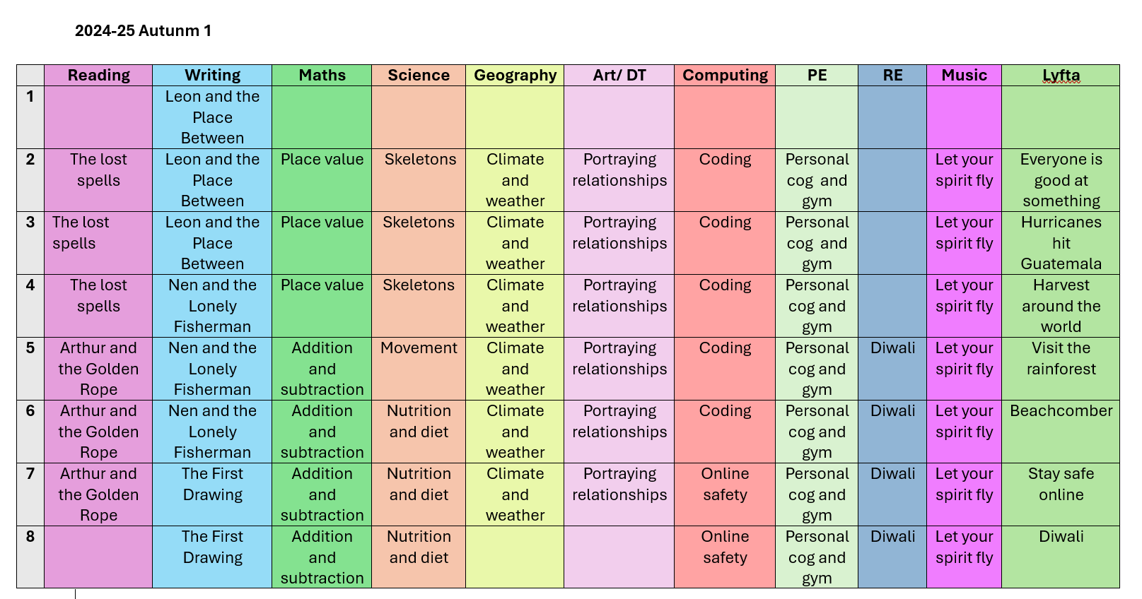
Curriculum - Autumn Overview

Slide 8
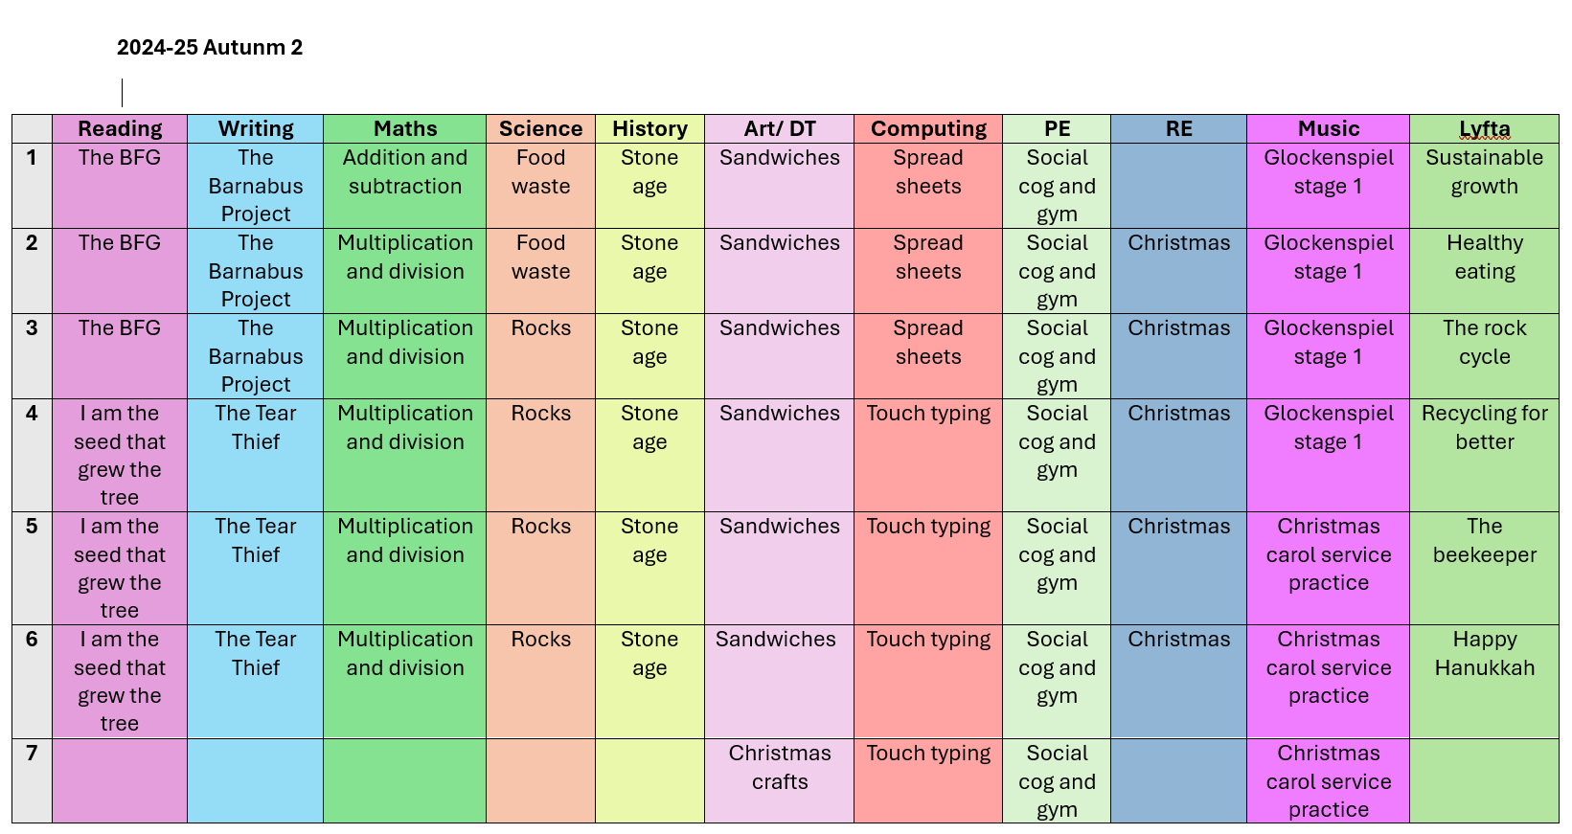
Curriculum - Autumn Overview

Slide 9
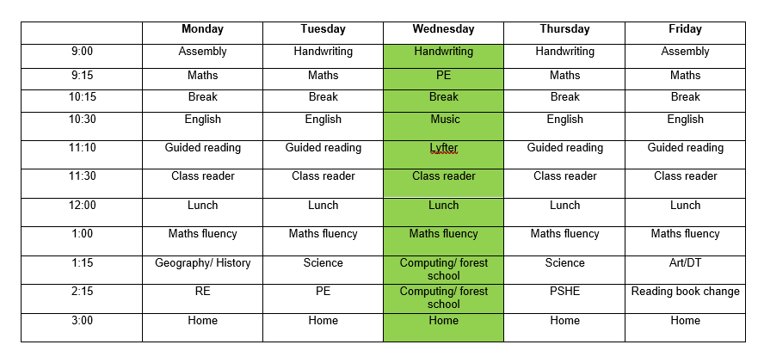

Slide 10
Curriculum – Knowledge Organisers
We have been working hard in school to create knowledge organisers which are summaries of the key learning points and vocabulary connected to a topic.
We have created them and are currently using them to drive teaching in Science, Geography, History and RE (please see website) and are a great way for children to have a summary of their learning to look at during and after the topic.

Slide 11
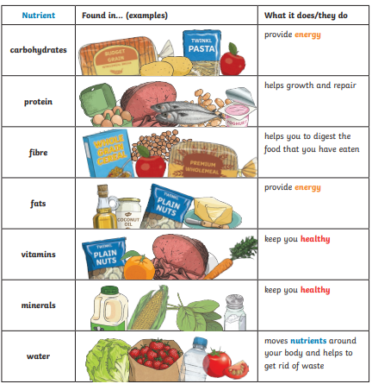
ANIMALS INCLUDING HUMANS – YEAR 3 SCIENCE
Prior Learning
Identify and name a variety of common animals including fish, amphibians, reptiles, birds and mammals. (Y1) Identify and name a variety of common animals that are carnivores, herbivores and omnivores. (Y1) • Describe and compare the structure of a variety of common animals (fish, amphibians, reptiles, birds and mammals, including pets). (Y1) • Find out about and describe the basic needs of animals, including humans, for survival (water, food and air). (Y2) • Describe the importance for humans of exercise, eating the right amounts of different types of food, and hygiene. (Y2)
Key Nutrients
Key Learning - Nutrition
To grow, be strong and stay healthy, humans need to exercise, eat a healthy diet and be hygienic. Animals, unlike plants which can make their own food, need to eat in order to get the nutrients. Food contains a range of different nutrients that the body needs – carbohydrates (including sugars), protein, vitamins, minerals, fats, sugars, water – and fibre. Humans, and some other animals, have skeletons and muscles which help them move and provide protection and support.
Key Vocabulary
healthy | in a good physical and mental condition
nutrients | substances that living things need to stay alive and healthy
energy | strength needed to move and grow
saturated fats | type of fat considered to be less healthy – should be eaten in small amounts
unsaturated fats | fats that give you energy, vitamins and minerals

Slide 12
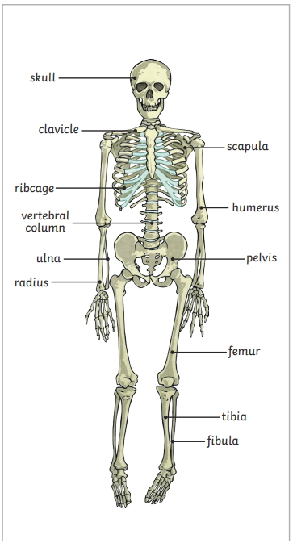
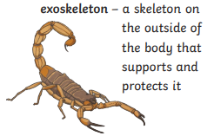
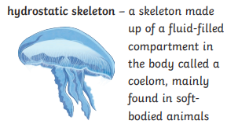
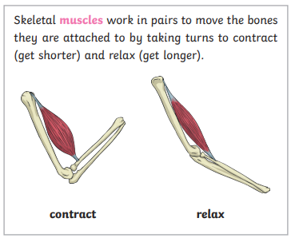
ANIMALS INCLUDING HUMANS – YEAR 3 SCIENCE
Key Learning - Skeletons
Skeletons do three important jobs: protect organs inside the body allow movement support the body and stop it from falling to the floor
Key Diagrams
Humans are vertebrates with a endoskeleton. This is a skeleton on the inside of the body that supports and protects it.
Key Vocabulary
vertebrate | animals with backbones
invertebrate | animals without backbones
muscles | soft tissues in the body that contract and relax to cause movement
tendons | cords that join muscles to bones
joints | areas where two or more bones are fitted together
I
N
V
E
T
E
B
R
A
T
E
S
Investigation Skills
- Classify food in a range of ways. - Collect data and look for patterns in diet - Use secondary sources to research the parts and functions of the skeleton. -Investigate patterns asking questions such as: ▪ Can people with longer legs run faster? ▪ Can people with bigger hands catch a ball better? - Compare, contrast and classify skeletons of different animals.

Slide 13
Curriculum – Knowledge Organisers
These are available on the school website and will give you great insight to your child’s learning and a great way to support your child’s learning

Slide 14
Communication
We encourage you to raise any concern or pass on suggestions as early as possible, so we can work as a team to support your child.
The first port of call if you have a worry is the class teacher where possible.
Best time to catch us face to face is at the end of the day, for a quick query or we can arrange a time to sit down and meet if more appropriate.
You can also reach us by emailing the school office or leaving a message on the school voicemail service. We will get back to you as soon as we can
We are committed to building a positive partnership, so please do get in touch if you think it could be helpful

Slide 15

Parent-Teacher Association
Amazing group
All parents are automatically members
Organises events for vital fundraising
Vacancies for roles or general help
Can you offer additional help for events?
They need you. We need you!
Infrequent meetings and meetings are mainly virtual
Get in touch:
dorneyschoolpta@gmail.com
office@dorneyschool.co.uk
Would be amazing to get parents from underrepresented groups

Slide 16
Thank you for listening
Does anybody have any questions ?

