Slide 1

DORNEY SCHOOL
We are a Forest school
Welcome to Year 2
2024-25

Slide 2
Welcome back!
Your children have made a great start to what I know will be a fabulous year.
The team working in your child’s year group includes:
  Mrs. Kumar
  Mrs Khakh
  Mrs. Minhas
  Mrs Hughes/Mrs Lee (Fridays)

Slide 3
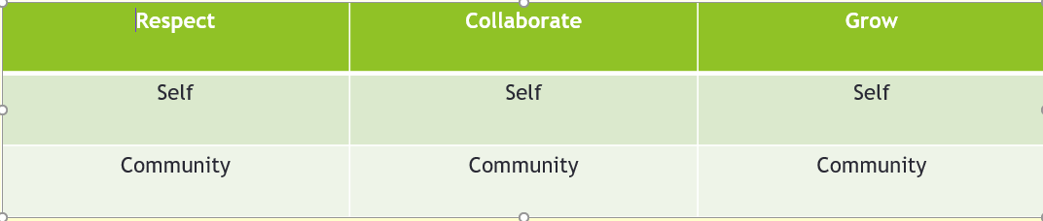
Values and Ethos

Slide 4

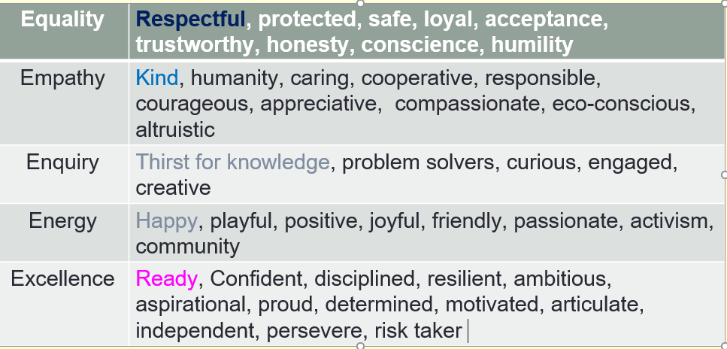
At Dorney School, ours is an education of: equality, empathy, enquiry, energy and excellence

Slide 5
Working Together
All staff at Dorney are committed to providing the very best for your child. We ask that pupils support us by working their hardest and doing their best every day – they have made an excellent start to this already ☺
We ask that parents and families support us by encouraging your children to be the best they can be at Dorney, by fostering a growth mindset, understanding that there may be occasions where things don’t go to plan and being positive about the school and learning.
The class teacher is always the first port of call for any ideas, queries or concerns (we will return to how best get in touch later in the meeting.)

Slide 6
What to expect in Year 2 - Organisation
Gentle reminder of full school uniform (this includes hair accessories, and appropriate shoes).
PE days are Monday and Friday.
Water bottles should be named and filled with plain water only
Healthy snack (please be aware that we are a nut free school)
Pencil case – basic equipment as requested.
Healthy packed lunch if not booked for school lunch
Reading books – changing day is Thursday – please have books in school every day with reading records.
Book swap /library day will be Monday – so book(s) will need to be brought in on this day.

Slide 7
What to expect in Year 2 - Reading
Reading books will be given out on a Thursday and will be changed the following week.
If you need more reading material, then children are welcome to ask and we will facilitate this.
Try to aim to read with your child at least 4 times a week. This will greatly support your child’s progress.
Do read to your child, and visit the local library
In Year 2 we are continuing to decode words and focusing on reading with fluency and expression – this is why we ask children to read texts more than once.
Please record reading at home by writing comments on your child’s fluency or if they found the book particularly challenging.

Slide 8
What to expect in Year 2 – Home learning
Home learning will be set on a Friday via Purple Mash (it will mainly be English and Maths, with occasional other subjects/topics), This will be due in the following Wednesday, again via Purple Mash.
Spellings will be set on a Friday via Purple Mash.
Please also try to access TTRS regularly to build multiplication knowledge.

Slide 9
Curriculum - Autumn Overview
English – We are Water Protectors by Carole Lindstrom and Michaela Goade, The Journey Home by Frann Preston-Gannon
Maths – Place Value, Addition and Subtraction, Shape
Science –Animals Needs for survival , Humans
Geog/History – Seasons / Bonfire Night and the Great Fire of London
P.E. – Fundamental movement skills (games), gym and dance
Art/D.T – ROAR project and viewfinders
PSHE – Respectful relationships
R.E. – Christianity (Jesus's teachings and Christmas)
Computing – Online safety and Coding
Music – Charanga

Slide 10
Curriculum – Knowledge Organisers
We have been working hard in school to create knowledge organisers which are summaries of the key learning points and vocabulary connected to a topic.
We are currently using them to drive teaching in Science, Geography, History and RE (please see website) and are a great way for children to have a summary of their learning to look at during and after the topic. They are also a useful tool for you to see what children will be learning and how they may be supported at home.

Slide 11
Communication
We encourage you to raise any concern or pass on suggestions as early as possible, so we can work as a team to support your child.
The first port of call if you have a worry is the class teacher where possible.
Best time to catch us face to face is at the end of the day for a quick query or we can arrange a time to sit down and meet if more appropriate.
You can also reach us by emailing the school office or leaving a message on the school voicemail service. We will get back to you as soon as we can
We are committed to building a positive partnership, so please do get in touch if you think it could be helpful

Slide 12

Parent-Teacher Association
Friendly and welcoming group
All parents are automatically members
Organises events for vital fundraising
Vacancies for roles or general help
Can you offer additional help for events?
We need you!
Infrequent meetings are mainly virtual
Get in touch:
dorneyschoolpta@gmail.com
office@dorneyschool.co.uk
Would be amazing to get parents from underrepresented groups

Slide 13
Thank you for listening

