Slide 1

Continuous Provision in Year 1

Slide 2
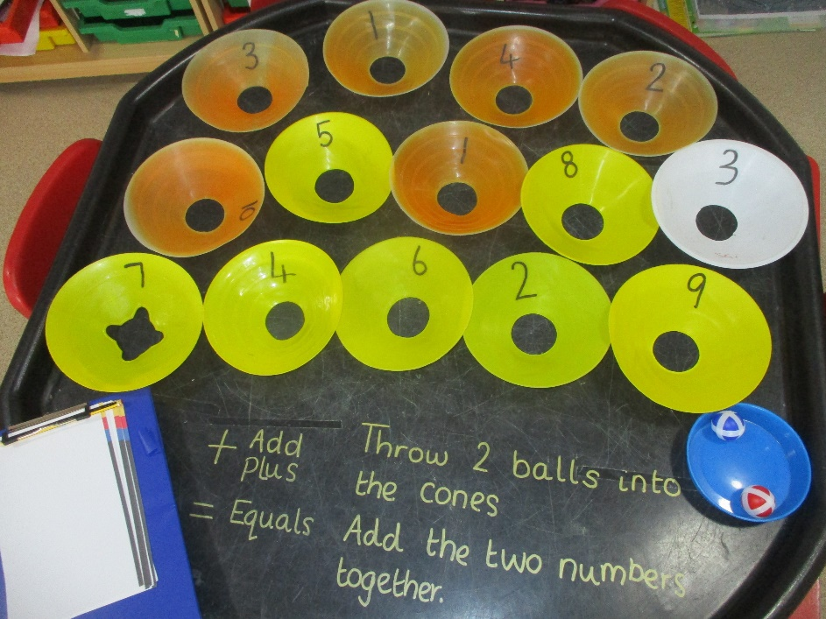
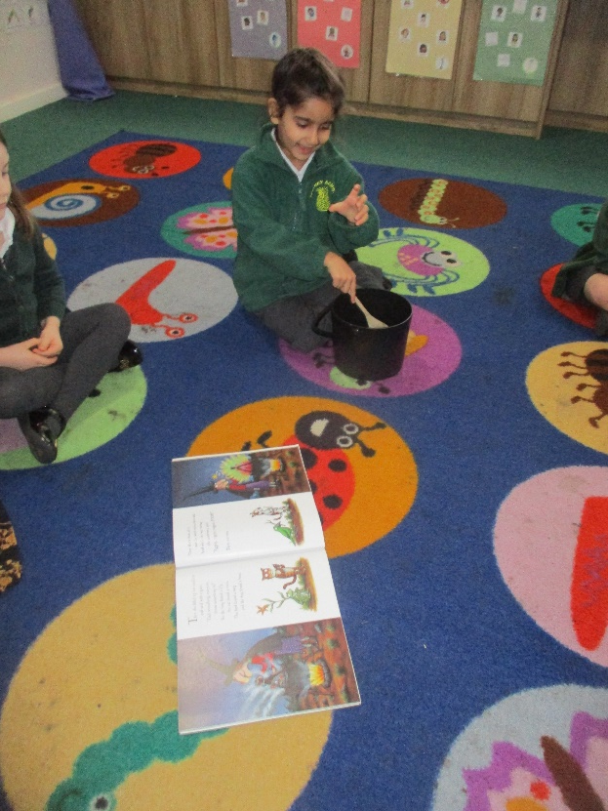
At Dorney School in Year 1 we teach the curriculum through a purposeful play based approach (continuous provision).
What is continuous provision?
Carefully chosen and organised quality resources placed in areas which are always available for children to access independently across every area of learning.
Children are ‘learning through play’. High levels of engagement from children will result in high levels of attainment. For all abilities.
The Role of the adult is vital for successful provision to take place. We have a fantastic team of adults who are trained in extending children’s learning and language though high quality interactions.
It doesn’t matter the age a child starts school, what matters the most is the experiences a child is given are appropriate to their age and stage of development (Julie Fisher, 2010).

Slide 3
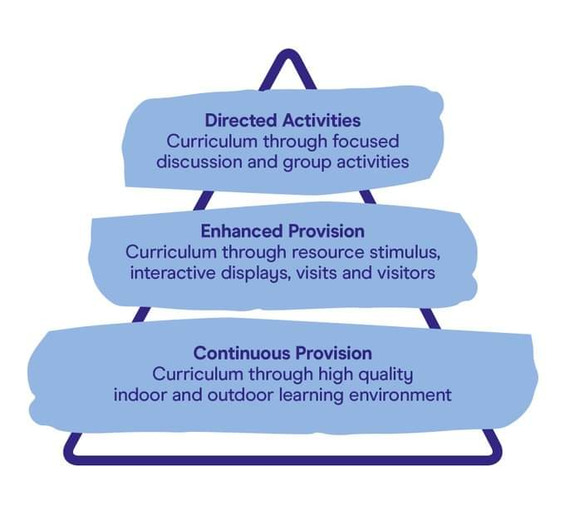
The children will experience learning in a variety of ways.
Directed activities will include specific and explicit teaching inputs both in whole class and in smaller groups such as when introducing a new topic or teaching new skills and knowledge.
Enhanced Provision will include a variety of pre planned activities available to the children based on current learning or topics of interest, these might be to access independently or with adult support and guidance.
Continuous provision is the access to resources that are available to children every day in the classroom to enhance their play and develop their learning and curiosty across all areas of the curriculum.
All learning opportunities will be carefully planned to cover the Early Years Reception Framework and the Year 1 National curriculum objectives and meeting the needs of all children.

Slide 4

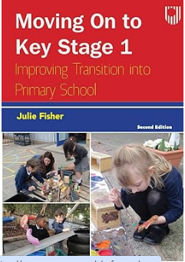

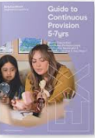


We have done lots of research and reading to ensure the children get the best
We have visited local schools who successfully have implemented a play based approach in Year 1 and attended training to support the change in approach.

Slide 5
The children will be sharing the learning space with Reception in a mixed class environment
This allows children access to all the high quality resources throughout their learning and to feel comfortable and confident within the environment.
The children have lots of space to play and have access to the outdoor area at all times.
This allows the Year 1 classroom to be used for focused direct tasks and a calm break out space.
We have found Reception children have risen to the challenge of their older peers and Year 1s have extended their learning and language in supporting, guiding and explaining to the younger children.
Children will be applying their learning in a way that suits their learning style and stage of development and will have the opportunity to continually practise and apply skills.

Slide 6
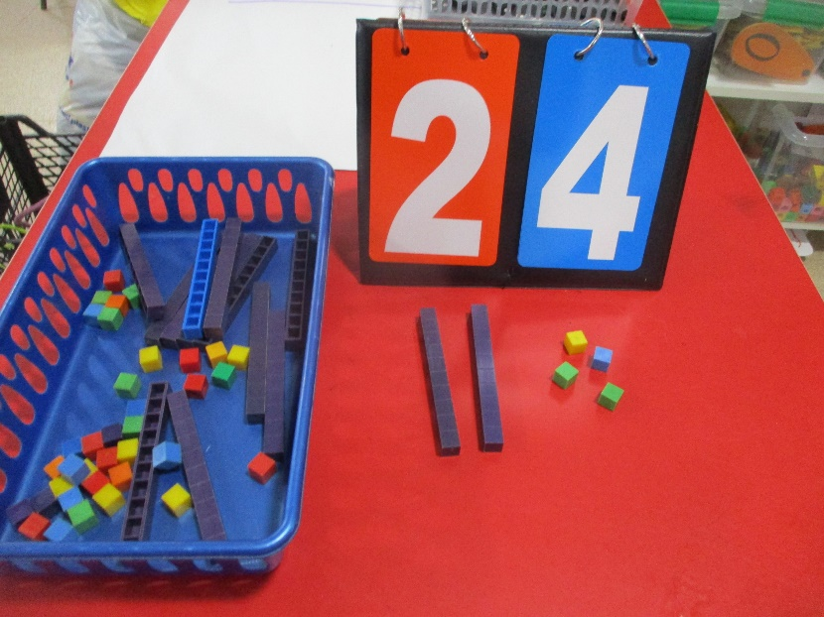
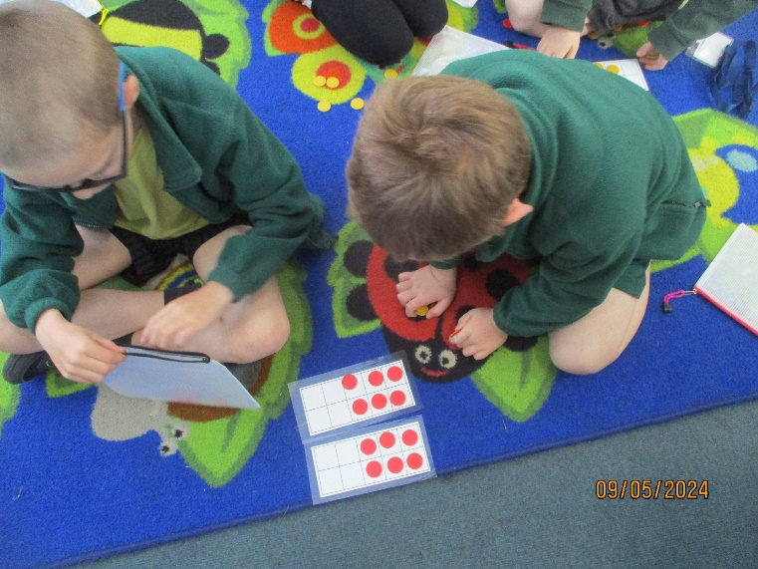
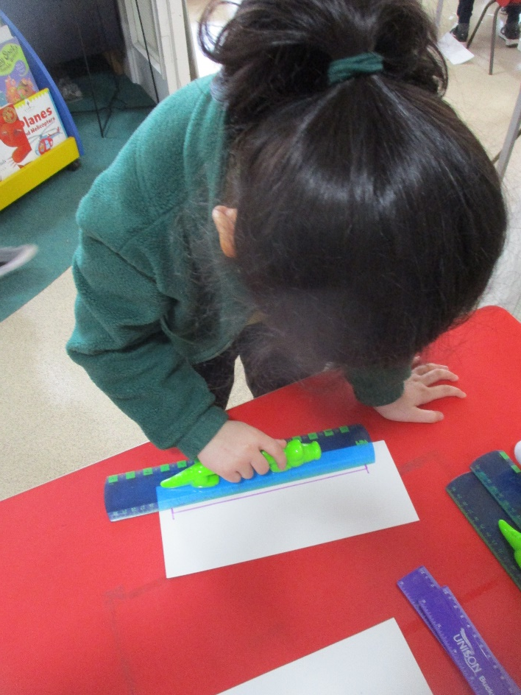
Learning through Play
Purposeful play gives children the opportunity to develop the following skills:
● Problem solving
● Collaboration
● Investigation
● Delegation
● Creativity
● Make decisions
● Work with purpose
● Independence
● Resilience
● Build on emotional development (Early Childhood Hub, 2022)
Happy children make successful learners (Alistair Bryce Clegg, 2020)

Slide 7
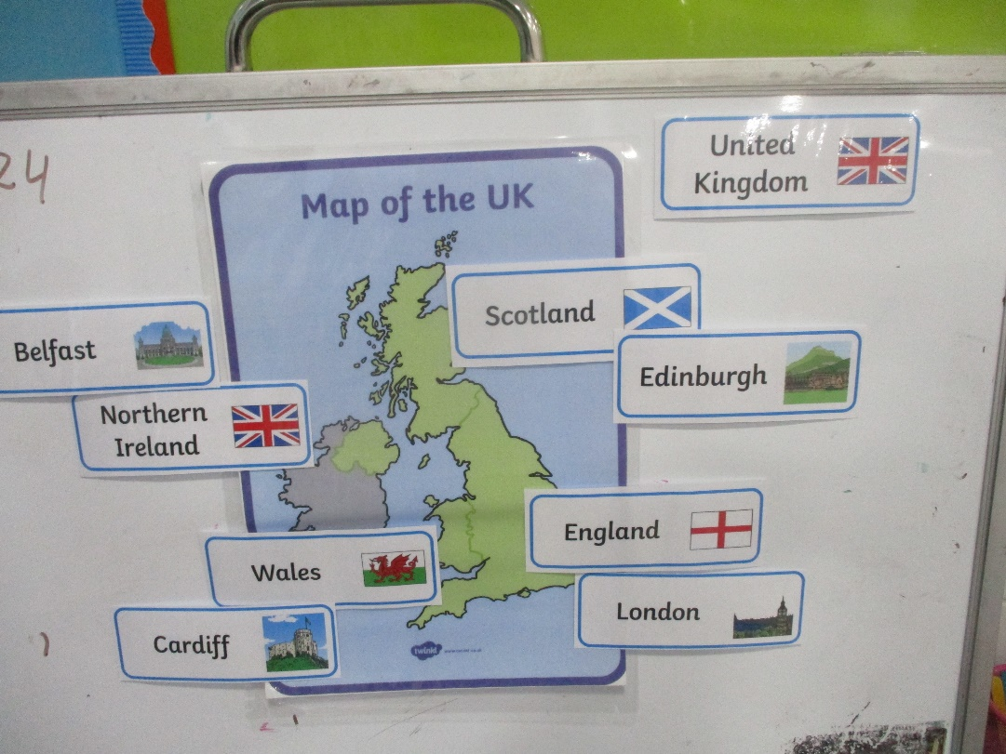
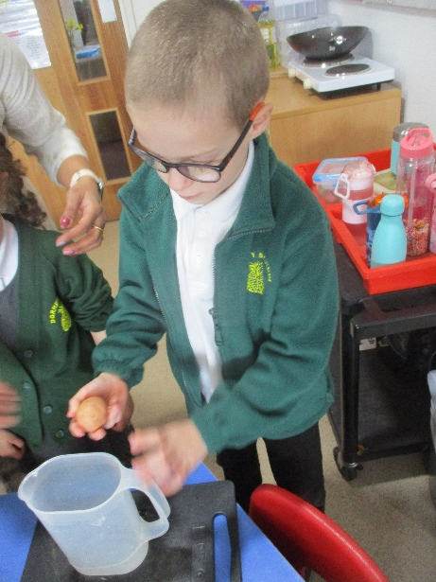
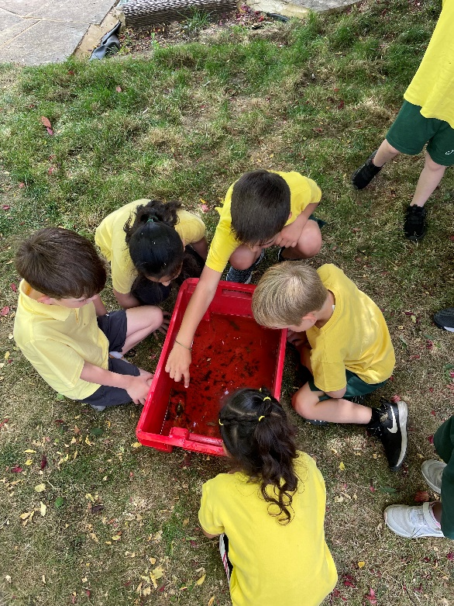
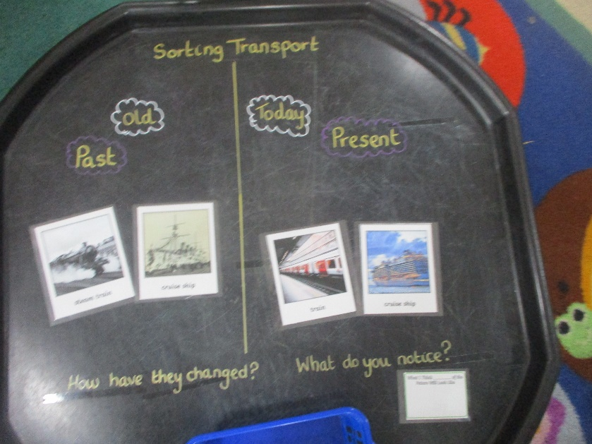
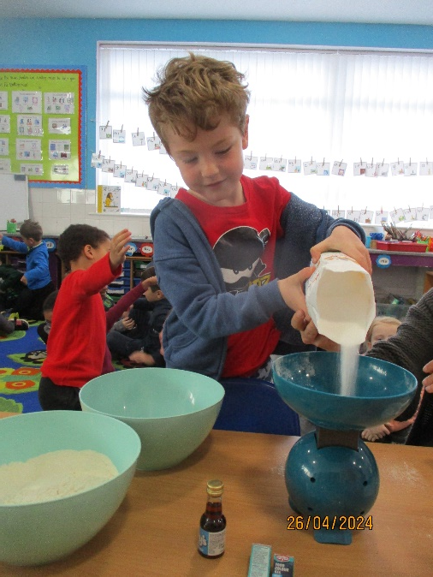
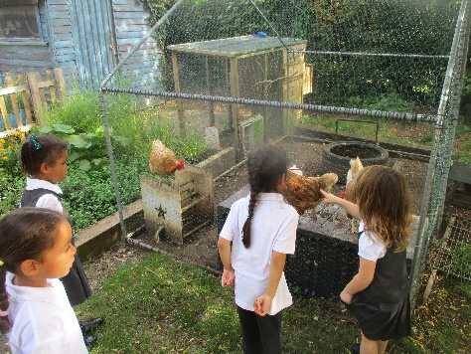
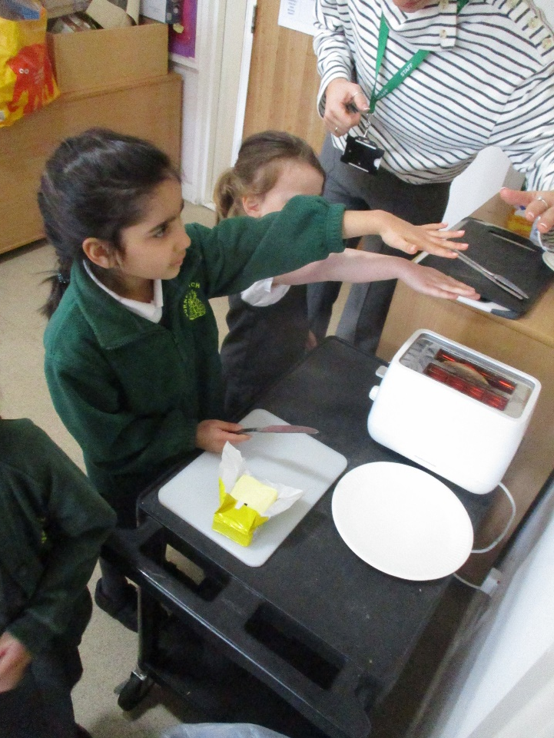
Young people want to learn and will take up teacher’s invitation to engage with enthusiasm and commitment if they find activities relevant, purposeful and meaningful to them, and if the classroom conditions are supportive of their learning.
Alison Peacock 2012
Children will be given opportunities to ‘revisit and embed knowledge and skills’ whilst strengthening effective learning behaviours they have established in Reception (Early Excellence, 2022)

Slide 8
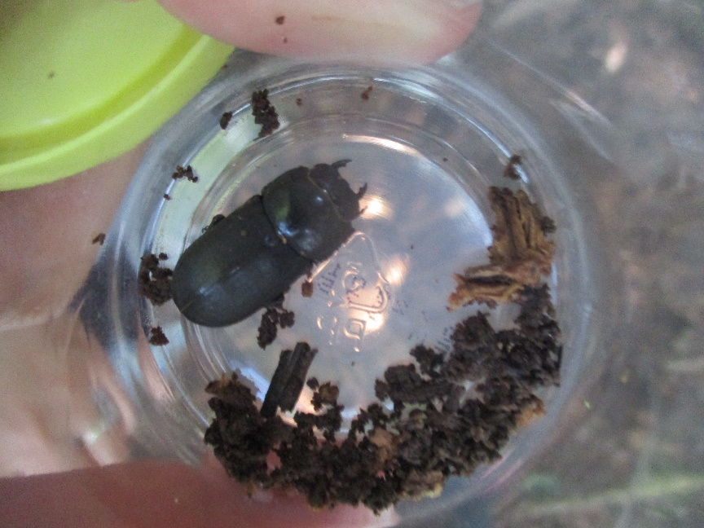
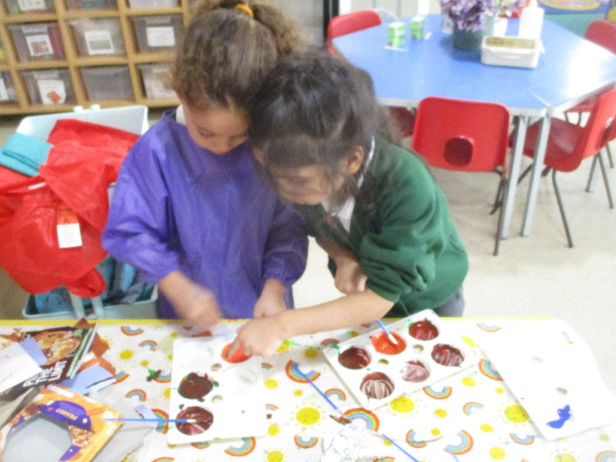
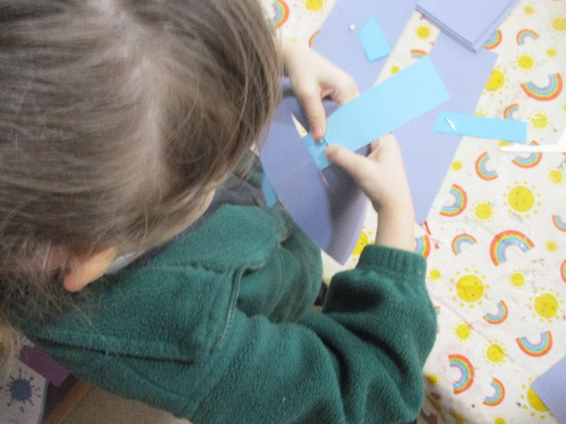
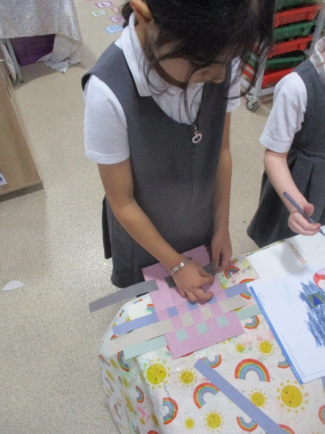
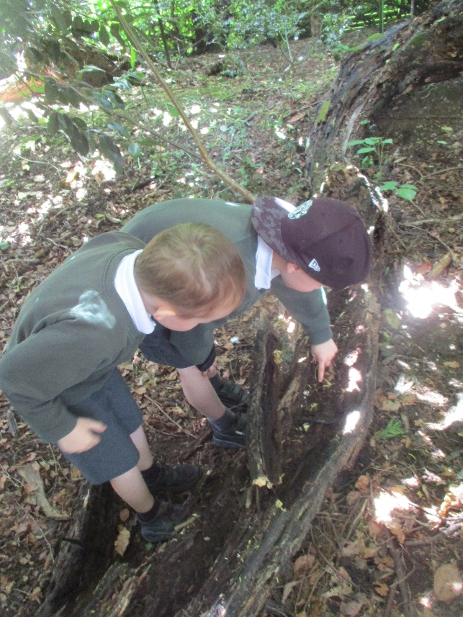
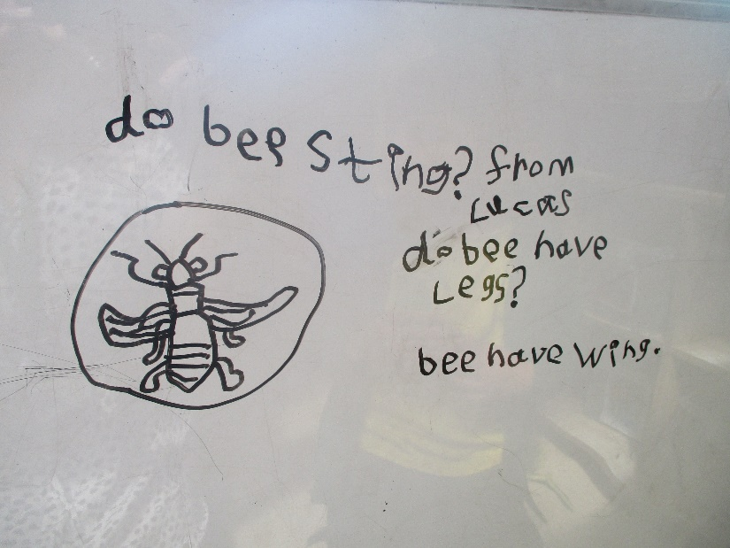
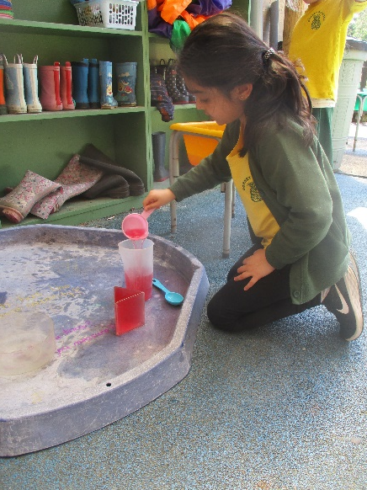
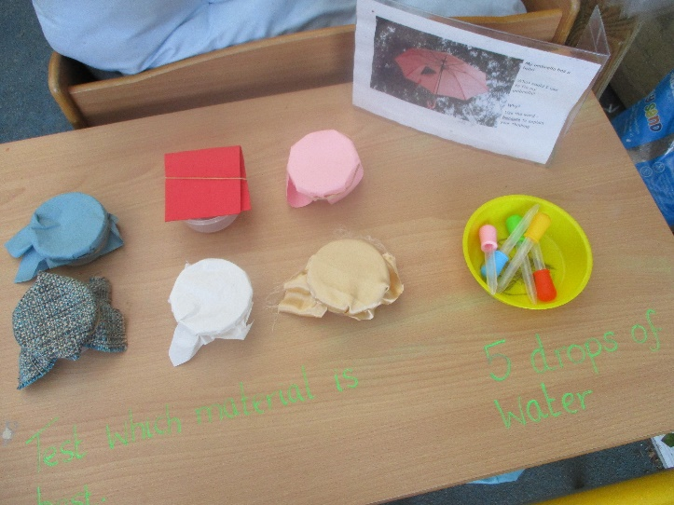
Children in ks1 need environments that encourage movement and active participation in practical, first-hand tasks. They need resources that provoke them to be curious, to investigate and to explore. They need challenges (some initiated by themselves, others initiated by the teacher) that inspire their creativity and imagination, and help them to solve problems and use their initiative. They need time and space to take their active learning wherever their interests and their investigations lead them.
Julie Fisher 2020
Having an Art and Design workshop available every day means children can become more proficient in each of these areas whilst exploring, practising, making mistakes and embedding their skills. Sue Quirk and Victoria Pettet 2020
Children need experiences to make sense of before what we teach them can make sense (Stein 2002).

Slide 9
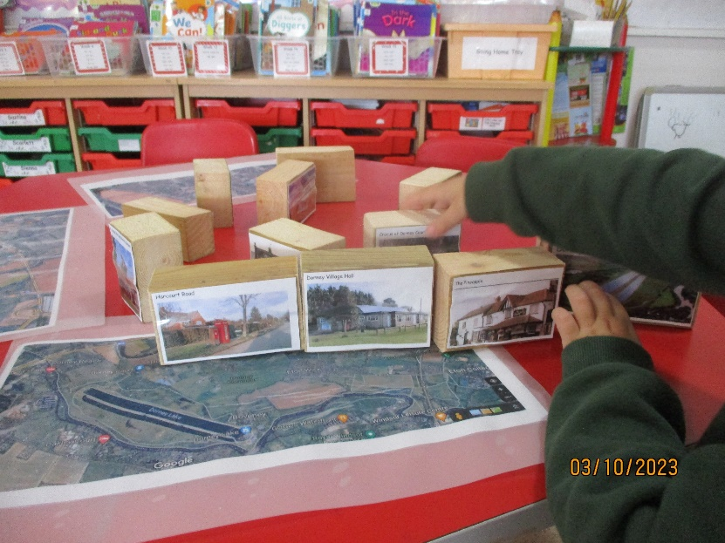
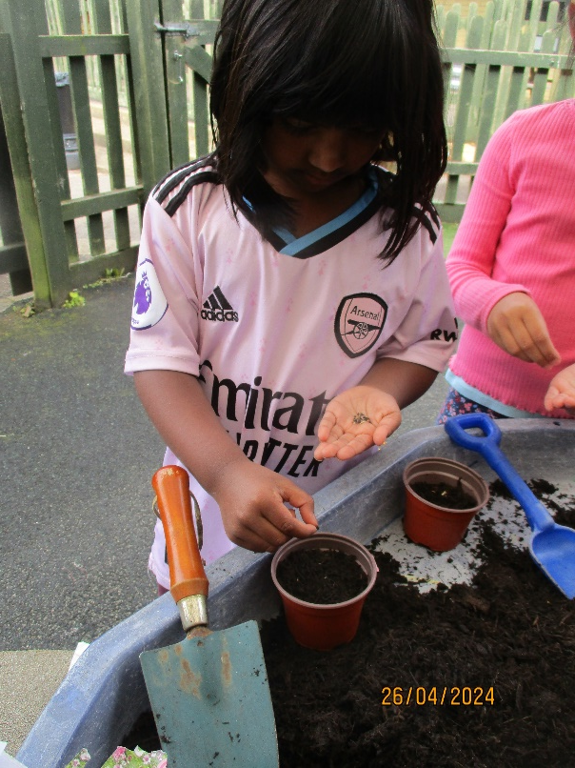
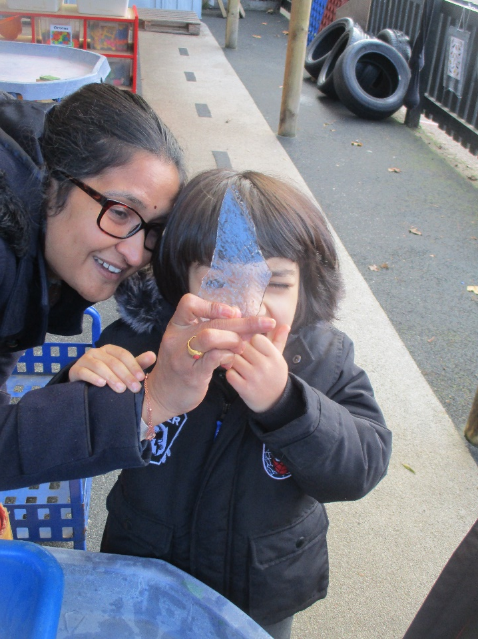
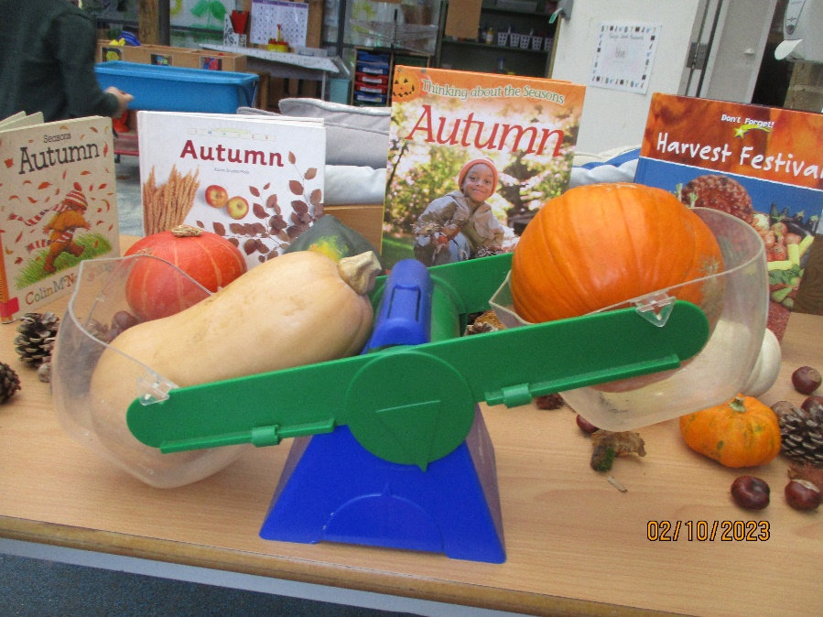
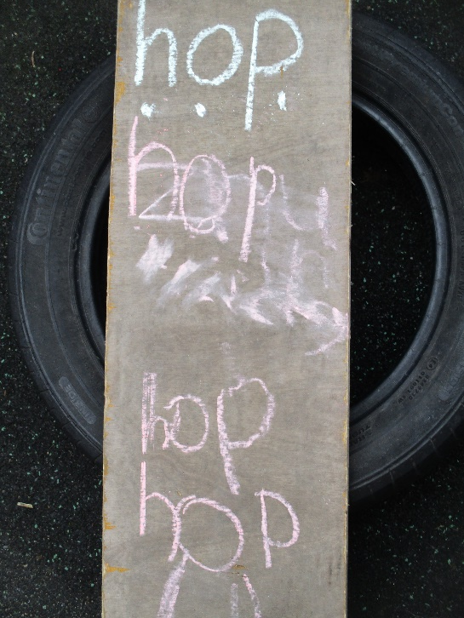
Practical first-hand experience is a primary way of reinforcing memory and learning. Play offers children daily opportunities to return to skills they are mastering and understandings that they are processing. Through play, something learned a day or two earlier can be tried, tested out and consolidated, and given deeper meaning by practice that is relevant and has purpose for the child.
Julie Fisher 2020
Play underpins learning for young children and is the vehicle through which they are able to make sense of the world.
Sue Quirk and Victoria Pettet 2020

Slide 10
Let me be 5…
I like to make mess and take risks,
I like the great outdoors,
I am an active learner and like to work with my friends,
I am not ready to sit at a desk all day,
I still need to play, explore and be creative.
Don’t make me grow up too quickly!
Sue Quirk and Victoria Pettet

