Slide 1



Dorney School
Helping Boys to learn

Slide 2
Why the focus on boys?
Boys lag behind girls in English in every region of the UK
This is typically by 20%
The same pattern is found across the world.
Why?
Motor Skills
Ability to focus
Lack of interest in topic
Progress Police (Peer Pressure)

Slide 3

With a Growth Mindset – you can achieve your goals!

Slide 4



5 top tips for helping boys to learn

Slide 5
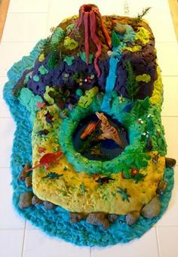
1, writing done for an authentic purpose…
Write a letter to NASA, an aunty, a pen pal…
Make a poster about safety to put up around the home or school
Make a spread sheet/shopping list
Read instructions together to build something

Slide 6

2, find adult mentors modelling writing
This could be big brothers, sisters, cousins, dads, mums … uncles, neighbours
Anyone – that can model an authentic reason for writing, filling out forms, ordering items, using check lists, etc

Slide 7


3, share and celebrate writing
Put examples up on fridge, wall, keep scrap books, albums,
Send into school
Write in a special book
or note pad
Reward effort and resilience

Slide 8


4, allow boys to choose…
Offer a theme – like transport, ask pupils to choose what aspect of transport they would like to study?

Slide 9

5, read to your boys
Make funny voices for characters.
Encourage emotional literacy through fictional characters.
Pick current, topical, interesting, funny books.
Read to enjoy!

Slide 10

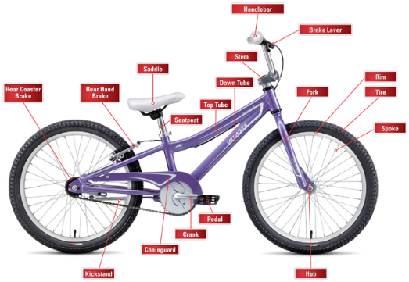
What other ideas have you got? (ideas from our staff/ parents..)
Listen to a variety of readers, mum, dad, grandparents…
Choose a book to read each night before bedtime
Burn off excess energy before sitting down t learn
Turn learning into games – “test” the whole family
3D spelling – make letters with sticks, playdough, mud!
Learn new facts from Guinness Book of records
Baking together..
Write a shopping list together , do a recipe
Regular breaks in learning to improve concentration and focus
Audio Books – play them in the car for reluctant readers
Flashcards and jigsaw puzzles – with key words
Read a chapter each night
Make up stories together
Treasure trails – write clues for them to follow to reach a prize.
Read when out and about – signs, notices

Slide 11

What other ideas have you got?
Word searches / memory games
Write instructions for Minecraft
Acknowledge achievements big or small by sharing with family and friends
Create a reward system to help aim for goals
Spend “golden time “ with your child – explain how proud you are of them
Reward sons with role play
Alternating pages of reading – putting character into story rather than constant correction, e.g. let them hear difficult character names
Post it notes used around the house, leading to a prize, “Find the Next Clue”
Choosing when he will do his homework (agreeing, not enforcing)
Read stories recommended by other boys.
Use whiteboard/blackboard to draw pictures to help describe stories
Read books about real life stories/ magazines like the Week Junior
Include other family members in learning
Preparation for upcoming events
Use Lego, magazines, comics,

Slide 12
What other ideas have you got?
Reduce screen time / set up time for unwinding – it helps
Write instructions for a computer game
Discuss feelings and tools/strategies that support
Keep routines consistent, meal times, breaks, play time, homework time, bedtime stories, bed!
Involve them in jobs around the house.. Making pancakes, counting eggs, measuring milk, laying the table
Do something physical during learning , e.g. after 2-3 lines of writing, do 5 star jumps.
Think out loud about a story while out in the garden
allow choices on topics
Use a timer, reward with stickers, keep things fun, do step by step
Play “shops” with real money – adding and take away
Other ways to tell stories – story cube, feeling flashcards
Allow flexibility and choice
Repeat back what they have understood from a story.

