Slide 1

English workshop
1st October 2024

Slide 2
How we teach Reading and writing
Reading
Primarily through phonics in Reception and Year One
Focus on grammar, spelling and embedding phonics in Year 2
Whole class guided reading from Year 3 onwards but will include extra phonics sessions as necessary – many pupils require the revision
Whole class reading
Group reading
Individual reading
Support and interventions as necessary
Keep up rather than catch up
Our Reading results at the end of Y6 is higher than local schools, and national attainment – 84%

Slide 3
R/Year 1 phonics
Essential Letters and Sounds

Slide 4
Y2-6
A selection of high quality whole texts and excerpts through Literacy Tree – Literacy Leaves
Depending on year group, 3 or 4 reading lessons a week
Between 40 minutes and an hour
Session 1 – pre-teaching and vocabulary
Session 2 – teacher reads aloud and class discussion
Sessions 3 and 4 – children may be asked to read aloud and answering questions
Inference ***

Slide 5
How you can help
Read, read, read
Model reading
Real books, online books, audio books, TV personalities reading stories, libraries, charity shops, book swaps
Expose children to new authors that are more relevant
https://www.booktrust.org.uk/books-and-reading/bookfinder/
Class library, school library, rainbow corridor, birthday books, cosy cabin

Slide 6
Writing
EYFS and National Curriculum
https://assets.publishing.service.gov.uk/media/64e6002a20ae890014f26cbc/DfE_Development_Matters_Report_Sep2023.pdf
https://assets.publishing.service.gov.uk/media/5a7de93840f0b62305b7f8ee/PRIMARY_national_curriculum_-_English_220714.pdf
Drawing Club and amazing stories – Reception
Literacy Tree/Writing Roots – work is done around quality texts and stories
An example

Slide 7
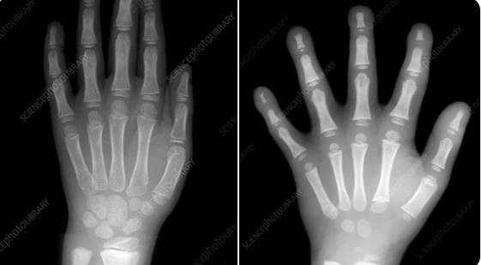

Slide 8
Handwriting – we follow Letter-join – a progressive scheme
Print in Reception and Year 1, pre-cursive in Year 2, joined up in Year 3
No ‘write’ way
Pupils must be comfortable with using a pencil
What is required before you can write confidently
Why boys generally struggle?
Pencil or pen?
Reluctant writers – why?

Slide 9
How can you help?
Read, read, read
Model writing lists, letters etc… this is hard as we all use text and keyboards
Gross and fine motor movements
Skipping
Praise, praise, praise
Motivate rather than reward
If rewarding, reward the effort
Punctuation is key – capital letters and full stops
What is the hook?

Slide 10
Year 4s Favourite food
I like pasta bake as sizzly as popping candy,
I like strawberries as red as a ladybird,
I like mashed potato as soft as play doh,
I like pasta as swirly as a helter-skelter,
I like bread as soft as a Squishmallow pillow
I like pancakes as yellow as an emoji,
I like ice cream as cold as an igloo,
I like KFC as warm as kettle water,
I like tasty pizza as round as a ball,
I like pretzels as salty as seawater,
I like blueberries as blue as Stitch!
I like cherries as red as the devil’s heart,
I like burgers as hot as Egypt,
I like tomatoes as red as rouge,
I like sushi as small as a mouse,
I like cereal as sweet as honey,
I like chewing gum as stretchy as slime.

Slide 11
In a child's front pocket,
You'll probably find toy rockets,
Or a white mint sweet,
That the child may eat,
Or small iridescent bugs,
That hide in toy mugs.
Maybe some pocket money,
Or a toy that is funny
Or a shell from a snail,
Or some lost mail,
Some sea glass from the beach,
Or slices from a peach!

Slide 12
Newspaper Club
Library Club
Drawing Club

Slide 13
A very difficult process
Fighting with technology and instant gratification
We are using more technology
Start small, easy wins and build on each milestone achieved – carefully planned

Slide 14
Our UKS2 children
Any questions?

