Slide 1
Welcome to
Maths at Dorney School

Slide 2
How has Maths changed in recent years?
We follow White Rose Maths, which is a mastery approach to teaching Maths
Mastery is a journey and long-term goal. This is achieved through exploration, clarification, practice and application. At each stage of learning, children should be able to demonstrate a deep, conceptual understanding of the topic and be able to build on this over time.
The concept of teaching for mastery is that we teach concepts until they are mastered. Challenge is provided by going deeper not accelerating. Learning is broken down in to small steps, and each of these steps build on the previous learning. Teachers provide short interventions to any child who may have gaps, or need more time to be able to consolidate what they have been learning.

Slide 3
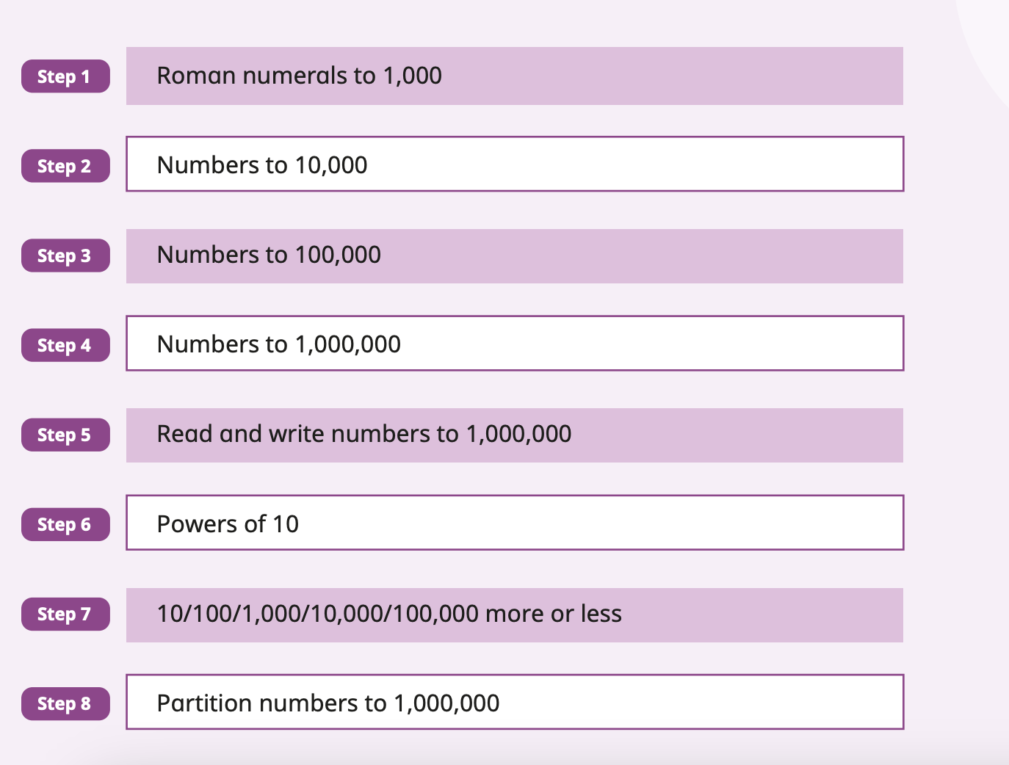
Small steps – an example – Year 5 place value

Slide 4
Maths fluency
Maths fluency is a key part of teaching Maths at Dorney, and is one of the key ideas when teaching using a mastery approach.
Fluency is quick and efficient recall of facts and procedures and the flexibility to move between different contexts and representations of Maths.
Reception, Year 1 and Year 2 follow Mastering Number from NCETM (National Centre for Excellence in the Teaching of Mathematics). This focuses on building an in depth understanding of number, so children are flexible with numbers.
Year 4 and Year 5 have also joined a Mastering Number program. This focuses on multiplication and division and how this can be applied in different contexts.
Classes do this at a different time to their Maths lessons – for most classes this is straight after lunch.

Slide 5
Some useful links
https://whiteroseeducation.com/parent-pupil-resources/maths/home-learning?year=year-5-new – these links have videos (we used these in lockdown, but they have been updated). These are great for children to watch at home if they need some extra help with their Maths or if you would like to see how we build on the learning through a Maths lesson.

Slide 6
How can you help at home
Use of Numbots (lots of number work – this is used mainly in KS1 classes)
Times tables rockstars (focus on multiplication and division facts – used in Year 2 – Year 6)
Find opportunities to talk about Maths – shopping lists, adding up the bill, talking about Maths in every day life
Make Maths fun!

Slide 7
Calculation Policy
There are lots of different representations in White Rose Maths – this includes how we work out addition, subtraction, multiplication and division.
There are two different calculation policies – one for addition and subtraction, and one for multiplication and division.

Slide 8
Thank you so much for coming
Any questions?

