Slide 1

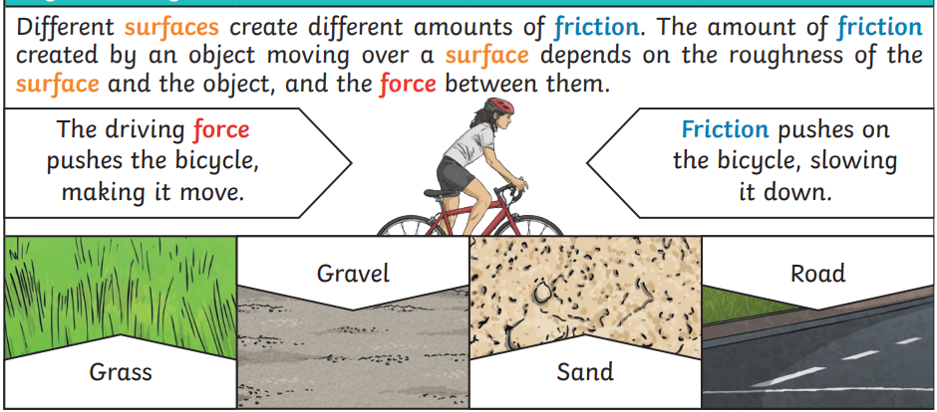
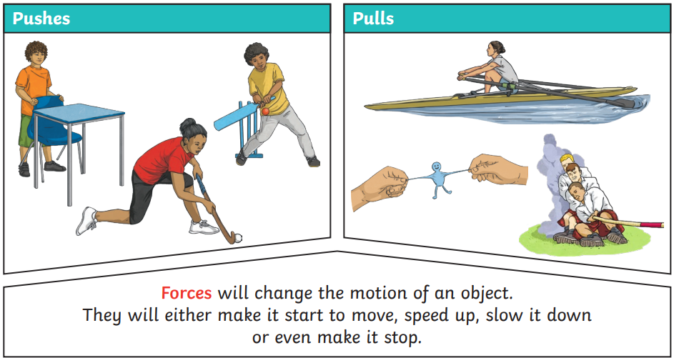
Year 3 - Science Knowledge Organiser Forces And Magnets – Summer 2
What should I already know?
Find out how the shapes of solid objects made from some materials can be changed by squashing, bending, twisting and stretching. (Y2 - Uses of everyday materials)
Key Learning – Forces and Magnets
A force is a push or a pull. When an object moves on a surface, the texture of the surface and the object affect how it moves. It may help the object to move better or it may hinder its movement e.g. ice skater compared to walking on ice in normal shoes. For some forces to act, there must be contact e.g. a hand opening a door, the wind pushing the trees. Some forces can act at a distance e.g. magnetism. The magnet does not need to touch the object that it attracts.
Key Vocabulary
force | A push or pull
gravity | A force that pulls objects towards the centre of earth or large size mass
friction | A force that acts between two surfaces that are moving, or trying to move
surface | The top layer of something
contact | When two surfaces touch
fair test | An investigation where only one variable changes, and the others stay the same

Slide 2
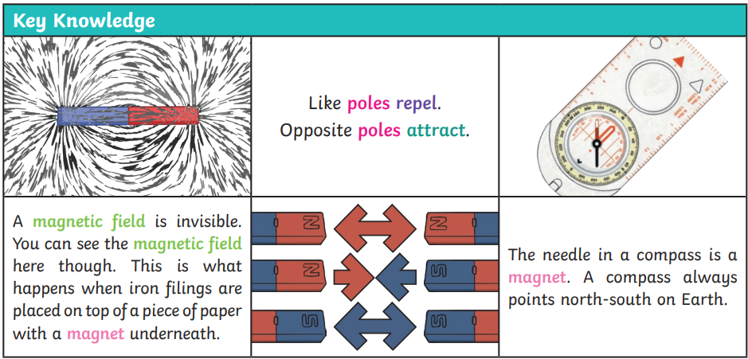
A magnet attracts magnetic materials. Iron and nickel and other materials containing these, e.g. stainless steel, are magnetic. The strongest parts of a magnet are the poles. Magnets have two poles – a north pole and a south pole. If two like poles, e.g. two north poles, are brought together they will push away from each other – repel. If two unlike poles, e.g. a north and south, are brought together they will pull together – attract.
Key Vocabulary - Magnets
magnet | An object that produces a magnetic field and pulls certain objects towards it
magnetic | Objects that are attracted to a magnet are magnetic. Objects containing iron, nickel and cobalt are all magnetic
magnetic field | An area around a magnet, where a magnetic force pulls a magnetic object towards it
poles | A magnetic has a North and a South pole at either end of a magnet
repel | Repulsion is a force which pushes two objects away
attract | Attraction is a force which pulls objects together.
Key Knowledge and Diagram - Magnets
Scientific Enquiry and Skills
Carry out investigations to explore how objects move on different surfaces • Explore what materials are attracted to a magnet. • Classify materials according to whether they are magnetic. • Explore the way that magnets behave in relation to each other. • Use a marked magnet to find the unmarked poles on other types of magnets. • Explore how magnets work at a distance e.g. through the table, in water, jumping paper clips up off the table. • Devise an investigation to test the strength of magnets.
Scientist: Issac Newton
Issac Newton was an English physicist who discovered gravity. A Newton metre which is a gadget which measures forces is named after him. Forces are measures in Newtons.

