Slide 1

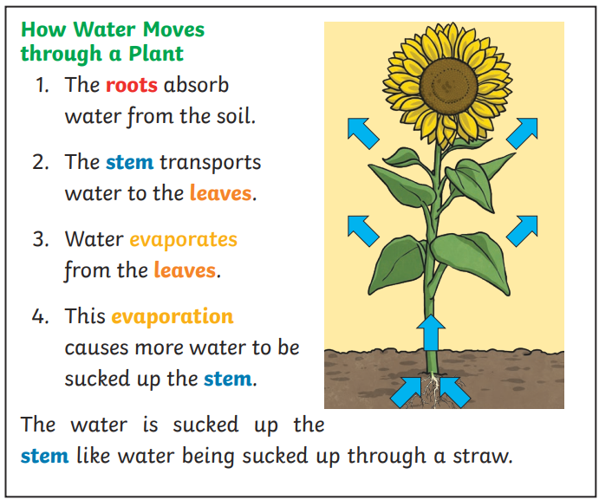
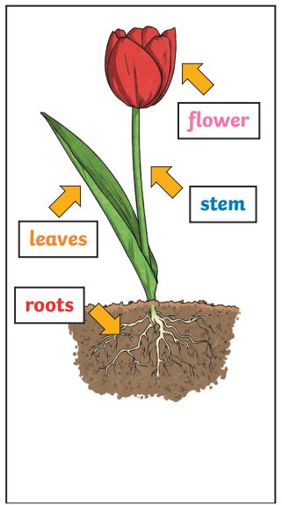
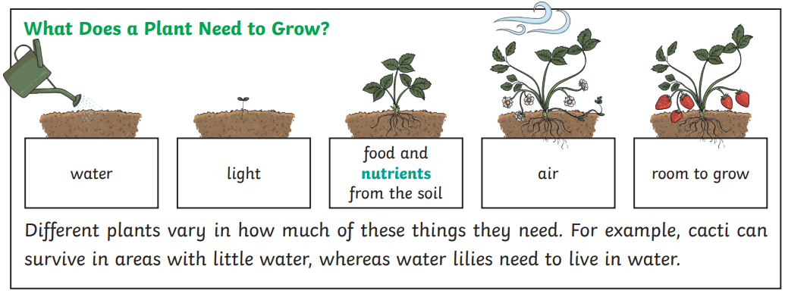
Year 3 Science Knowledge Organiser Plants – Summer 1
What should I already know?
Observe and describe how seeds and bulbs grow into mature plants. (Y2 - Plants) Find out and describe how plants need water, light and a suitable temperature to grow and stay healthy. (Y2 - Plants)
Key Learning – Parts Of Plants
Many plants, but not all, have roots, stems/trunks, leaves and flowers/blossom. The roots absorb water and nutrients from the soil and anchor the plant in place. The stem transports water and nutrients/minerals around the plant and holds the leaves and flowers up in the air to enhance photosynthesis, pollination and seed dispersal. The leaves use sunlight and water to produce the plant’s food. Different plants require different conditions for germination and growth. Different plant parts provide food for us to eat.
Key Vocabulary
roots | These anchor the plant into the ground and absorb water and nutrients from the soil.
stem | This holds the plant up and carries water and nutrients from the soil to the leaves. A trunk is the stem of a tree.
leaves | These make food for the plant using sunlight and carbon dioxide from the air
flowers | These make seeds to grow into new plants. Their petals attract pollinators to the plant.
nutrients | These substances are needed by living things to grow and survive. Plants get nutrients from the soil and also make their own food in their leaves.
evaporation | When a liquid turns into a gas.
Scientist: Katherine Esau
A Russian-born American botanist (1898-1997) who did ground-breaking work on the structure and workings of plants. Her book Plant Anatomy is a classic in the field.

Slide 2
Food From Plant Parts
Roots | Stems and shoots | Leaves | Flowers | Fruits | Nuts and seeds
Potatoes Carrots Parsnips Beetroot Swede
Celery
Rhubarb
Chard stems
Spinach
Lettuce
Rocket
Cabbage
Kale
Cauliflower
Broccoli
Borage
Nasturtium
Tomatoes
Peppers
Apples
Melon
Strawberries
Peas
Chickpeas
Coconut
Hazel nuts
Cucumber
Scientific Enquiry and Skills
i. asking relevant questions and using different types of scientific enquiries to answer them ii. setting up simple practical enquiries, comparative and fair tests iii. making systematic and careful observations and, where appropriate, taking accurate measurements using standard units, using a range of equipment, including thermometers and data loggers iv. gathering, recording, classifying and presenting data in a variety of ways to help in answering questions v. recording findings using simple scientific language, drawings, labelled diagrams, keys, bar charts, and tables vi. reporting on findings from enquiries, including oral and written explanations, displays or presentations of results and conclusions vii. using results to draw simple conclusions, make predictions for new values, suggest improvements and raise further questions viii. identifying differences, similarities or changes related to simple scientific ideas and processes ix. using straightforward scientific evidence to answer questions or to support their findings

Slide 3
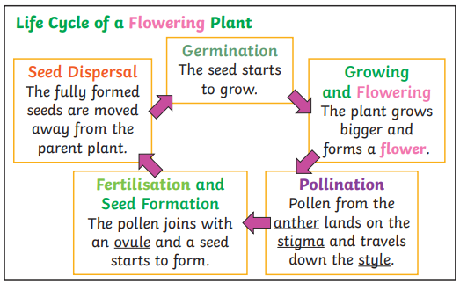
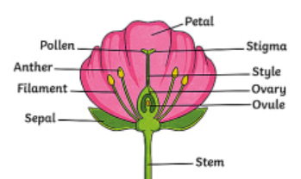
Year 3 Science Knowledge Organiser Plants – Summer 1
What should I already know?
Observe and describe how seeds and bulbs grow into mature plants. (Y2 - Plants) Find out and describe how plants need water, light and a suitable temperature to grow and stay healthy. (Y2 - Plants) Describe which parts of plants can be food (Yr 3 – Plants) Describe role of different plant parts (Yr 3 – Plants)
Key Learning – Life Cycle Of Flowering Plant
Some plants produce flowers which enable the plant to reproduce. Pollen, which is produced by the male part of the flower, is transferred to the female part of other flowers (pollination). This forms seeds, sometimes contained in berries or fruits which are then dispersed in different ways. The stem has many jobs but key to this learning is that it holds the flowers up in the air to enhance pollination and seed dispersal.
Key Vocabulary
germination | When a seed starts to grow
pollination | When pollen (a fine powdery substance produced by a flowering plant) is moved from the male anther of a flower to the female stigma
pollinator | Animals or insects which carry pollen between plants. Examples include birds, bees and bats.
petal | The brightly coloured part of the flower that attracts insects to pollinate the plant.
fertilisation | When the male and female parts of the flower have mixed in order to make seeds for new plants.
stamen | The male parts of the flower. The stamen is made up of the anther and the filament. The filament’s job is to hold up the anther. The job of the anther is to make the pollen.
carpel (pistil) | The female parts of the flower. Made up of the stigma, style and ovary. The job of the style is to hold up the stigma. The stigma collects the pollen when a pollinator brushes by it. The ovary contains the ovules, which are the part of the flower that gets fertilised and eventually becomes the new seed.
sepal | Leaf-like structures that protect the flower and petals before they open out.
seed dispersal | A method of moving the seeds away from the parent plant so that the seeds have the best chance of survival.
Scientist: Camerarius (1694), and Koelreuter (1761)
These two scientists were accredited with discovering that plants had female and male parts of the plant to help it be able to reproduce.

Slide 4
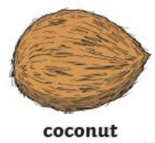
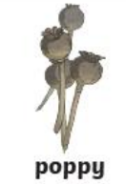
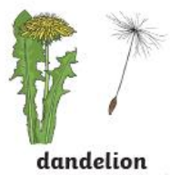


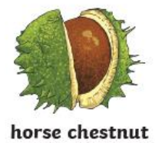



Different Types Of Seed Dispersal
Water | Bursting/ Explosion | Wind | Animals eating | Animals fur | Dropping
Scientific Enquiry and Skills
• Spot flowers, seeds, berries and fruits outside throughout the year. • Observe flowers carefully to identify the pollen. • Observe flowers being visited by pollinators e.g. bees and butterflies in the summer. • Observe seeds being blown from the trees e.g. sycamore seeds. • Research different types of seed dispersal. • Classify seeds in a range of ways, including by how they are dispersed.
Observe
Classify
Research

