Slide 1

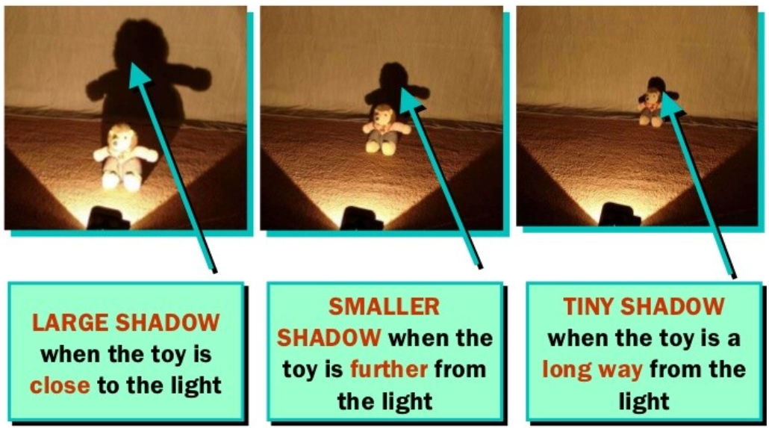
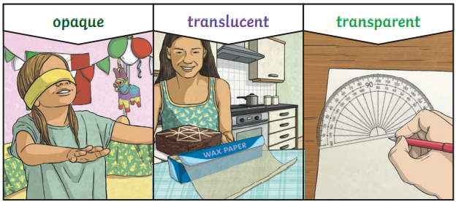
Year 3 Science Knowledge Organiser Light – Spring 2
What should I already know?
Identify, name, draw and label the basic parts of the human body and say which part of the body is associated with each sense. (Y1 - Animals, including humans) Describe the simple physical properties of a variety of everyday materials. (Y1 - Materials)
Key Learning – Light And Shadows
We see objects because our eyes sense light. Dark is the absence of light. We cannot see anything in complete darkness. Some objects, for example, the sun, light bulbs and candles are sources of light. Objects are easier to see if there is more light. Shadows are formed on a surface when an opaque or translucent object is between a light source and the surface and blocks some of the light. The size of the shadow depends on the position of the source, object and surface.
Key Vocabulary
light | A form of energy that travels in waves from a source
light source | An object that makes it’s own light e.g. the sun, a torch a candle
dark | The absence of light e.g. where there is no light
shadow | An area of darkness where light has been blocked
transparent | Describes an object which lets light travel through it
translucent | Describes an object which lets some light travel through it
opaque | Describes an object which lets no light travel through it

Slide 2
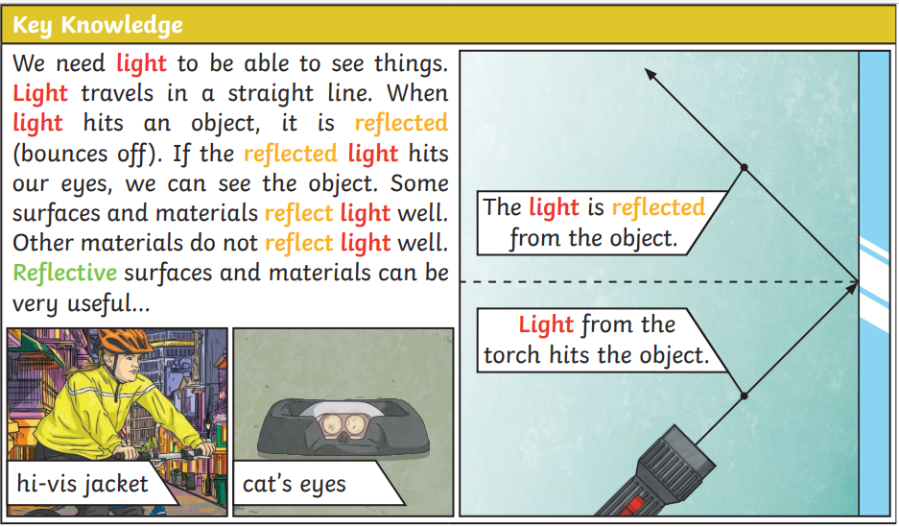
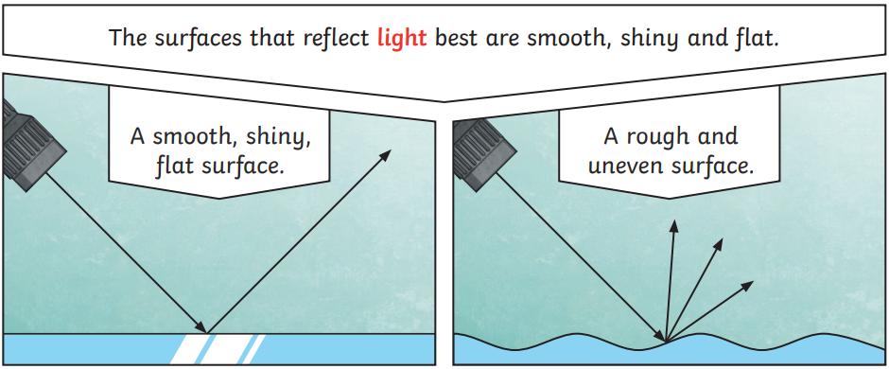
Key Knowledge and Diagram - Reflection
Key Vocabulary Reflection
reflection | The process where light hits the surface of an object and bounces off into our eyes.
reflect | To bounce off
reflective | A word to describe something that reflect light well
ray | A wave of light is called a ray of light or a beam of light
Scientific Enquiry and Skills
Explore how different objects are more or less visible in different levels of lighting. Explore how objects with different surfaces, e.g. shiny vs matt, are more or less visible. Explore how shadows vary as the distance between a light source and an object or surface is changed. Explore shadows which are connected to and disconnected from the object e.g. shadows of clouds and children in the playground. Choose suitable materials to make shadow puppets.
Scientist: Thomas Edison
Thomas Edison was the scientist who invented the light bulb and the motion picture camera.

