Slide 1

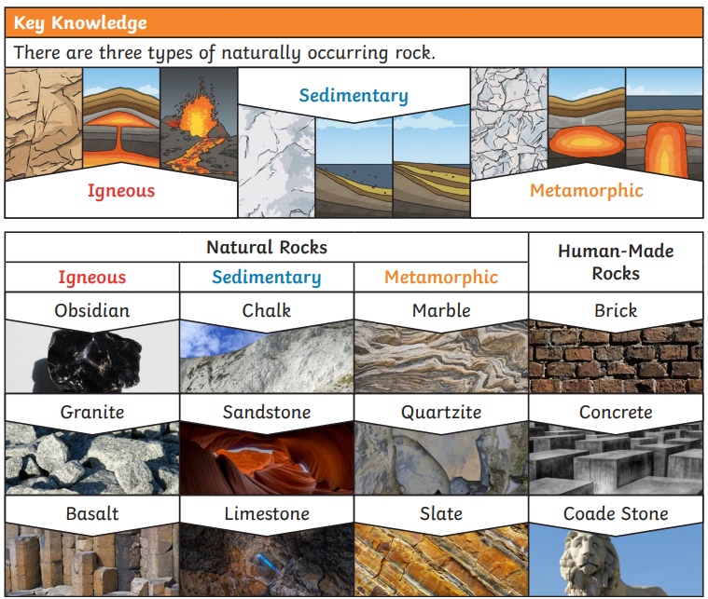
Year 3 Science Knowledge Organiser Rocks And Soils – Autumn 2 and Spring 1
What should I already know?
Distinguish between an object and the material from which it is made. (Y1). Identify and name a variety of everyday materials, including wood, plastic, glass, metal, water, and rock. (Y1). Describe the simple physical properties of a variety of everyday materials. (Y1). Compare and group together a variety of everyday materials on the basis of their simple physical properties. (Y1). Identify and compare the suitability of a variety of everyday materials, including wood, metal, plastic, glass, brick, rock, paper and cardboard for particular uses. (Y2)
Key Learning - Rocks
Rock is a natural material. There are different types of rock e.g. sandstone, limestone, slate etc. which have different properties. Rocks can be hard or soft. They have different sizes of grain or crystal. They may absorb water. Rocks can be different shapes and sizes (stones, pebbles, boulders).
Key Vocabulary
igneous | Rocks that have been formed from magma or lava
sedimentary | Rocks that have been made by layers of sediment being pressed down hard and sticking together. You can see the layers in these rocks
metamorphic | Rocks that started off as igneous or sedimentary rocks but have changed due to extreme heat or pressure
absorbent | Lets water soak into it.
permeable impermeable | Permeable allows water to pass through it. Impermeable materials that do not let water through them.
Words To Describe Rocks
hard, soft, rough, smooth, layers, grains, crystals, dull, shiny, permeable, impermeable, speckled, crumbly

Slide 2
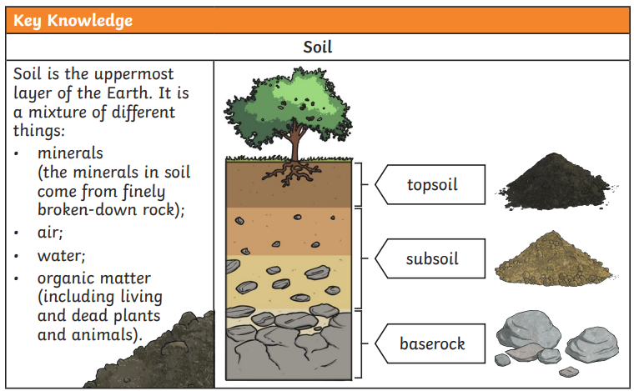
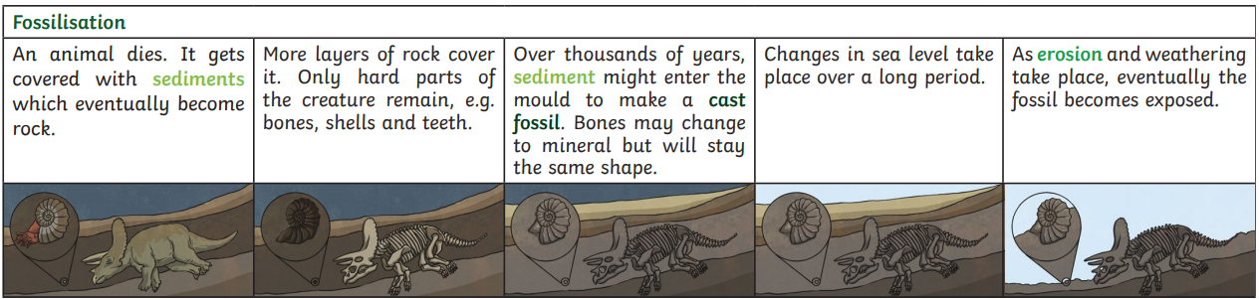
Key Learning – Soils
Soils are made up of pieces of ground down rock which may be mixed with plant and animal material (organic matter). The type of rock, size of rock pieces and the amount of organic matter affect what the soil is like.
Key Diagram
Scientific Enquiry and Skills
Observe rocks and soils closely. Classify rocks and soils in a range of ways, based on their appearance. Devise a range of tests 1) to investigate the hardness of a range of rocks 2) how much water different rocks absorb. 3) investigate the water retention of soils. Research using secondary sources how fossils are formed and the work of Mary Anning. Observe how soil can be separated through sedimentation.
Key Vocabulary
orgnaic matter | plant or animal material | texture, absorbent, permeable, impermeable, sandy, chalky, clay, peat
fossilisation | how fossils are made
palaeontologist | Someone who studies fossils
Key Learning – Fossils
Fossils were formed millions of years ago. When plants and animals died, they fell to the seabed. They became covered and squashed by other material. Over time the dissolving animal and plant matter is replaced by minerals from the water.
Scientist: Mary Anning
Mary Anning was an English fossil collector and palaeontologist who became known around the world for finds she made in Jurassic marine fossil beds on the south coast of England.

