Slide 1

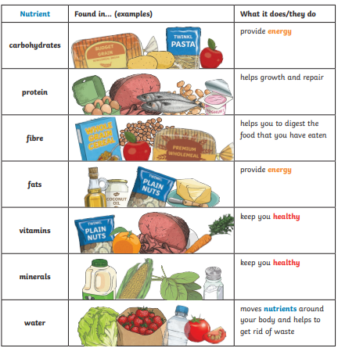
Year 3 - Science Knowledge Organiser - Animals Including Humans – Autumn 1
What should I already know?
Identify and name a variety of common animals including fish, amphibians, reptiles, birds and mammals. (Y1) Identify and name a variety of common animals that are carnivores, herbivores and omnivores. (Y1) • Describe and compare the structure of a variety of common animals (fish, amphibians, reptiles, birds and mammals, including pets). (Y1) • Find out about and describe the basic needs of animals, including humans, for survival (water, food and air). (Y2) • Describe the importance for humans of exercise, eating the right amounts of different types of food, and hygiene. (Y2)
Key Learning - Nutrition
To grow, be strong and stay healthy, humans need to exercise, eat a healthy diet and be hygienic. Animals, unlike plants which can make their own food, need to eat in order to get the nutrients. Food contains a range of different nutrients that the body needs – carbohydrates (including sugars), protein, vitamins, minerals, fats, sugars, water – and fibre. Humans, and some other animals, have skeletons and muscles which help them move and provide protection and support.
Key Nutrients
Key Vocabulary
healthy | in a good physical and mental condition
nutrients | substances that living things need to stay alive and healthy
energy | strength needed to move and grow
saturated fats | type of fat considered to be less healthy – should be eaten in small amounts
unsaturated fats | fats that give you energy, vitamins and minerals

Slide 2
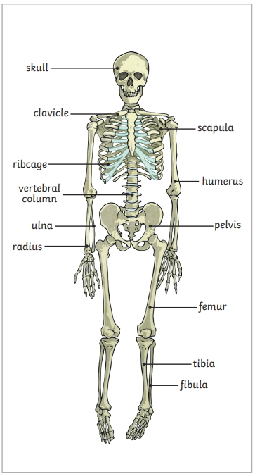
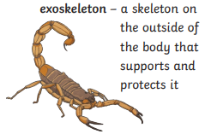
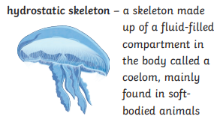
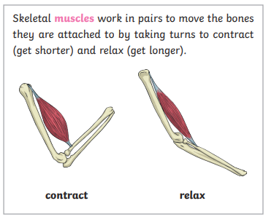
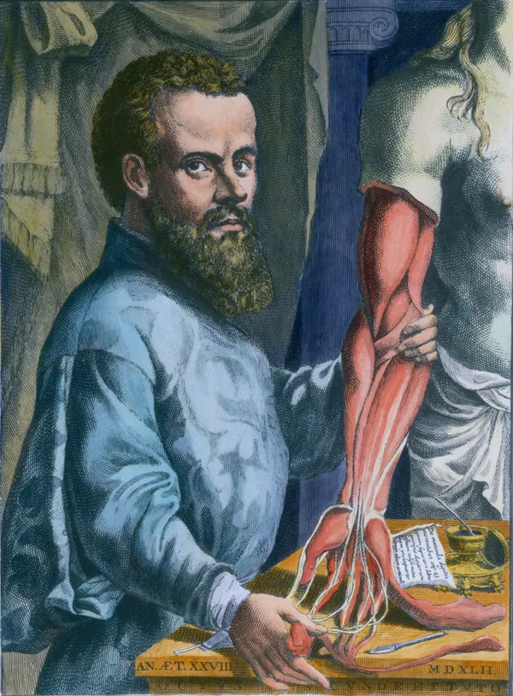
Key Learning - Skeletons
Skeletons do three important jobs: protect organs inside the body allow movement support the body and stop it from falling to the floor
Humans are vertebrates with a endoskeleton. This is a skeleton on the inside of the body that supports and protects it.
Key Diagrams
I
N
V
E
T
E
B
R
A
T
E
S
Key Vocabulary
vertebrate | animals with backbones
invertebrate | animals without backbones
muscles | soft tissues in the body that contract and relax to cause movement
tendons | cords that join muscles to bones
joints | areas where two or more bones are fitted together
Scientific Enquiry and Skills
- Classify food in a range of ways. - Collect data and look for patterns in diet - Use secondary sources to research the parts and functions of the skeleton. -Investigate patterns asking questions such as: ▪ Can people with longer legs run faster? ▪ Can people with bigger hands catch a ball better? - Compare, contrast and classify skeletons of different animals.
Scientist: Andreas Vesalius
A young Flemish anatomist. He was one of the most important figures in the history of medicine.

