Slide 1

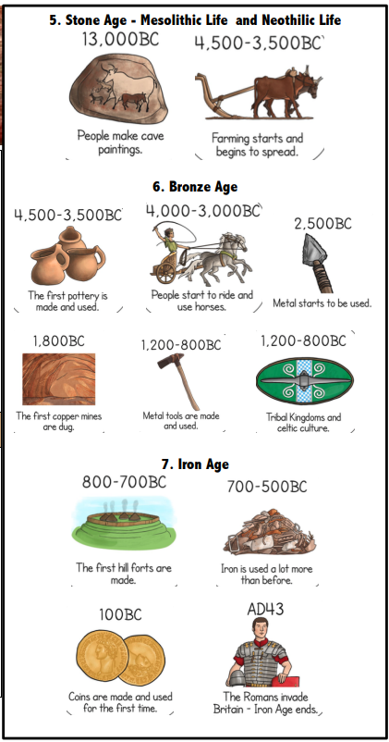
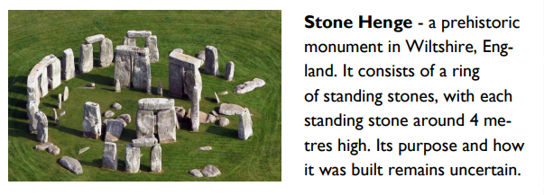
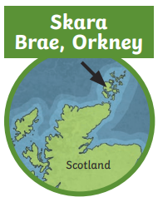
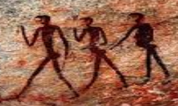
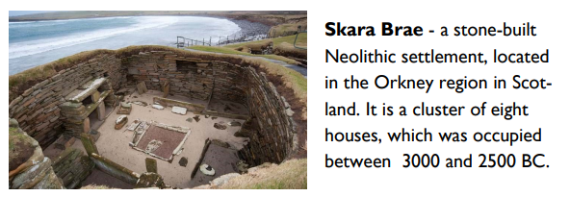
Year 3 History Knowledge Organiser - Stone Age to Iron Age – Autumn 2
Key Knowledge
B.C. means before Christ. A date such as 3000BC means 3000 years before the year 1 AD (there was no year zero) A.D. – means Anno Domini in Latin which means ‘in the year of our lord’. A date 2021 mean 2021 years after Jesus is believed to have been born Important Time Periods Stone Age – When the first humans began to live in Europe. They used stones as tools. This time period was split into 3 eras - Paleolithic (Old Stone Age), Mesolithic (Middle Stone Age), and Neolithic (New Stone Age) Bronze Age – In this era, metals were used to make hunting tools. Humans also began to farm. Iron Age – Humans now used iron to make tools, and farmed instead of hunting. They lived in communities.

Slide 2
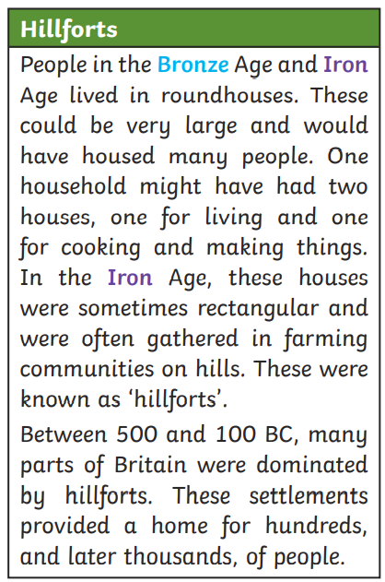
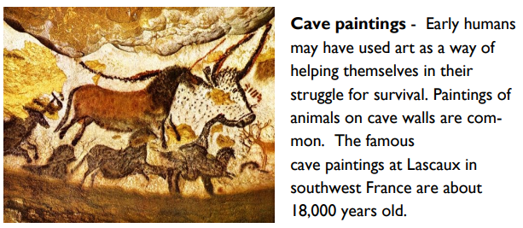
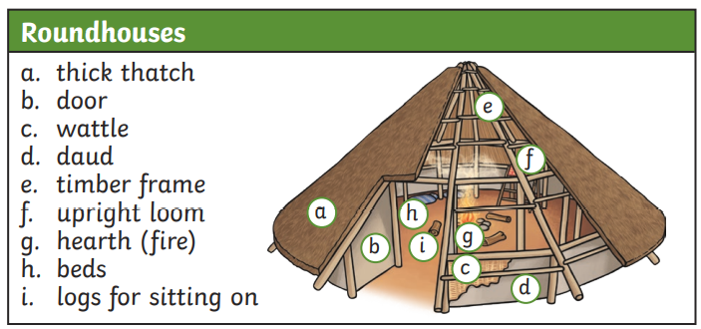
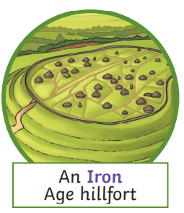
Key Vocabulary
chronology | in time order
era | period of time
archaeologist | A person who learns about the past by digging up artefacts
artefact | An object made by a human
flint | A type of stone that can be shaped into blades, knives and spears for hunting.
settlement | A place where a group of people live together in many buildings
bronze | A metal alloy made from a mixture of copper and tin. It is a much harder and more long-lasting material than stone.
iron | A metal stronger than bronze.
Key Diagrams/Pictures
agriculture | The practice of farming and growing crops (plants.)
hunter gatherer | A member of a nomadic group who hunt or harvest food that grows in the wild

