Slide 1

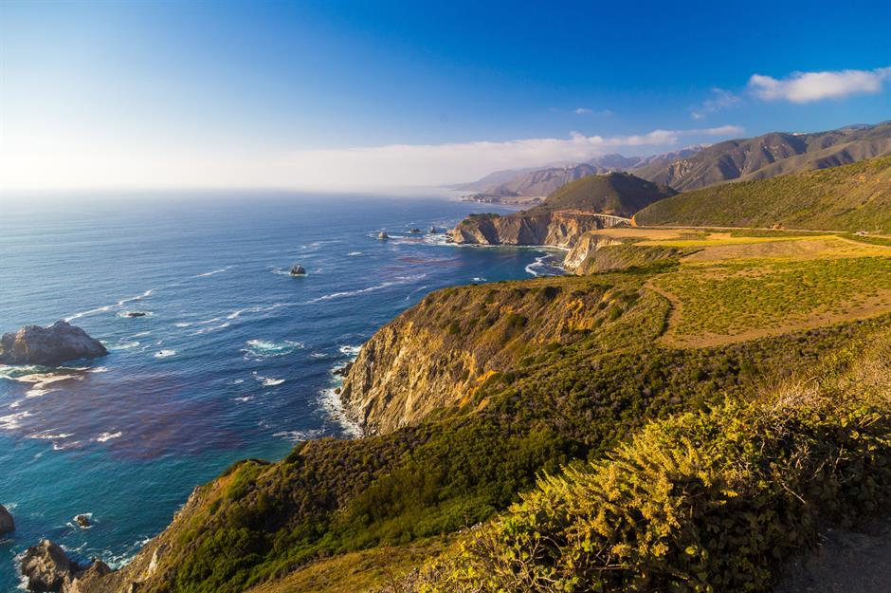
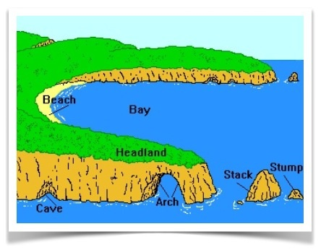
SUBJECT : Geography: Coasts (Summer 1) YEAR: 3
Vocabulary
1 | Coast | The land next to the sea or ocean. This is the key concept for the unit.
2 | Beach | A sandy or pebbly area along the shore, where many activities occur and a common feature of coasts.
3 | Cliff | A steep face of rock or earth, often found along coastlines, important for understanding coastal geography.
4 | Wave | A movement of water in the sea, caused by wind or tides, central to the coastal environment.
5 | Tide | The regular rise and fall of the sea, which shapes the coastline over time
6 | Erosion | The process of land being worn away by wind, water, or natural forces, a key process affecting coasts.
7 | Shore | The area where the land meets the sea, which helps students understand the boundary between the coast and the water.
8 | Harbour | A sheltered area of water where boats and ships can dock, often found along coasts and important for trade and safety.
9 | Sand | Small grains of rock or shells, commonly found on beaches, which form the foundation of many coastal areas.
What Should I Already Know?
Understand symbols, and using maps to locate countries, cities, and features like rivers or oceans. Know the difference between human features (e.g., cities, buildings) and physical features (e.g., mountains, rivers, forests, seas). Describe basic weather patterns (sunny, rainy, windy, snowy) and understand how weather affects the land.
Key Facts
COASTS ARE A MEETING PLACE- A coast is the area where land meets the sea or ocean. This can include different landforms such as beaches, cliffs, and rocky shores. The coastline is constantly changing due to natural processes like erosion (wearing away of land) and deposition (where materials like sand or pebbles are added to the coast). Over time, the sea shapes and forms the coast by washing away or adding materials, making it different from one place to another.
TIDES AND WAVES- Tides are the rise and fall of the sea level caused by the pull of the moon and the sun. High tide is when the sea is at its highest point, and low tide is when it’s at its lowest. This means that at different times of the day, the shore can look very different. Waves are created by the wind blowing across the sea, and they can wear away rocks and sand along the coast, causing erosion. Some waves carry materials, like sand and pebbles, and deposit them on the beach, which helps form beaches.
COASTS ARE A HOME- Coastal areas provide unique habitats for a variety of plants and animals. For example, sand dunes on beaches can be home to plants like sea grasses, and animals such as sand lizards.

