Slide 1

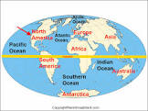
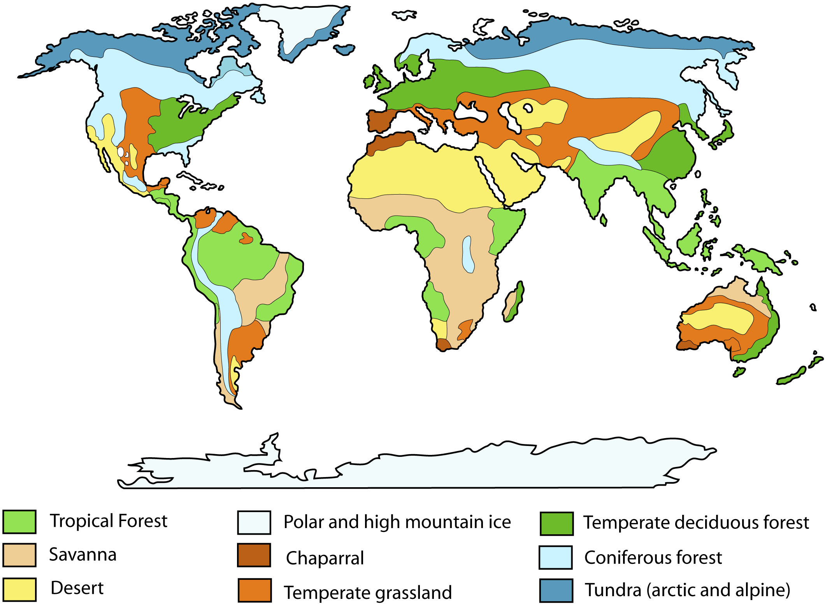
SUBJECT : Geography: Climate and Weather (Summer 1) YEAR: 3
Vocabulary
1 | Lines of latitude | These are lines that are used to specify the North and South sides (hemispheres) of the earth. They run parallel to the equator and describe their position from it.
2 | North and South hemispheres | Countries and continents that are on the half of the earth which is north of the equator are in the Northern Hemisphere and those south of the equator are in the Southern Hemisphere.
3 | Climate zones | Areas which have similar climates e.g. polar, temperate, equatorial, temperate tropical, rainforest and sub tropical
4 | Polar climate zone | Area which is very cold including Antarctica (Southern Hemisphere) a continent with land beneath the ice sheet, surrounded by sea and the Arctic (Northern Hemisphere) water beneath the sea ice, surrounded by land.
5 | Temperate climate zone | Areas which are neither very hot nor very cold. These areas have four seasons, like the UK.
6 | Sub-tropical zone | Areas which are hot, with one hot/wet season and one hot/dry season.
7 | Equatorial, rain forest or tropical climate zone | Areas which are very hot, and wet. There is rainfall in all months.
8 | Desert climate zone | Areas which are very hot, and dry including Sahara (Arabic for ‘The Great Desert’), Namibian Desert, Mojave Desert (pronounced ‘mo-harvey’)
9 | flora | The plants, trees and vegetation of a particular region or habitat
10 | fauna | The animals of a particular region or habitat
What Should I Already Know?
Identify and name worlds continents/oceans and locate them on a world map Know that weather can be different in different parts of the UK Know the four seasons and the correct order and identify seasonal and daily weather patterns in the UK. Start to give reasons why the UK has the weather it does (e.g. wind).
Key Facts
WEATHER KEY FACTS - Weather is short term. It is what happens in our atmosphere from day to day. It includes precipitation, temperature, wind and humidity. Weather varies from place to place, from day to day and from season to season. The range of weather in a place is a characteristic of its climate
CLIMATE KEY FACTS - Climate is long term. It refers to the average weather pattern of a place over many years. Climates can be predominantly hot, cold, wet or dry, hot and wet, hot and dry and so on. The climate of a place affects the soil, flora and fauna of that place and impacts on human activity in a variety of ways.
BIOMES KEY FACTS - Biomes include deserts, forests, grasslands, tundra and aquatic environments. They are defined collectively by the climate, soil organisms, flora and fauna of a large geographical area. Each biome consists of many ecosystems whose communities have adapted to the small differences in climate and the environment inside the biome.

Slide 2
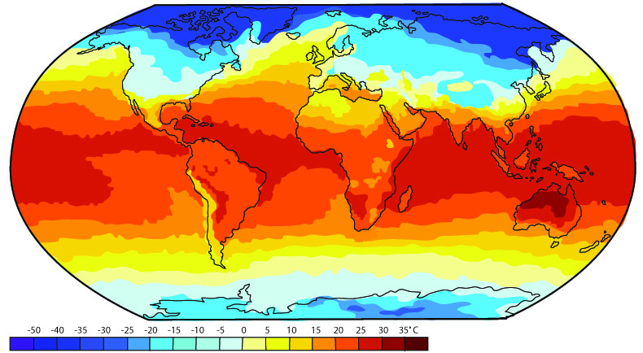
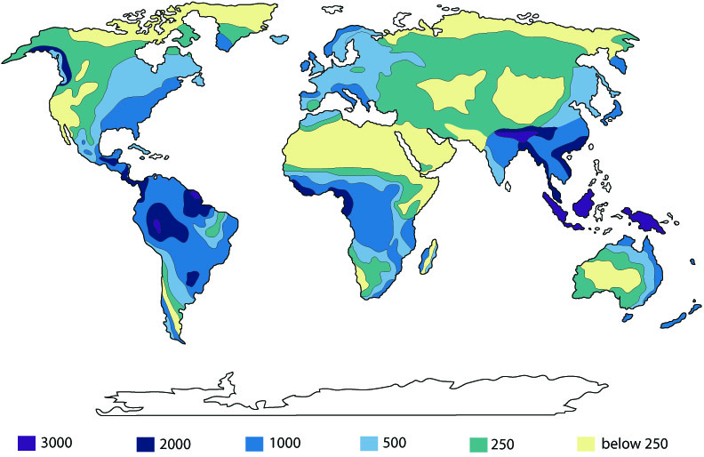
SUBJECT : Geography: Climate and Weather (Summer 1) YEAR: 3
A world map showing average temperature
A world map showing average rainfall
What I Need To Know
Understand the geographical terms of weather, climate, climate zones and biomes | Describe the ‘tropical desert climate’ and ‘tropical desert biome’ are.
Understand and locate different weather and climate zones. The location of the Prime/Greenwich Meridian its significance. | Describe the ‘tropical rainforest climate’ and ‘rainforest biome’ mean.
Use a map of world, annual average air temperatures and/or a globe to describe the world climate zones from the Poles to the equator | Describe the seasonal weather associated with a temperate climate (in the UK) and describe some ways in which the temperate climate affects human activities in the UK.
Identify where the coldest places on Earth are in relation to the equator and Poles. | I can describe some effects of extreme climatic events in the UK.
Describe the polar climate, and characteristics of the polar climate zone. | Describe how the flora, fauna and human activity is affected by weather and climate and use geographical vocabulary to do so.

