Slide 1

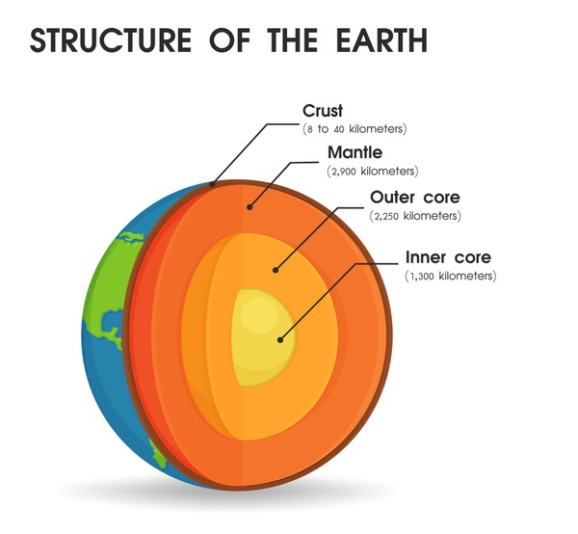
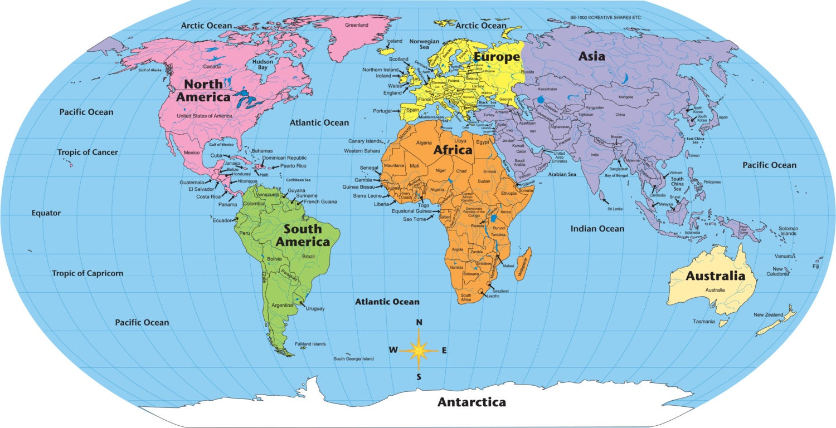
SUBJECT : Geography: Our World (Spring 1) YEAR: 3
Vocabulary
1 | Earth | The planet we live on, the third planet from the Sun.
2 | Continent | A large landmass on Earth. There are seven continents: Africa, Antarctica, Asia, Europe, North America, South America, and Australia.
3 | Climate zones | Areas which have similar climates e.g. polar, temperate, equatorial, temperate tropical, rainforest and sub tropical
4 | Ocean | A large body of saltwater that covers most of the Earth’s surface. There are five oceans: Atlantic, Pacific, Indian, Southern, and Arctic.
5 | Country | A distinct area of land that has its own government, laws, and border
6 | Capital | The city where the government of a country is based. For example, London is the capital of the UK.
7 | Climate | The average weather conditions in a particular area over a long period of time.
8 | Weather | The daily changes in temperature, wind, and rain in a particular place.
9 | Equator | An imaginary line that divides the Earth into the Northern and Southern Hemispheres. It is the warmest part of the Earth.
10 | Pollution | The introduction of harmful substances or products into the environment, such as plastic waste or chemicals in the air or water.
What Should I Already Know?
Know how to use them to locate countries, oceans, and continents. They should also be able to understand symbols and use basic map features like a compass (north, south, east, west). Know about basic landforms, such as mountains, rivers, hills, and valleys. Children should have a basic understanding of their local environment and community, including landmarks, human-made features (like houses, schools, and parks), and natural features (like forests, rivers, and beaches).
Key Facts
THE EARTH IS MADE UP OF CONTINENTS AND OCEANS- The Earth is divided into seven continents (Africa, Antarctica, Asia, Europe, North America, South America, and Australia) and five oceans (Atlantic, Pacific, Indian, Southern, and Arctic). Continents are large areas of land, while oceans are vast bodies of water. Together, they make up the Earth’s surface.
DIFFERENT PLACES HAVE DIFFERENT CLIMATE-Climate refers to the typical weather conditions of a place over a long period of time. For example, tropical climates are hot and wet, while polar climates are cold and dry. The Earth’s climate is affected by where a place is located, like near the equator or the poles, and by weather patterns.
NATURAL FEATURES- Landforms such as mountains, rivers, forests, and deserts make up the Earth’s physical features. These landforms affect where animals, plants, and people live. For example, animals like polar bears live in cold places, while cacti grow in deserts. Rivers and forests provide habitats and resources for many living things.

