Slide 1

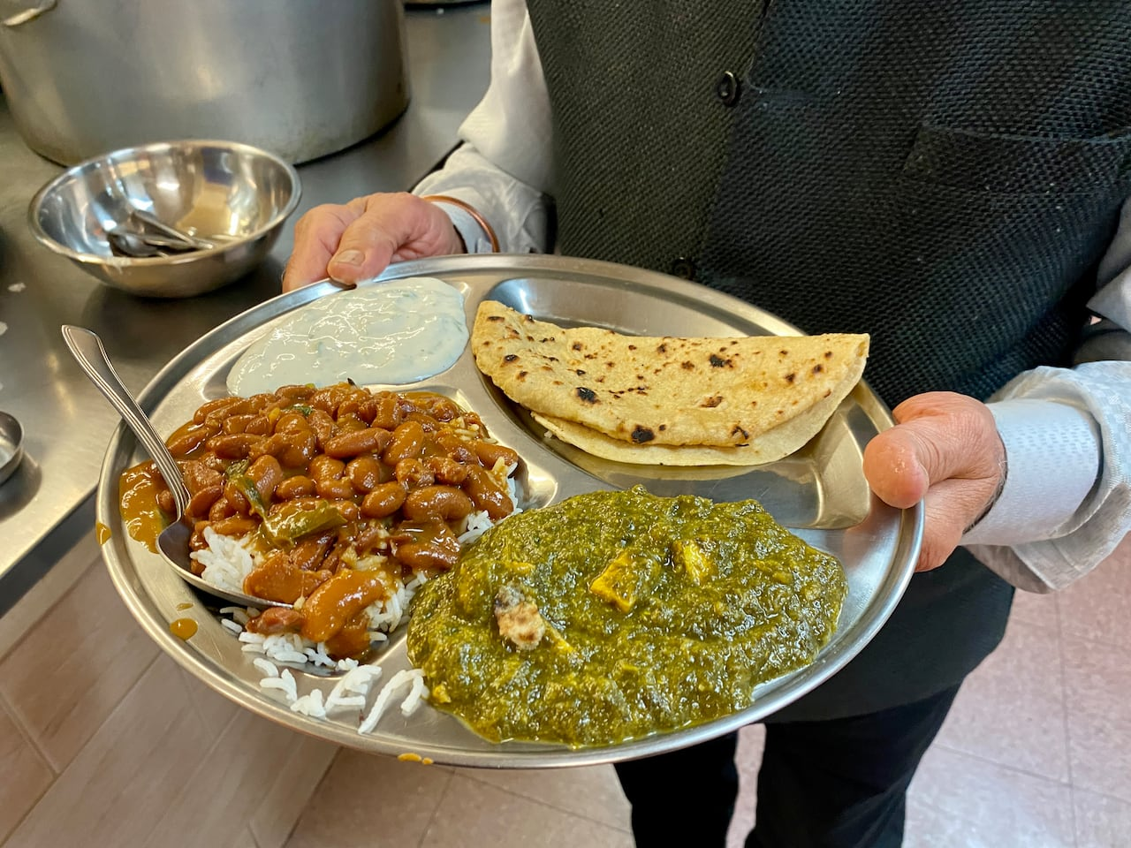
RE: (Summer 1) YEAR: 3 – Sikhism
How important is sharing to Sikhs?
Vocabulary
1 | Guru | A spiritual teacher
2 | Gurdwara | A Sikh place of worship
3 | Vaisakhi | A Sikh festival celebrating the birth of Khalsa
4 | Khalsa | A group into which committed Sikhs can be initiated to demonstrate their devotion to their faith.
5 | Langar | Free food that is shared in the Gurdwara between Sikhs and other religions.
What should I already know?
Sikhs are people who believe in Sikhism.
I may be able to talk about some of the things Sikhs do to show their religion is important to them.
Key Knowledge
1 | The Sikh festivals of Vaisakhi and Diwali are opportunities for Sikhs to share their faith with each other. They might share time at the Gurdwara, share a meal or share the stories behind the festivals with others.
2 | During the festival of Diwali Sikhs celebrate at home with fireworks, a shared meal, rangoli patters and lighting candles. The celebrate in the Gurdwara too by remembering the story of how Guru Hargobind worked for freedom.
3 | Guru Granth Sahib is the central holy scripture for Sikhs. It outlines some rules that Sikhs follow. One of these is share with the needy whenever you have spare.
4 | The Langar meal is a free meal that Sikhs provide at the Gurdwara for those who need it. Anyone can come and take part in the meal even if you are not a Sikh.
Key Questions
Where and how to Sikh’s worship?
What is the Sikh holy book?
How was Sikhism founded?
What are other Sikh traditions?
Do all Sikh men and women join the Khalsa?

