Slide 1

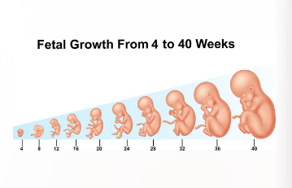
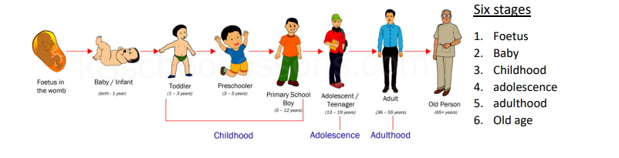
Science: Animals including Humans (Summer 2) YEAR: 5
Vocabulary
1 | Fertilisation | the action or process of fertilizing an egg of a female mammal.
2 | Reproduce | To produce young – make more of the species.
3 | Gestation | The process or time when prenatal development takes place (length of pregnancy.)
4 | Mammal | A warm-blooded vertebrate animal, with hair or fur, giving birth to live young with mothers who feed them milk.
5 | Foetus | An unborn or unhatched offspring of a mammal.
6 | Adolescence | The social and emotional stage of development between childhood and adulthood.
7 | Life expectancy | The average period that you may expect to live.
8 | Sperm | Sperm are the male reproductive cells.
9 | Egg | The female reproductive cell,
What should I already know?
A male gamete must fertilise a female gamete in order to reproduce.
The human life cycle - stages of development.
Humans are a species of mammal.
Some of the key changes that take place during adolescence.
A mammal is fed milk in infancy..
Animals, including humans, have offspring which grow into adults.
Key Knowledge
1 | Can name the different stages of the human life cycle.
2 | Can describe the gestation period of different mammals.
3 | Can explain the changes that take place to the body during puberty.
4 | Can draw conclusions from data relating, for example, to the length or weight of a baby during its first year of life.
5 | Can explain some of the changes that happen in late adulthood.
6 | Understand most animals reproduce sexually. A sperm from the male fertilises the female egg.
7

