Slide 1

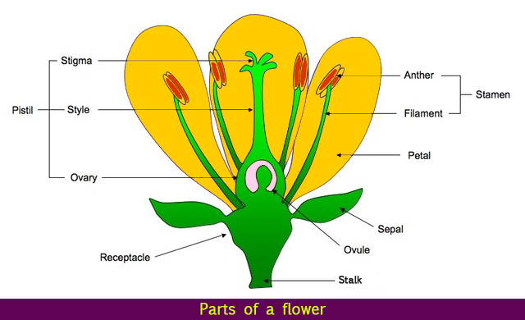
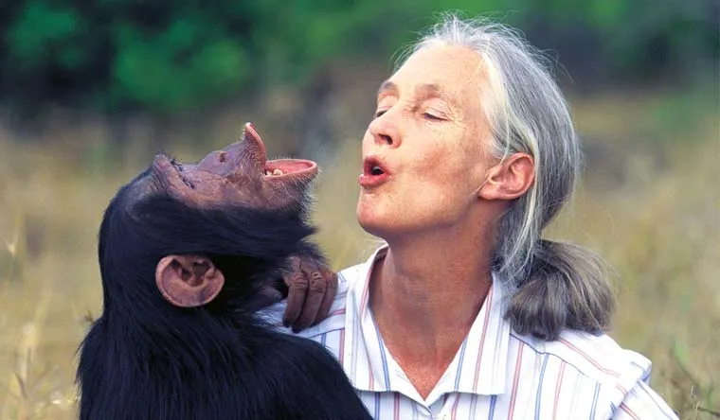
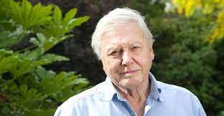
Science: Living Things and their Habitats (Summer 1) YEAR: 5
Vocabulary
1 | Amphibian | A cold-blooded vertebrate animal e.g.frogs, toads, newts, salamanders and caecilians
2 | bird | A warm-blooded egg-laying vertebrate animal with feathers, wings, a beak and typically able to fly
3 | Insect | A small animal that has six legs and generally one or two pairs of wings
4 | Mammal | A warm-blooded vertebrate animal, with hair or fur, giving birth to live young with mothers who feed them milk
5 | Vertebrate | An animal with a backbone/ spinal column
6 | Life cycle | The series of changes in the life of an organism including reproduction
7 | Metamorphosis | A transformation from an immature form to an adult form in two or more distinct stages
8 | Asexual reproduction | Offspring get genes from one parent so are clones of their parents
9 | Sexual reproduction | where 2 parents are required to reproduce
10 | Fertilisation | the action or process of fertilizing an egg or a female animal or plant
What should I already know?
Animals can be grouped into vertebrates (fish, reptiles, amphibians, birds and mammals) and invertebrates
Animals can be grouped based on their diet into carnivores, herbivores or omnivores
How animals and plants are suited to their habitat
The different sources of food from plants and other animals
That animals and plants are linked via food chains
Key Scientists
1 | Jane Goodall: a behaviourist, is best known for her 60 year research on social interactions of wild chimpanzees.
2 | Sir David Attenborough, a naturalist, who has dedicated his life to the study of natural history .
Key Knowledge
1 | I can describe the differences in the life cycles of a mammal, an amphibian, an insect and a bird.
2 | I can describe the life process of reproduction in some plants and animals.
Scientific enquiry & skills
Observe and sketch insect, amphibian, mammalian and bird life lifecycles for comparison .
Compare the lifecycles of mammals, amphibians, insects and birds.
Research reproduction in plants and animals.
Planning different types of scientific enquiries to answer questions.
Use relevant scientific language and illustrations to discuss, communicate and justify their scientific ideas

