Slide 1

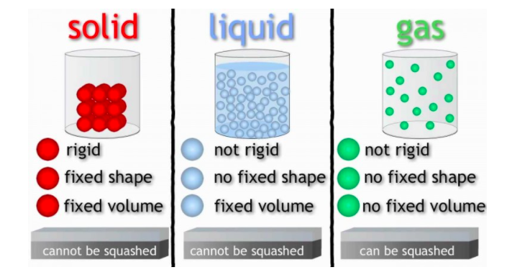
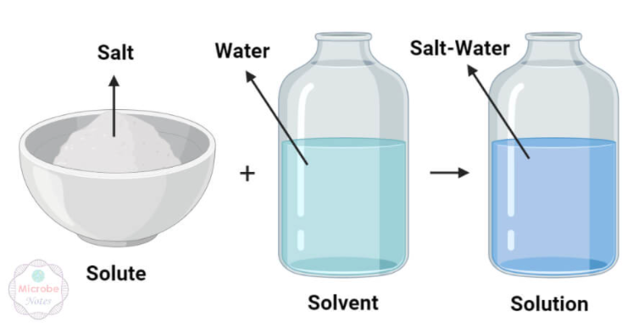
Science: Changing Materials - Reversible and Irreversible Changes (Spring 2) YEAR: 5
Vocabulary
1 | Soluble | able to be dissolved, especially in water
2 | Insoluble | cannot be dissolved, especially in water
3 | Dissolve | when something solid mixes with a liquid and becomes part of the liquid
4 | Solution | is made when one substance dissolves into another
5 | Reversible change | can be reversed back to its original state
6 | Irreversible change | cannot be reversed back to its original state
7 | solvent | ordinarily a liquid, in which other materials dissolve to form a solution
8 | solute | a dissolved substance e.g. sugar
9 | Solid | Solid particles are very close together, meaning solids, such as wood and glass, hold their shape
10 | Liquid | can flow and take the shape of the container because the particles are more loosely packed than solids and can move around each other
11 | Gas | particles are further apart than solid or liquid particles and they are free to move around. A gas fills its container, taking both the shape and the volume
What should I already know?
How the shapes of solid objects made from some materials can be changed by squashing, bending, twisting and stretching.
Observe that some materials change state when they are heated or cooled, and measure or research the temperature at which this happens.
Identify the part played by evaporation and condensation in the water cycle and associate the rate of evaporation with temperature.
Key Knowledge
1 | Reversible changes, such as mixing and dissolving solids and liquids together, can be reversed by sieving, filtering, evaporating.
2 | Irreversible changes often result in a new product being made from the old materials (reactants). E.g. burning wood produces ash.
3 | A solution is made when solid particles are mixed with liquid particles.
4 | A chemical change is when two or more substances (called the reactants) are combined to create a new substance.
Scientific enquiry & skills
Knows that some materials will dissolve in liquid to form a solution, and describe how to recover a substance from a solution.
Can use knowledge of solids, liquids and gases to decide how mixtures might be separated, including through filtering, sieving and evaporating.
Can demonstrate that dissolving, mixing and changes of state are reversible changes.
Can explain that some changes result in the formation of new materials, and that this kind of change is not usually reversible.

