Slide 1

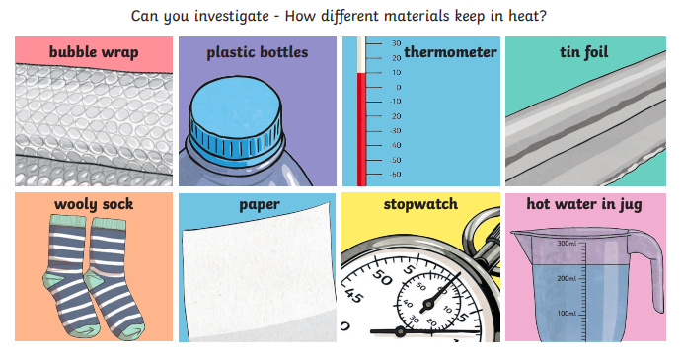
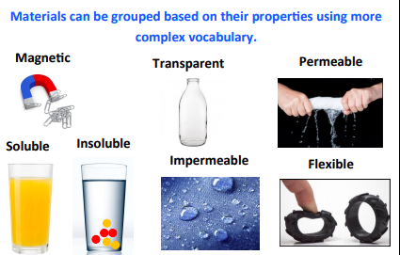
Science: Properties and changes of materials (Spring 1) YEAR: 5
Vocabulary
1 | material | any substance that has a name. Eg. chalk, paper, wood, iron, air, water.
2 | thermal insulator | materials that prevent heat from passing through them.
3 | thermal conductor | Materials that heat passes through easily.
4 | electrical insulator | materials that do not allow electricity to pass through them.
5 | electrical conductor | a conductor allows electricity to pass through it.
6 | transparent | a material that light completely passes through.
7 | translucent | a material that some light passes through but it is scattered.
8 | absorbent | different types of materials which can soak up liquid.
9 | permeable | A material that allows something such as water or gas can pass through it or soak into it.
What should I already know?
Identify and compare the suitability of a variety of everyday materials, including wood, metal, plastic, glass, brick, rock, paper and cardboard for particular uses
Compare and group materials together, according to whether they are solids, liquids or gases.
Observe that some materials change state when they are heated or cooled, and measure or research the temperature at which this happens in degrees Celsius (°C).
Identify the part played by evaporation and condensation in the water cycle and associate the rate of evaporation with temperature.
Key Facts
1 | Materials have different uses depending on their properties and state (liquid, solid, gas).
2 | Properties include hardness, transparency, electrical and thermal conductivity and attraction to magnets.
Scientific enquiry & skills
Give reasons for the particular uses of everyday materials eg. including metals, wood and plastic (based on fair tests and comparisons.)
Compare and group together everyday materials on the basis of their properties, including their hardness, solubility, transparency, conductivity (electrical and thermal), and response to magnets.
Taking measurements, using a range of equipment, with increasing accuracy and, taking repeat readings when appropriate.
Planning different types of scientific enquiries to answer questions.

