Slide 1

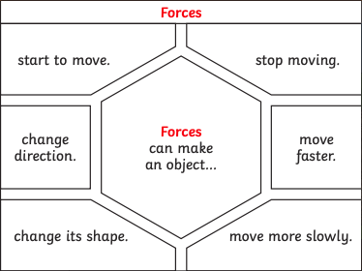
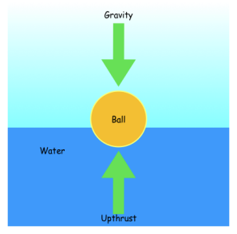
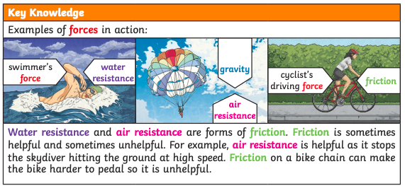
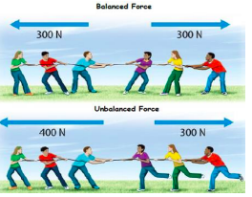
Science Knowledge Organiser – Forces – Autumn Term 2 – Year 5
Vocabulary
Forces | Pushes and pulls
Gravity | A pulling force exerted by the Earth (or anything else which has mass.)
Earth’s gravitational pull | The pull that Earth exerts on an object, pulling it towards Earth’s centre. It is the Earth’s gravitational pull which keeps us on the ground.
Weight | The measure of the force of gravity on an object.
Mass | A measure of how much matter (or ‘stuff’) is inside an object.
Friction | A force that resists the sliding or rolling of one solid object over another
Upthrust | A force that pushes objects up, usually in water.
Propulsion | To push forward or drive an object forward
Air resistance | A type of friction caused by air pushing against any moving object.
Water resistance | A type of friction caused by water pushing against any moving object
What should I already know?
Forces are either a push or a pull
Forces make things move or stop
Magnetic forces can act at a distance
Not all metal is magnetic
Magnets have a North and South pole – opposite poles attract
Key Knowledge
Pulley’s they are used to reduce the amount of force needed to lift a load. The more wheels in a pulley the less force is needed to lift the weight.
Gears or cogs are used to change speed, direction or force of a motion. When 2 gears are connected they always turn in the opposite direction to one another.
Levers can be sued to make a small force lift a lighter load. A lever always rests on a pivot or fulcrum.

