Slide 1

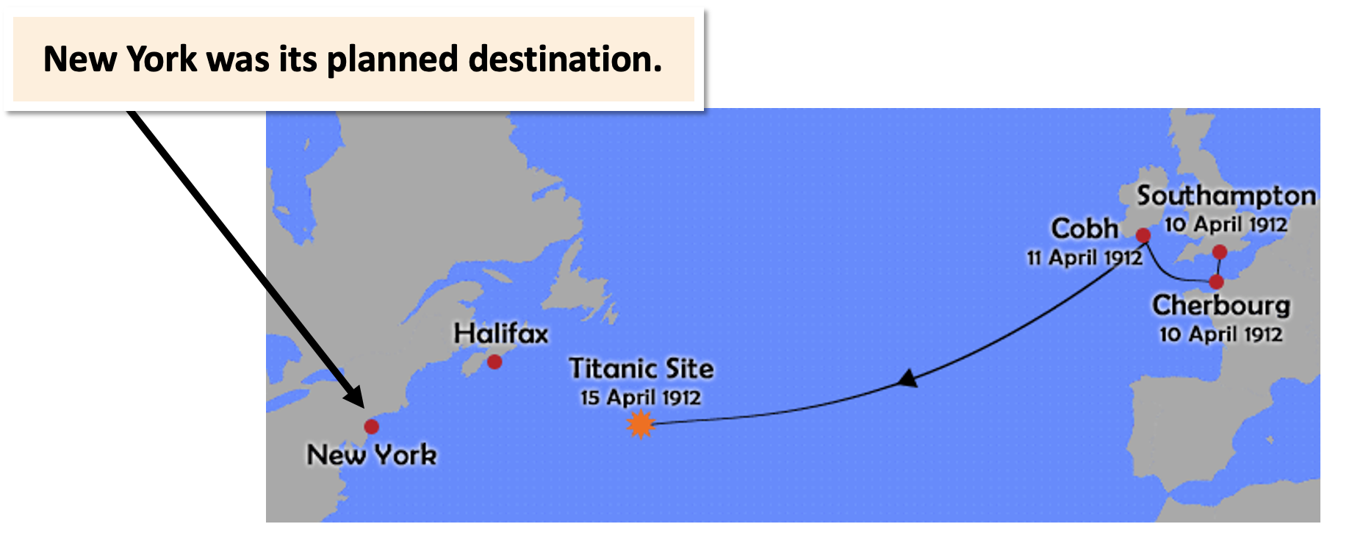
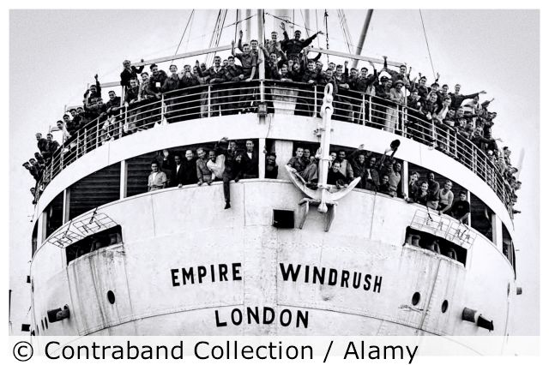
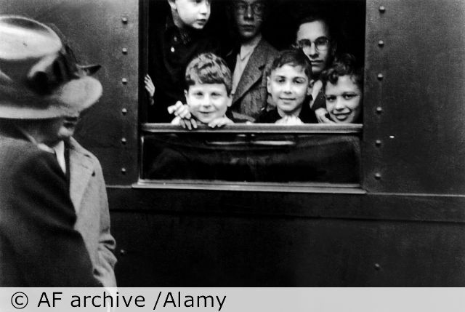
History: Journeys – Summer 2 – Year 5
Key Vocabulary
1 | Journey | travel or passage from one place to another.
2 | Migration | a long journey to a new home.
3 | Emigration | the act of leaving a country and moving to another country permanently.
4 | Immigration | the process of moving to a new country, with plans to live there permanently.
5 | Migrant | a person who moves from one place to another, especially in order to find work.
6 | Invader | an army or country that uses force to enter and take control of another country.
7 | Settler | a person who has migrated to an area and made a permanent home there.
8 | Explorer | someone who travels to places about which very little is known, in order to discover what is there.
What should I already know?
KS1 – Great explorers of the world
KS2 – introduction of the railways enabling people to travel to the coast for holidays,
KS2 – Romans – they journey across Europe and into Great Britain.
Key Knowledge
1 | Raleigh was an explorer and a sailor, and he lived during the Tudor and Stuart periods.
2 | The Tudors took voyages to: sell goods ,make money, for religious reasons, to settle, to escape from something or for fame/status.
3 | The Titanic was built in Belfast at the Harland and Wolff Shipyards. It set off on its maiden voyage across the Atlantic.
4 | Vera Schaufeld, travelled from Czechoslovakia to the United Kingdom in 1939 using the rescue operation ‘Kindertransport .‘
5 | In the 1940s, the West Indies was part of the British Empire.
6 | HMT Empire Windrush brought 492 passengers to Britain – sadly, the passengers were not made welcome.
7 | In 2017, 1.3 million people fled their country of origin, and many of these tried to reach the UK. Countries they are fleeing include Syria, Afghanistan, Southern Sudan, Somalia, the Congo and Myanmar.
Key Questions
What makes people go on a journey?
Was Walter Raleigh just in it for the money?
Why did the Irish 3rd class passengers on the Titanic make the journey to America?
How did Vera Schaufeld become a refugee?
Why did people sail on the Empire Windrush?
What makes refugees go on a difficult journey today?

