Slide 1

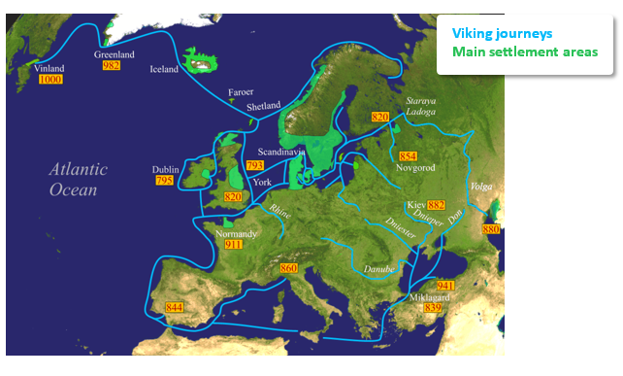
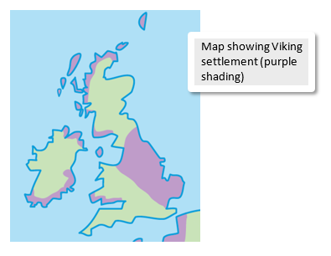
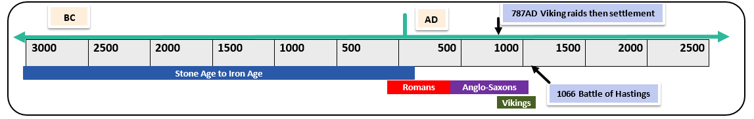
History – The Vikings - Year 5 - Spring 2
Key Vocabulary and Definitions
1 |  | interpretation: a description or explanation of something in the past based on sources of evidence
2 |  | migrate: to move from one place to another
3 |  | raid: to enter a place by force to steal something
4 |  | rural: countryside areas, usually focused on farming
5 |  | saga: a story that tells a heroic adventure
Key Facts
 | Viking means ‘pirate’ or ‘raider’. Vikings came from Scandinavia (Norway, Sweden, Denmark). Not all Viking people were raiders; many were farmers, traders and craftspeople. Vikings migrated from their homeland for a number of reasons. Some included push factors – where they came from was overpopulated and there was not enough food. Pull factors included wealth and a better climate. Vikings settled in many places, not just in Britain. They mainly settled in rural areas in the East of England as these were the first places they encountered. We know about Vikings by studying archaeological remains, studying the Viking sagas and reading written accounts. Some accounts were written by other groups, like Anglo-Saxons, a number of years after the events took place. Historians continue to review their interpretation of what Viking people were like.
What I need to know
Develop a chronologically secure knowledge and understanding of British history Understand how our knowledge of the past is constructed from a range of sources Establish clear narratives within and across the periods Develop the appropriate use of historical terms Address historically valid questions about cause and significance Construct informed responses that involve the thoughtful selection and organisation of relevant historical information Note contrasts and connections over time
What should I already know?
The Roman invasion of Britain The Anglo-Saxon invasion of Britain

