Slide 1

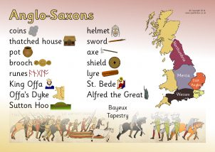
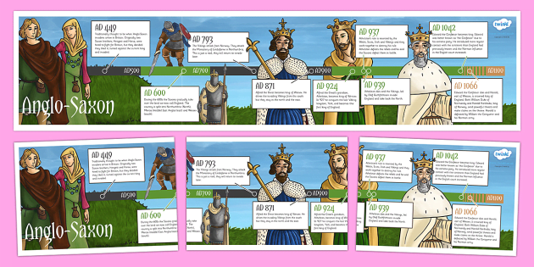
SUBJECT : History: The Anglo-Saxons ( Autumn 2) YEAR: 5
Vocabulary
1 | Invasion | an instance of invading a country or region with an armed force.
2 | Anglo-Saxons | The Anglo-Saxons were a cultural group who inhabited England in the Early Middle Ages
3 | Reconstruction | the action or process of reconstructing or being reconstructed.
4 | Dark Ages | The 'Dark Ages' were between the 5th and 14th centuries, lasting 900 years. The timeline falls between the fall of the Roman Empire and the Renaissance. It has been called the 'Dark Ages' because many suggest that this period saw little scientific and cultural advancement.
6 | Pagan | a person holding religious beliefs other than those of the main world religions.
7 | Plunder | steal goods from (a place or person), typically using force and in a time of war or civil disorder.
8 | Scandinavia | Scandinavia is a subregion in Northern Europe, with strong historical, cultural, and linguistic ties between its constituent peoples. In English usage, Scandinavia most commonly refers to Denmark, Norway, and Sweden.
9 | ecclesiastical | relating to the Christian Church or its clergy.
What Should I Already Know?
Links will be made to prior learning, particularly to Year 4 Unit 2: Roman Britain - learn about the Roman Empire and its impact and legacy on Britain through a range of curricular approaches.
What I Need To Know
The term Dark Ages and how this links in with the Anglo Saxon period – showing evidence and understanding and reaching a conclusion about the Dark Ages with clear reference made to the preceding arguments. Any evidence leading up to the use of the term Dark Ages. (The 'Dark Ages' were between the 5th and 14th centuries, lasting 900 years. The timeline falls between the fall of the Roman Empire and the Renaissance. It has been called the 'Dark Ages' because many suggest that this period saw little scientific and cultural advancement.)
Timeline

Slide 2
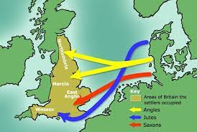
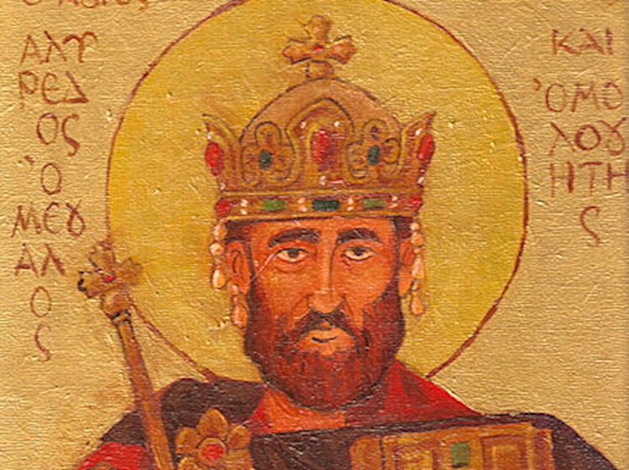
SUBJECT : History: The Anglo-Saxons ( Autumn 2) YEAR: 5
Additional facts
1 | Who were the Anglo-Saxons? | Anglo-Saxon, term used historically to describe any member of the Germanic peoples who, from the 5th century ce to the time of the Norman Conquest (1066), inhabited and ruled territories that are today part of England and Wales.
2 | Why is Anglo-Saxon important? | The Anglo-Saxon period includes the creation of an English nation, with many of the aspects that survive today, including regional government of shires and hundreds. During this period, Christianity was re-established and there was a flowering of literature and language. Charters and law were also instituted.
3 | What is Anglo-Saxon called now? | What is Anglo-Saxon called now? The term Anglo-Saxon is popularly used for the language that was spoken and written by the Anglo-Saxons in England and south eastern Scotland from at least the mid-5th century until the mid-12th century. In scholarly use, it is more commonly called Old English.
4 | What did the Anglo-Saxons change? | They replaced the Roman stone buildings with their own wooden ones, and spoke their own language, which gave rise to the English spoken today. The Anglo-Saxons also brought their own religious beliefs, but the arrival of Saint Augustine in 597 converted most of the country to Christianity.
5 | How did the Anglo-Saxon era end? | A descendant of Viking raiders, William brought his army of Normans to Britain to take on the new king, and on 14 October 1066, the two armies fought at the Battle of Hastings. The Normans were victorious and Harold was killed. This signalled the end of Anglo-Saxon rule in Britain.
Alfred the Great
Who is the most famous Saxon? King Alfred the Great is the most famous and celebrated of all Anglo-Saxon kings. His statue stands at the heart of a number of southern English towns – Wantage, where he was born over a thousand years ago; Winchester, where he was buried; Pewsey and Shaftesbury, where he also had strong personal connections

